Slide 1
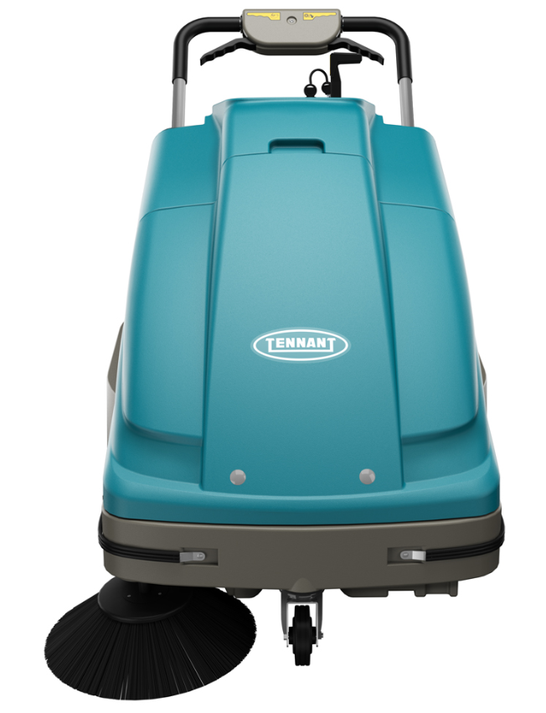
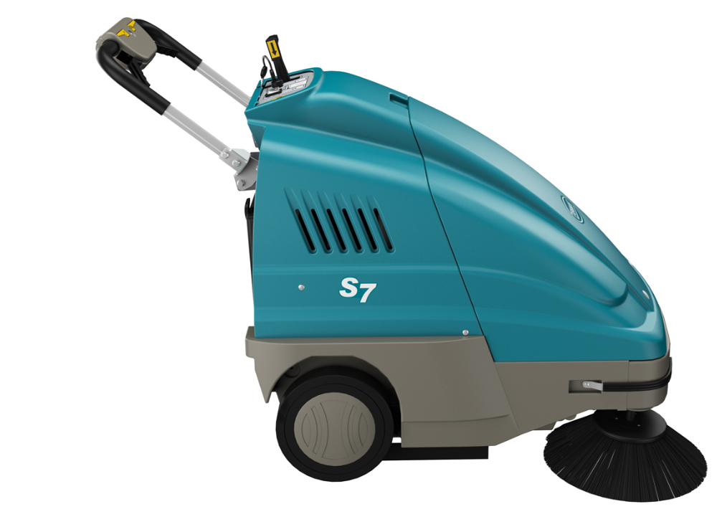
S7 Product Guide (PAS Guide)
Purpose of this internal product guide: Self-train and educate on S7 Sweeper
Other helpful sources for understanding these products:
Operator’s manual
Brochure
Public Website (videos available)
S7
Confidential Information - For Internal Use Only

Slide 2
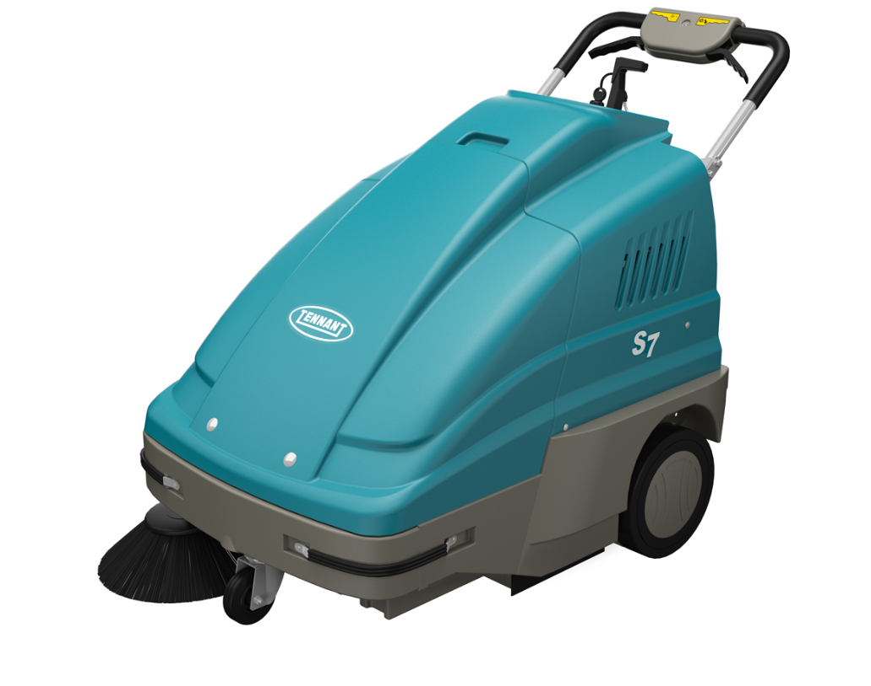
Product Strategy
Utilize IPC machines to
Enhance margins – replace current outsourced walk-behind sweepers with machines from IPC
  Return to similar IPC sweepers previously sold by Tennant (S8)
  Eliminate the S3 push sweeper altogether
S7
Confidential Information - For Internal Use Only

Slide 3
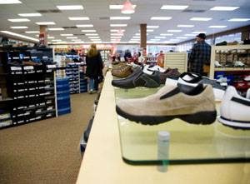


Markets and Applications
MARKET | APPLICATION | FLOOR TYPES
Retail | Aisle ways, check out counters, around displays, deli/cafeteria areas, ramps, side walks, parking lots | Carpet, VCT, polished stone, terrazzo, grouted ceramic and porcelain tile, concrete, asphalt
Schools and Universities | Hallways, entryways, kitchens, classrooms, cafeterias, ramps, sidewalks, parking lots | Carpet, VCT, polished stone, terrazzo, grouted ceramic and porcelain tile, concrete, asphalt
Healthcare | Hallways, entryways, patient rooms, cafeterias, handicapped ramps, sidewalks, parking lots | Carpet, VCT, polished stone, terrazzo, grouted ceramic and porcelain tile, concrete, asphalt
Hospitality | Lobbies, hallways, elevator areas, ramps sidewalks, parking lots | Carpet, VCT, polished stone, terrazzo, grouted ceramic and porcelain tile, concrete, asphalt
Logistics/ Light Manufacturing | Aisles, in-and-around equipment, ramps employee cafeterias, parking lots | Sealed concrete, polished concrete, coated floors, asphalt
Confidential Information - For Internal Use Only

Slide 4
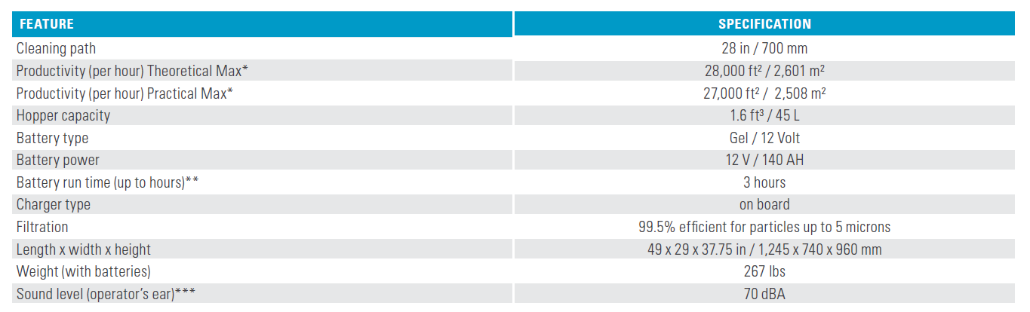
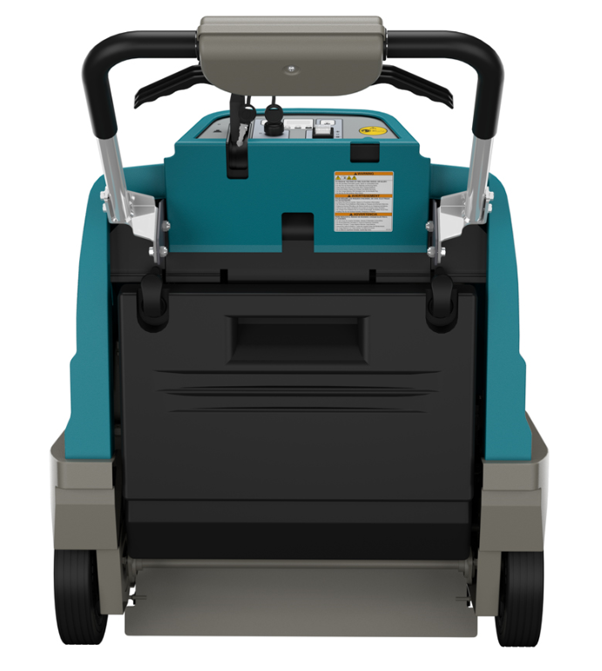
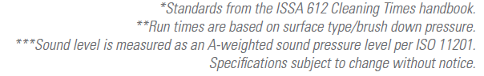
S7 Sweeper Product Specifications
Confidential Information - For Internal Use Only

Slide 5
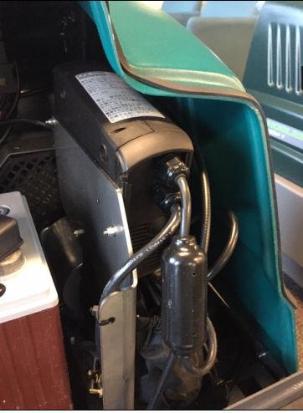
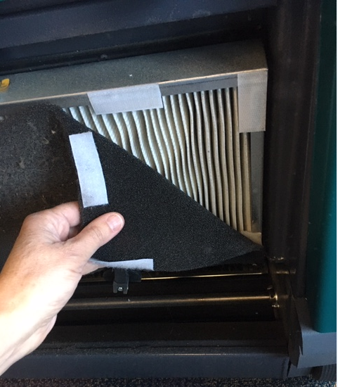
S7 Key Highlights Summary
28”/ 70 cm overall path width
  19.7”/50 cm main brush
Sealed battery
  12 v, 140 AH with built in on board charger
Hopper capacity
  1.6 ft3/45 L
Filtration
  Pre-filter and main filter
  Main filter at 99.5% at 5 microns
On-Board Charger
Pre-Filter and Main Filter
Confidential Information - For Internal Use Only

Slide 6
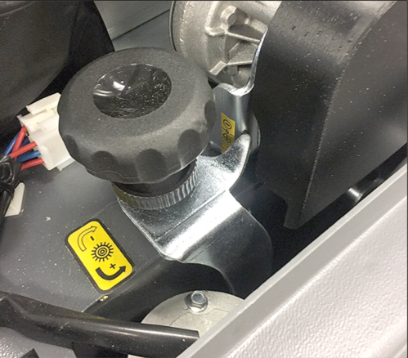
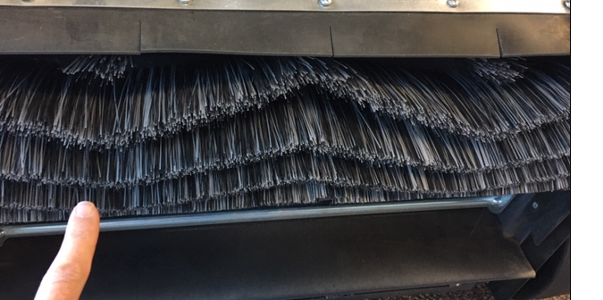
S7 Key Highlights Summary Cont’d
Adjustable main and side brush
  Main brush set for hard floor, adjust brush height with adjustment knob under hood
  Side brush adjustment; tool required
Main brush
  When replacing main brush -
    Make sure the “v” in the chevron pattern is pointing to the ground
    Make sure to adjust the carpet height knob back to the initial “starting point as shown on the decal
Note initial brush adjustment line on decal – set to hard floor
Confidential Information - For Internal Use Only

Slide 7
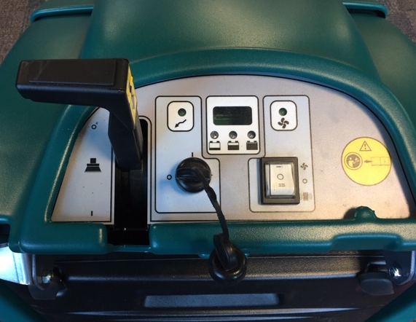
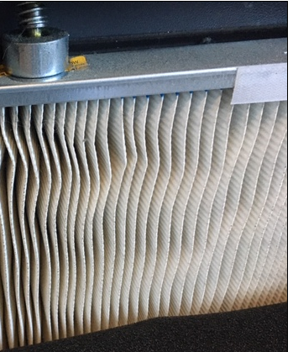
S7 Key Highlights Summary Cont’d
Simple controls with electronic filter shaker
  Safety is assured with key on/off
  Easily see battery status with battery discharge indicator lights
  Cleaning the filter is easy with built-in electronic filter shaker
  Units moves easily when engaging drive lever (1)
  Pick up bulkier items with when the flap trap lever is engaged (2)
Safe for operators and others
  Breathe easy at 99.5% filtration up to 5 microns
  Work when people are present
  Sealed batteries ensure no overspills/splashes to harm the working environment or employees
1
2
Confidential Information - For Internal Use Only

Slide 8
Warranty
S7 Warranty
  1 year parts
  1 year labor
  30 days travel
  battery pro-rated for 12 months
Confidential Information - For Internal Use Only

Slide 9
S7 Summary
Additional margin opportunities
  Tennant/IPC product vs. Outsourced
  Return to “known” products with the family
Confidential Information - For Internal Use Only

