Slide 1
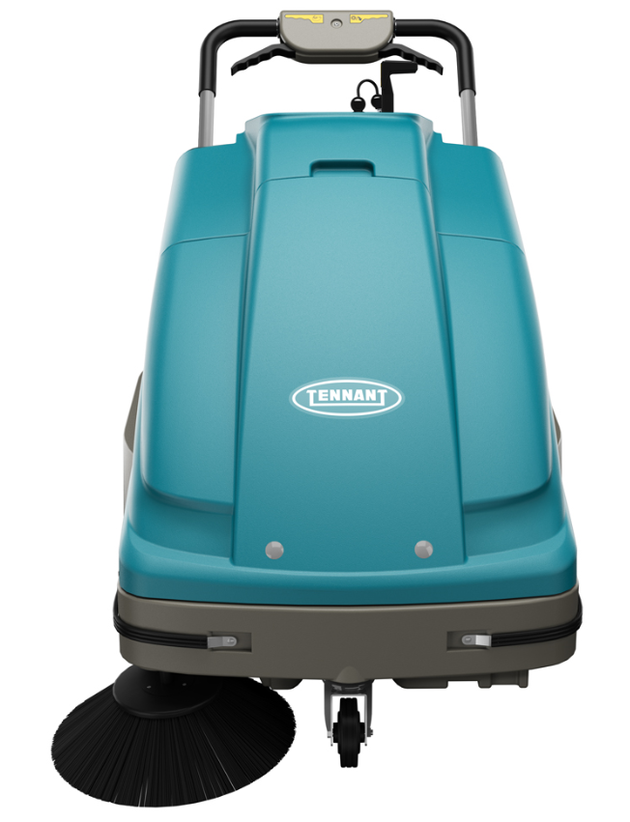
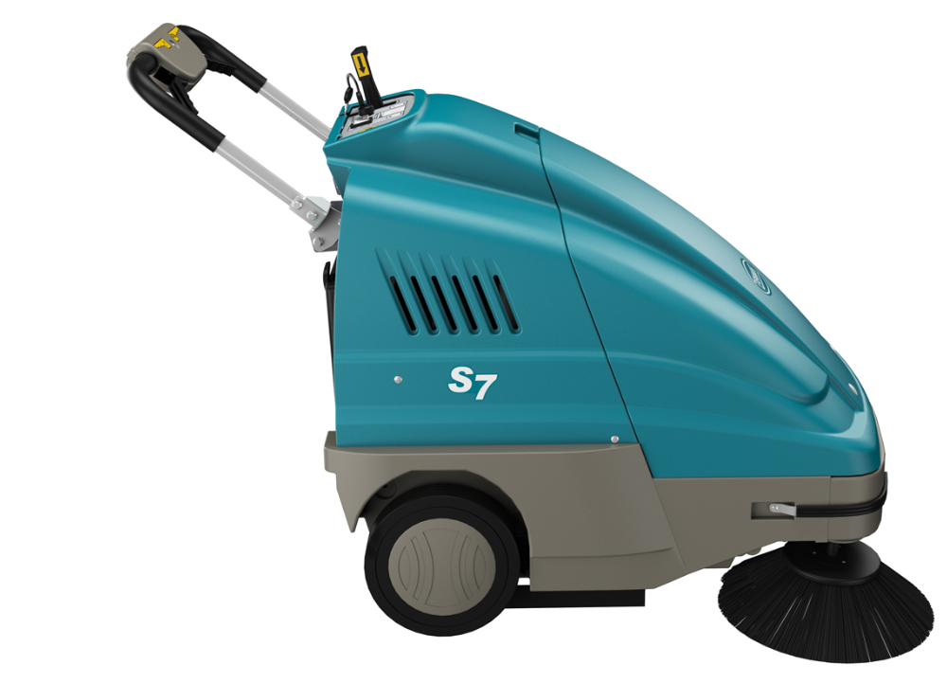
S7 Product Guide (PAS Guide)
Purpose of this internal product guide: Self-train and educate on S7 Sweeper
Other helpful sources for understanding these products:
Operator’s manual
Brochure
Public Website (videos available)

Slide 2
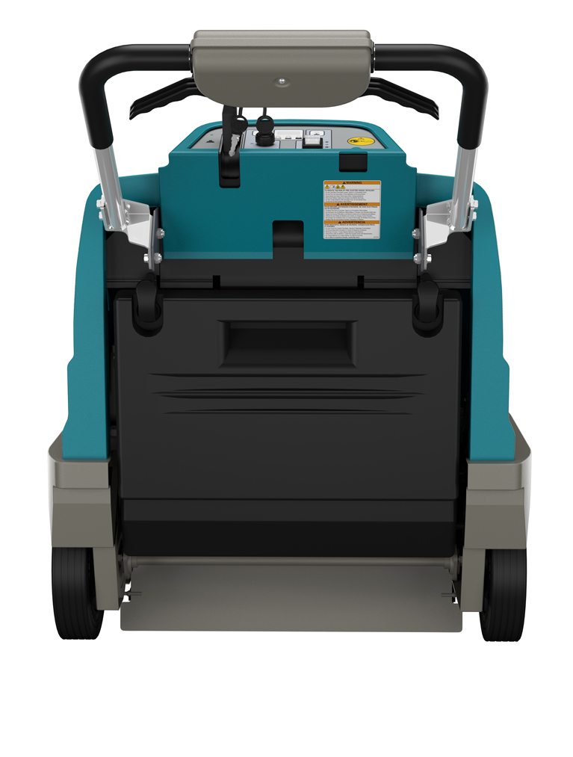
Product Strategy
Utilize IPC machines to
Enhance margins – replace current outsourced walk-behind sweepers with machines from IPC
  Return to similar IPC sweepers previously sold by Tennant (S8)
  Eliminate the S3 push sweeper altogether

Slide 3
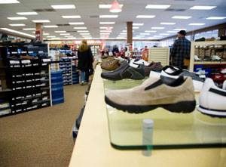


Markets and Applications
MARKET | APPLICATION | FLOOR TYPES
Retail | Aisle ways, storage space, side walks, parking lots | Carpet, VCT, polished stone, terrazzo, grouted ceramic and porcelain tile, concrete, asphalt
Education | Hallways, entryways, sidewalks, parking lots | Carpet, VCT, polished stone, terrazzo, grouted ceramic and porcelain tile, concrete, asphalt
Healthcare | Hallways, entryways, handicapped ramps, sidewalks, parking lots | Carpet, VCT, polished stone, terrazzo, grouted ceramic and porcelain tile, concrete, asphalt
Hospitality | Lobbies, hallways, sidewalks, parking lots | Carpet, VCT, polished stone, terrazzo, grouted ceramic and porcelain tile, concrete, asphalt
Logistics/Manufacturing | Aisles, production areas, ramps, parking lots | Sealed concrete, polished concrete, coated floors, asphalt

Slide 4
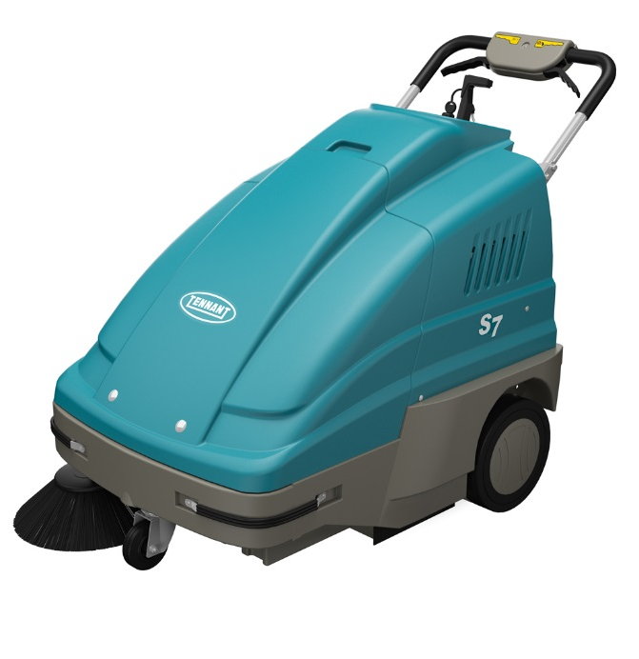
Product Specifications
Feature | Specification
Cleaning path | 700 mm
Productivity (per hour) Theoretical Max | 2601 m²
Productivity (per hour) Practical Max | 2508 m²
Hopper capacity | 45 L
Battery | Gel 105Ah-C5 12V
Battery run time | Up to 3 hours
Length x width x height | 1245 x 737 x 959 mm
Weight (excl. batteries) | 75 kg
Sound level (operator’s ear) | 70 dbA

Slide 5
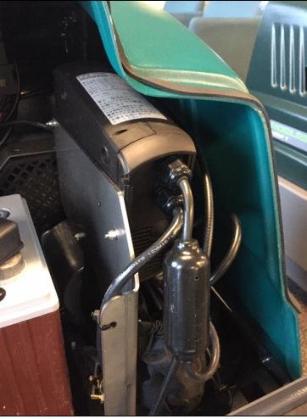
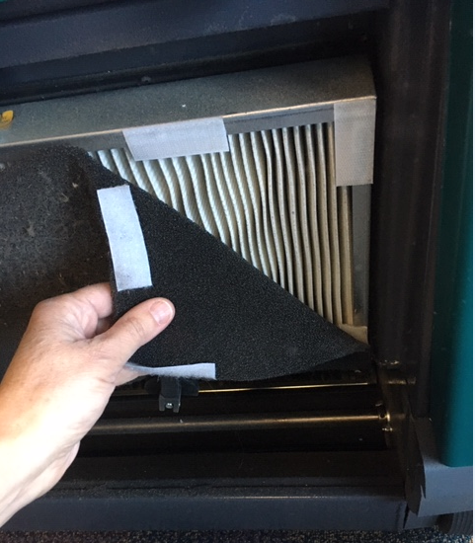
Key Highlights
70 cm overall path width
  50 cm main brush
Sealed battery
  105 AH (C5) with onboard charger
Hopper capacity
  45 L
Filtration
  Pre-filter and main filter
  Main filter at 99.5% at 5 microns
Onboard Charger
Pre-Filter and Main Filter

Slide 6
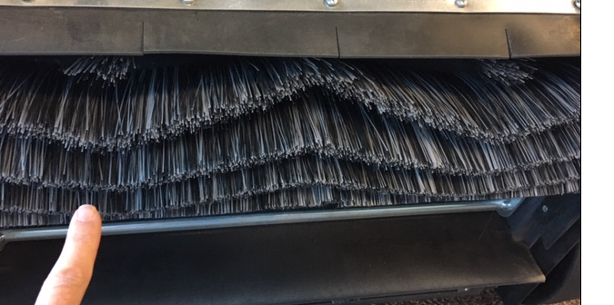
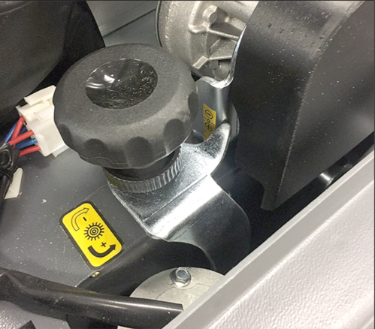
Brush Settings and Replacement
Adjustable main and side brush
  Main brush is set for hard floor. Adjust brush height with adjustment knob under hood.
  Side brush adjustment and replacement: tools required.
Main brush
  When replacing main brush:
    Make sure the “w” in the pattern is as shown:
    Make sure to adjust the carpet height knob back to the initial starting point as shown on the decal

Slide 7
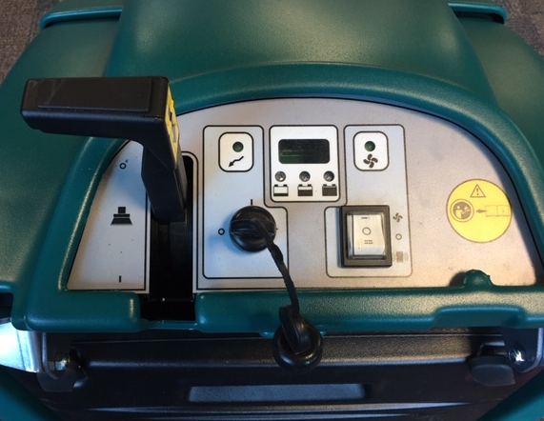
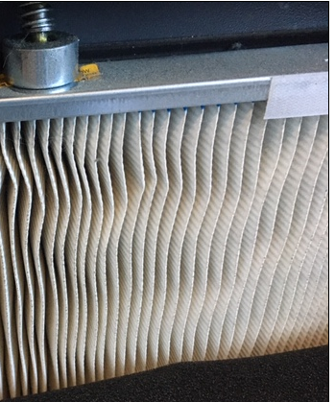
Safe and Comfortable Operations
Simple controls with electronic filter shaker
  Safety is assured with key on/off
  Easily see battery status with battery discharge indicator lights
  Cleaning the filter is easy with built-in electronic filter shaker (1)
  Unit moves easily when engaging drive lever (2)
    Forward only
    Manually pull machine for backward
  Pick up bulkier items when the flap trap lever is engaged (3)
Safe for operators and others
  Breathe easy at 99.5% filtration up to 5 microns
  Work quietly when people are present
  Sealed batteries ensure no overspills/splashes to harm the working environment or employees
1
2
3

Slide 8
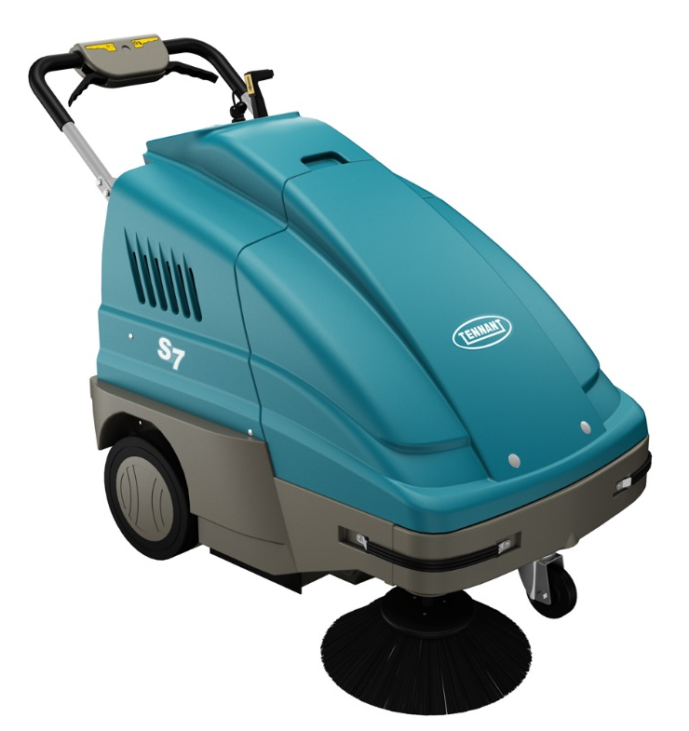
Pricing
S7 Machine and common wear items | PN | List Price
S7 | 1251275 | € 4.250,00
Pre-filter | FTDP00004 | € 13,50
Main filter | FTDP76065 | € 35,93
Main Brush | SPPV00051 | € 65,46
Side Brush | PMVR00248 | € 25,55
Replacement Battery | 994201 | € 513,64
Rubber Flap Kit | MPVR76042 | € 58,38
Rubber side skirt LH | MPVR75928 | € 6,89
Rubber side skirt RH | MPVR75922 | € 6,89
Rubber skirt inner | MPVR75927 | € 5,46
Rubber skirt rear | MPVR85933 | € 23,85
Main Front Skirt Flap | MPVR87400 | € 2,85
Front Skirt Flap | MPVR00731 | € 2,99

Slide 9
S7 Summary
Additional margin opportunities
  Tennant/IPC product vs. Outsourced
Improved cleaning cost for our customers
  Lower acquisition costs

