Slide 1
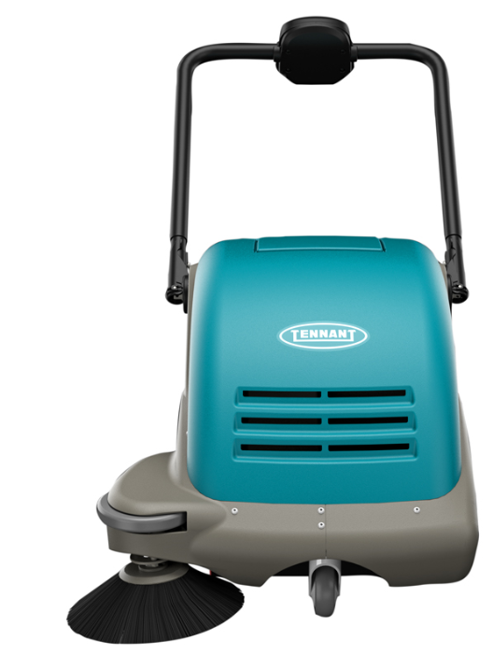
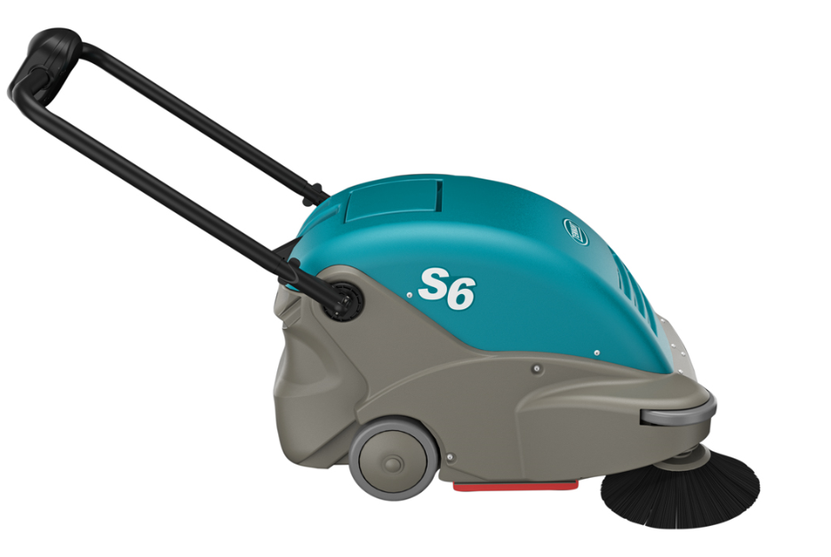
S6 Product Guide (PAS Guide)
Purpose of this internal product guide: Self-train and educate on S6 Sweeper
Other helpful sources for understanding these products:
Operator’s manual
Brochure
Public Website (videos available)
S6

Slide 2
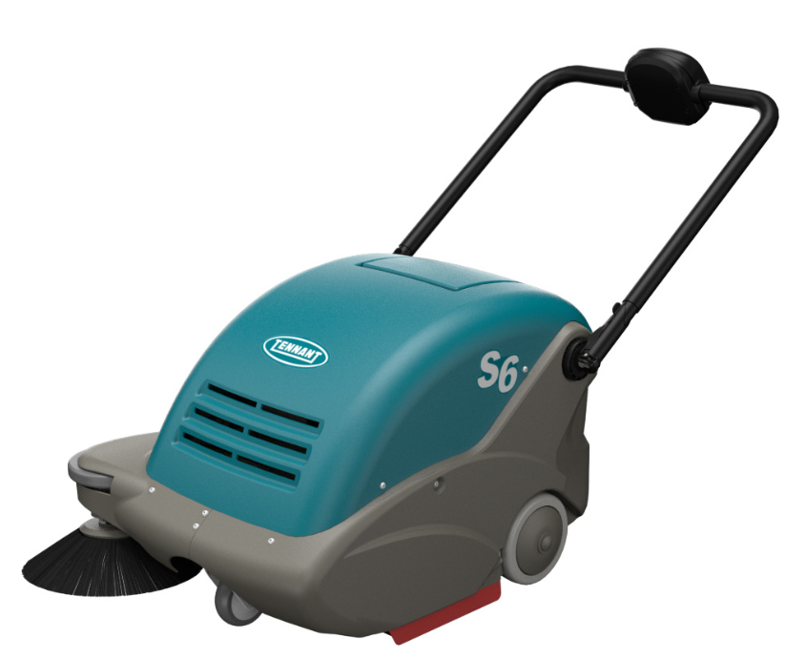
Product Strategy
Utilize IPC machines to
Enhance margins – replace current outsourced walk-behind sweepers with machines from IPC
  Return to similar IPC sweepers previously sold by Tennant (3610)
  Eliminate the S3 push sweeper altogether
S6

Slide 3
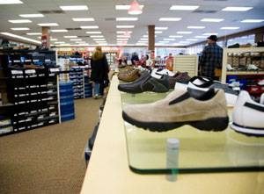


Markets and Applications
MARKET | APPLICATION | FLOOR TYPES
Retail | Aisle ways, check out counters, around displays, deli/cafeteria areas, ramps, side walks, parking lots | Carpet, VCT, polished stone, terrazzo, grouted ceramic and porcelain tile, concrete, asphalt
Schools and Universities | Hallways, entryways, kitchens, classrooms, cafeterias, ramps, sidewalks, parking lots | Carpet, VCT, polished stone, terrazzo, grouted ceramic and porcelain tile, concrete, asphalt
Healthcare | Hallways, entryways, patient rooms, cafeterias, handicapped ramps, sidewalks, parking lots | Carpet, VCT, polished stone, terrazzo, grouted ceramic and porcelain tile, concrete, asphalt
Hospitality | Lobbies, hallways, elevator areas, ramps sidewalks, parking lots | Carpet, VCT, polished stone, terrazzo, grouted ceramic and porcelain tile, concrete, asphalt
Logistics/ Light Manufacturing | Aisles, ramps, employee cafeterias, parking lots | Sealed concrete, polished concrete, coated floors, asphalt

Slide 4
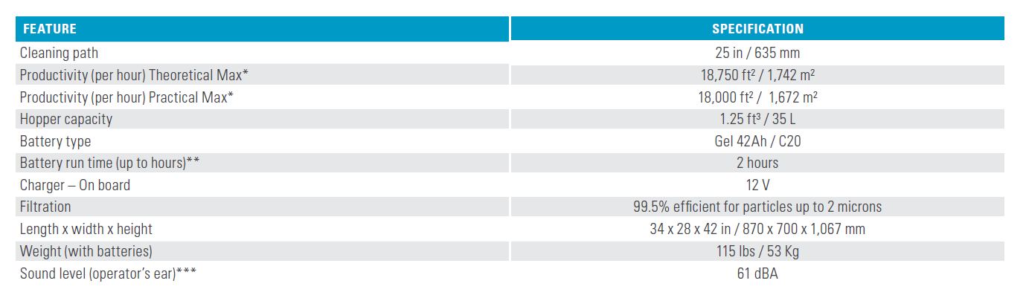
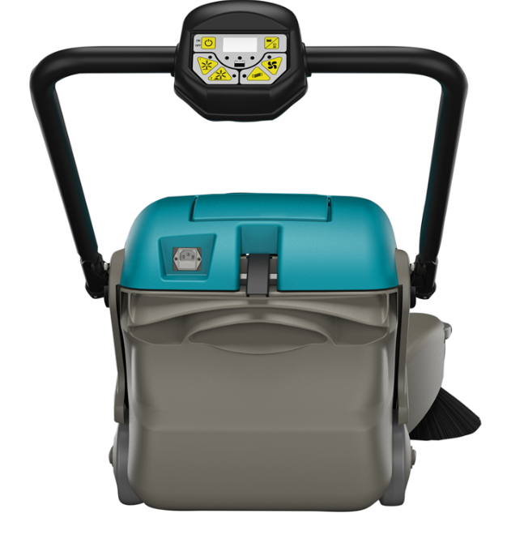
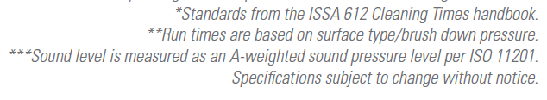
S6 Sweeper Product Specifications

Slide 5
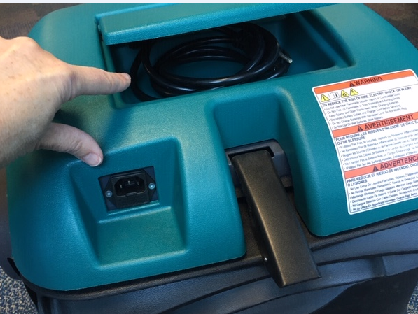
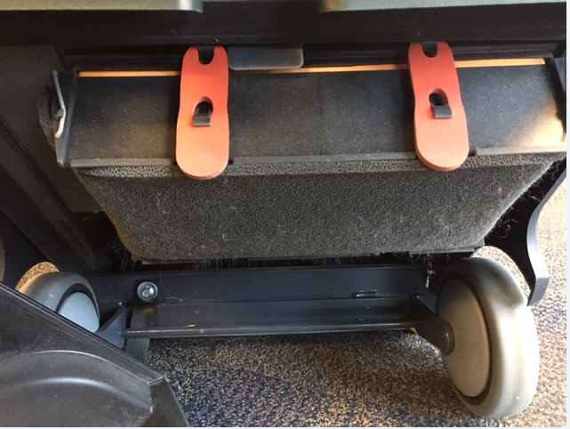
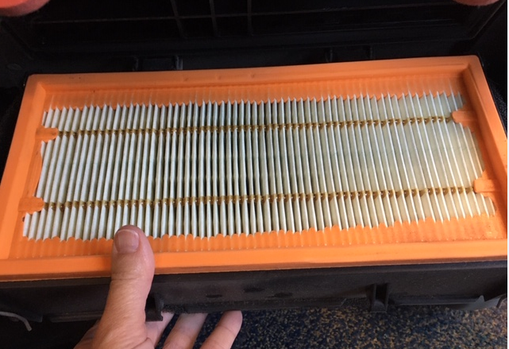
S6 Key Highlights Summary
25”/ 63.5 cm overall path width
  Push unit
Sealed battery
  12 v, 42 AH with built in on board charger
  Up to 2 hrs. of run time
Hopper capacity
  1.25 ft³ / 35 L
Filtration
  Pre-filter and main filter
  Main filter at 99.5% at 2 microns
Noise Level
  Low 61 dBa
On-Board Charger with Cord Storage
Pre-Filter and Main Filter

Slide 6
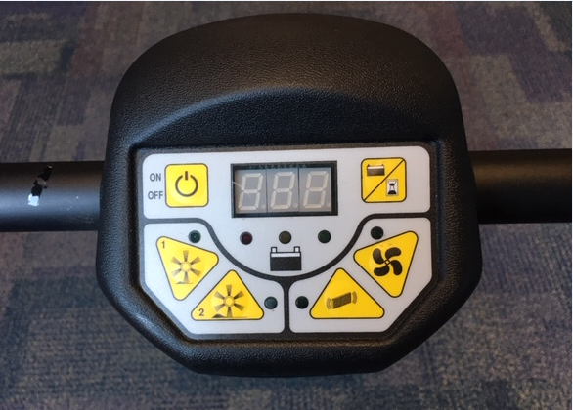
S6 Key Highlights Summary Cont’d
Simple controls with auto electronic filter shaker
  Simple on/off button
  Easily see battery status with battery discharge indicator lights
  Two sweeping modes to adjust to flooring needs
    Mode 1 – light debris, smooth surfaces
    Mode 2 – for heavy debris, concrete, asphalt and carpeted surfaces
  Vacuum fan switch – standard on
  Cleaning the filter is easy with built-in pre-timed electronic filter shaker or can be manually engaged when desired
Sweeping mode 1 for light debris and mode 2 for heavy
Manual filter shaker switch. This is in addition to the auto filter shaking that cycles every 3 minutes
vac fan auto activates when sweeping mode is on. Switch is used to shut off the vac fan during sweeping mode
In addition to battery voltage, the display indicates the machine working hours (pressing once) and minutes (pressing twice)

Slide 7
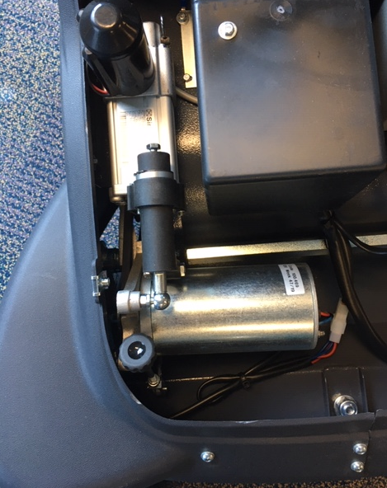
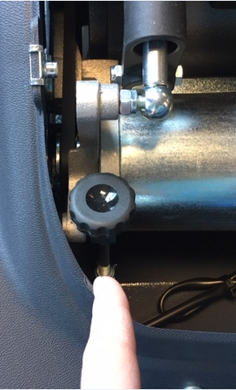
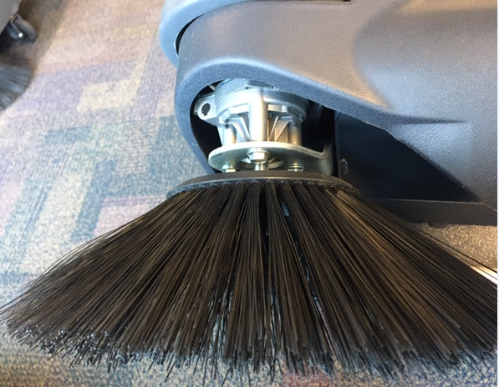
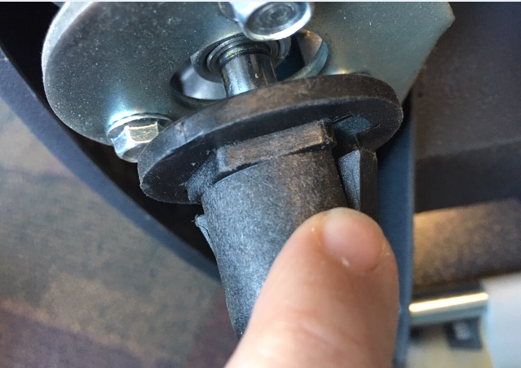
S6 Key Highlights Summary Cont’d
Automatically adjusting main
brush and adjustable side brush
  Automatically go from soft/hard floor without adjusting main brush
  Side brush manual adjustment; remove top cover (allen wrench required)
Main brush/side brush change
  No tools required
  Main brush
    Manually turn brush to see black button (right side)
    Press to disengage
  Side brush
    Simple pinch of two tabs
Side brush height adjustment knob under top cover
Side brush replacement – depress two pinch tabs

Slide 8
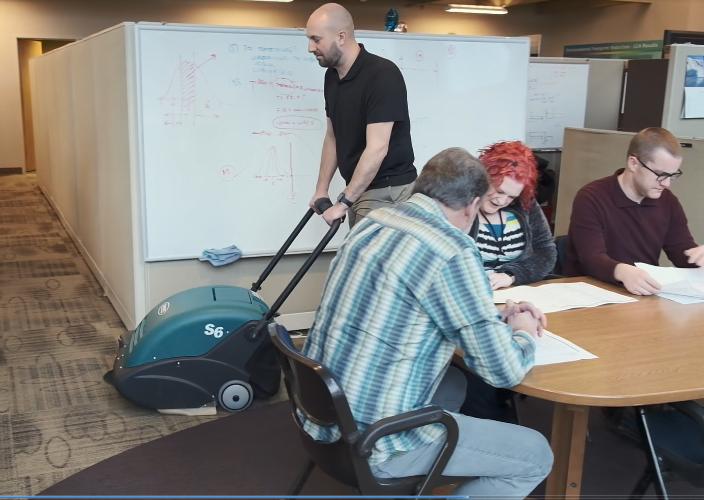
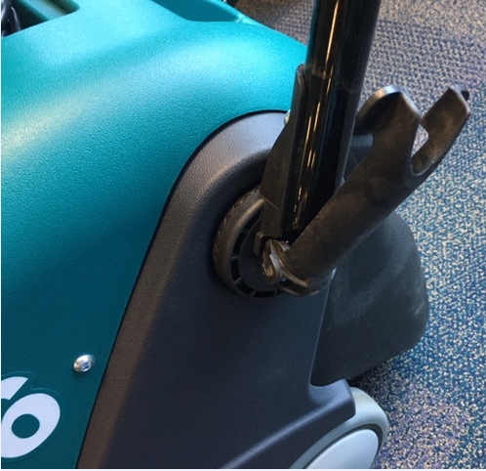
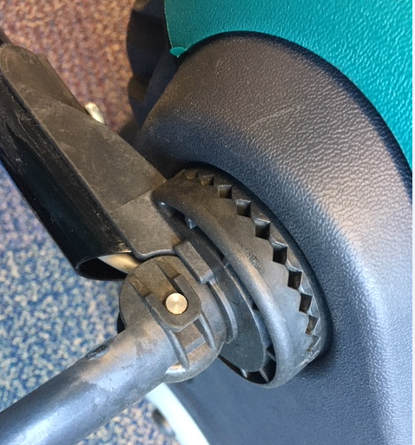
S6 Key Highlights Summary Cont’d
Safe for operators and others
  Breathe easy at 99.5% filtration up to 2 microns
  Work quietly when people are present at 61 dBa
  Sealed batteries ensure no overspills/splashes to harm the working environment or employees
Ergonomic adjustable handle
  Handle fully adjustable to operator’s comfort with locking cam design
Adjustable Handle

Slide 9
S6 Warranty
S6 Warranty
  1 year parts
  1 year labor
  30 days travel
  battery pro-rated for 12 months

Slide 10
S6 Summary
Additional margin opportunities
  Tennant/IPC product vs. Outsourced
  Return to “known” products with the family

