Slide 1
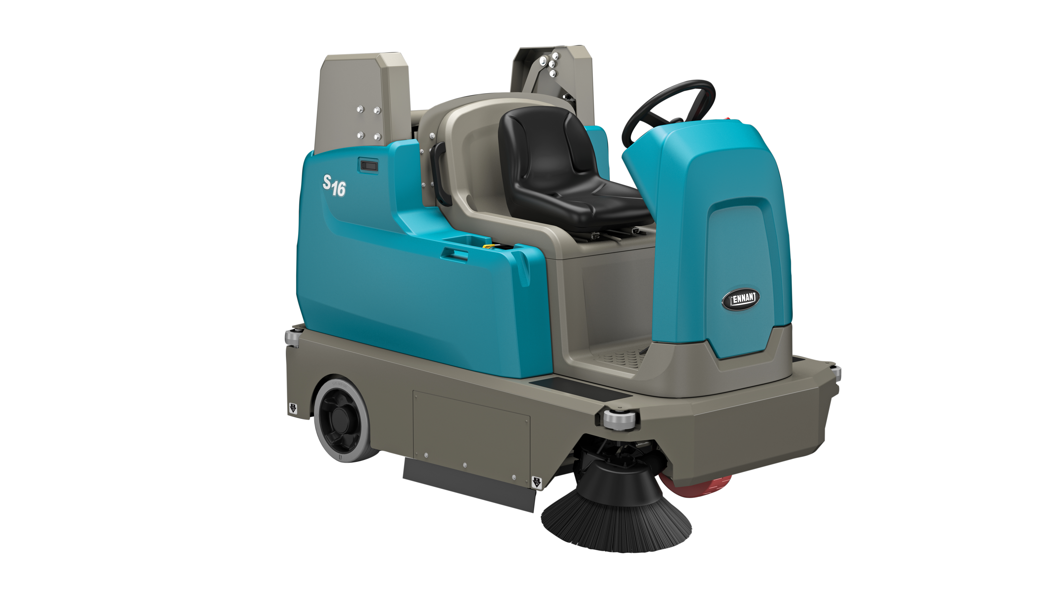
S16 BATTERY RIDE-ON SWEEPER
PRESENTER NAME MONTH.DATE.YEAR

Slide 2


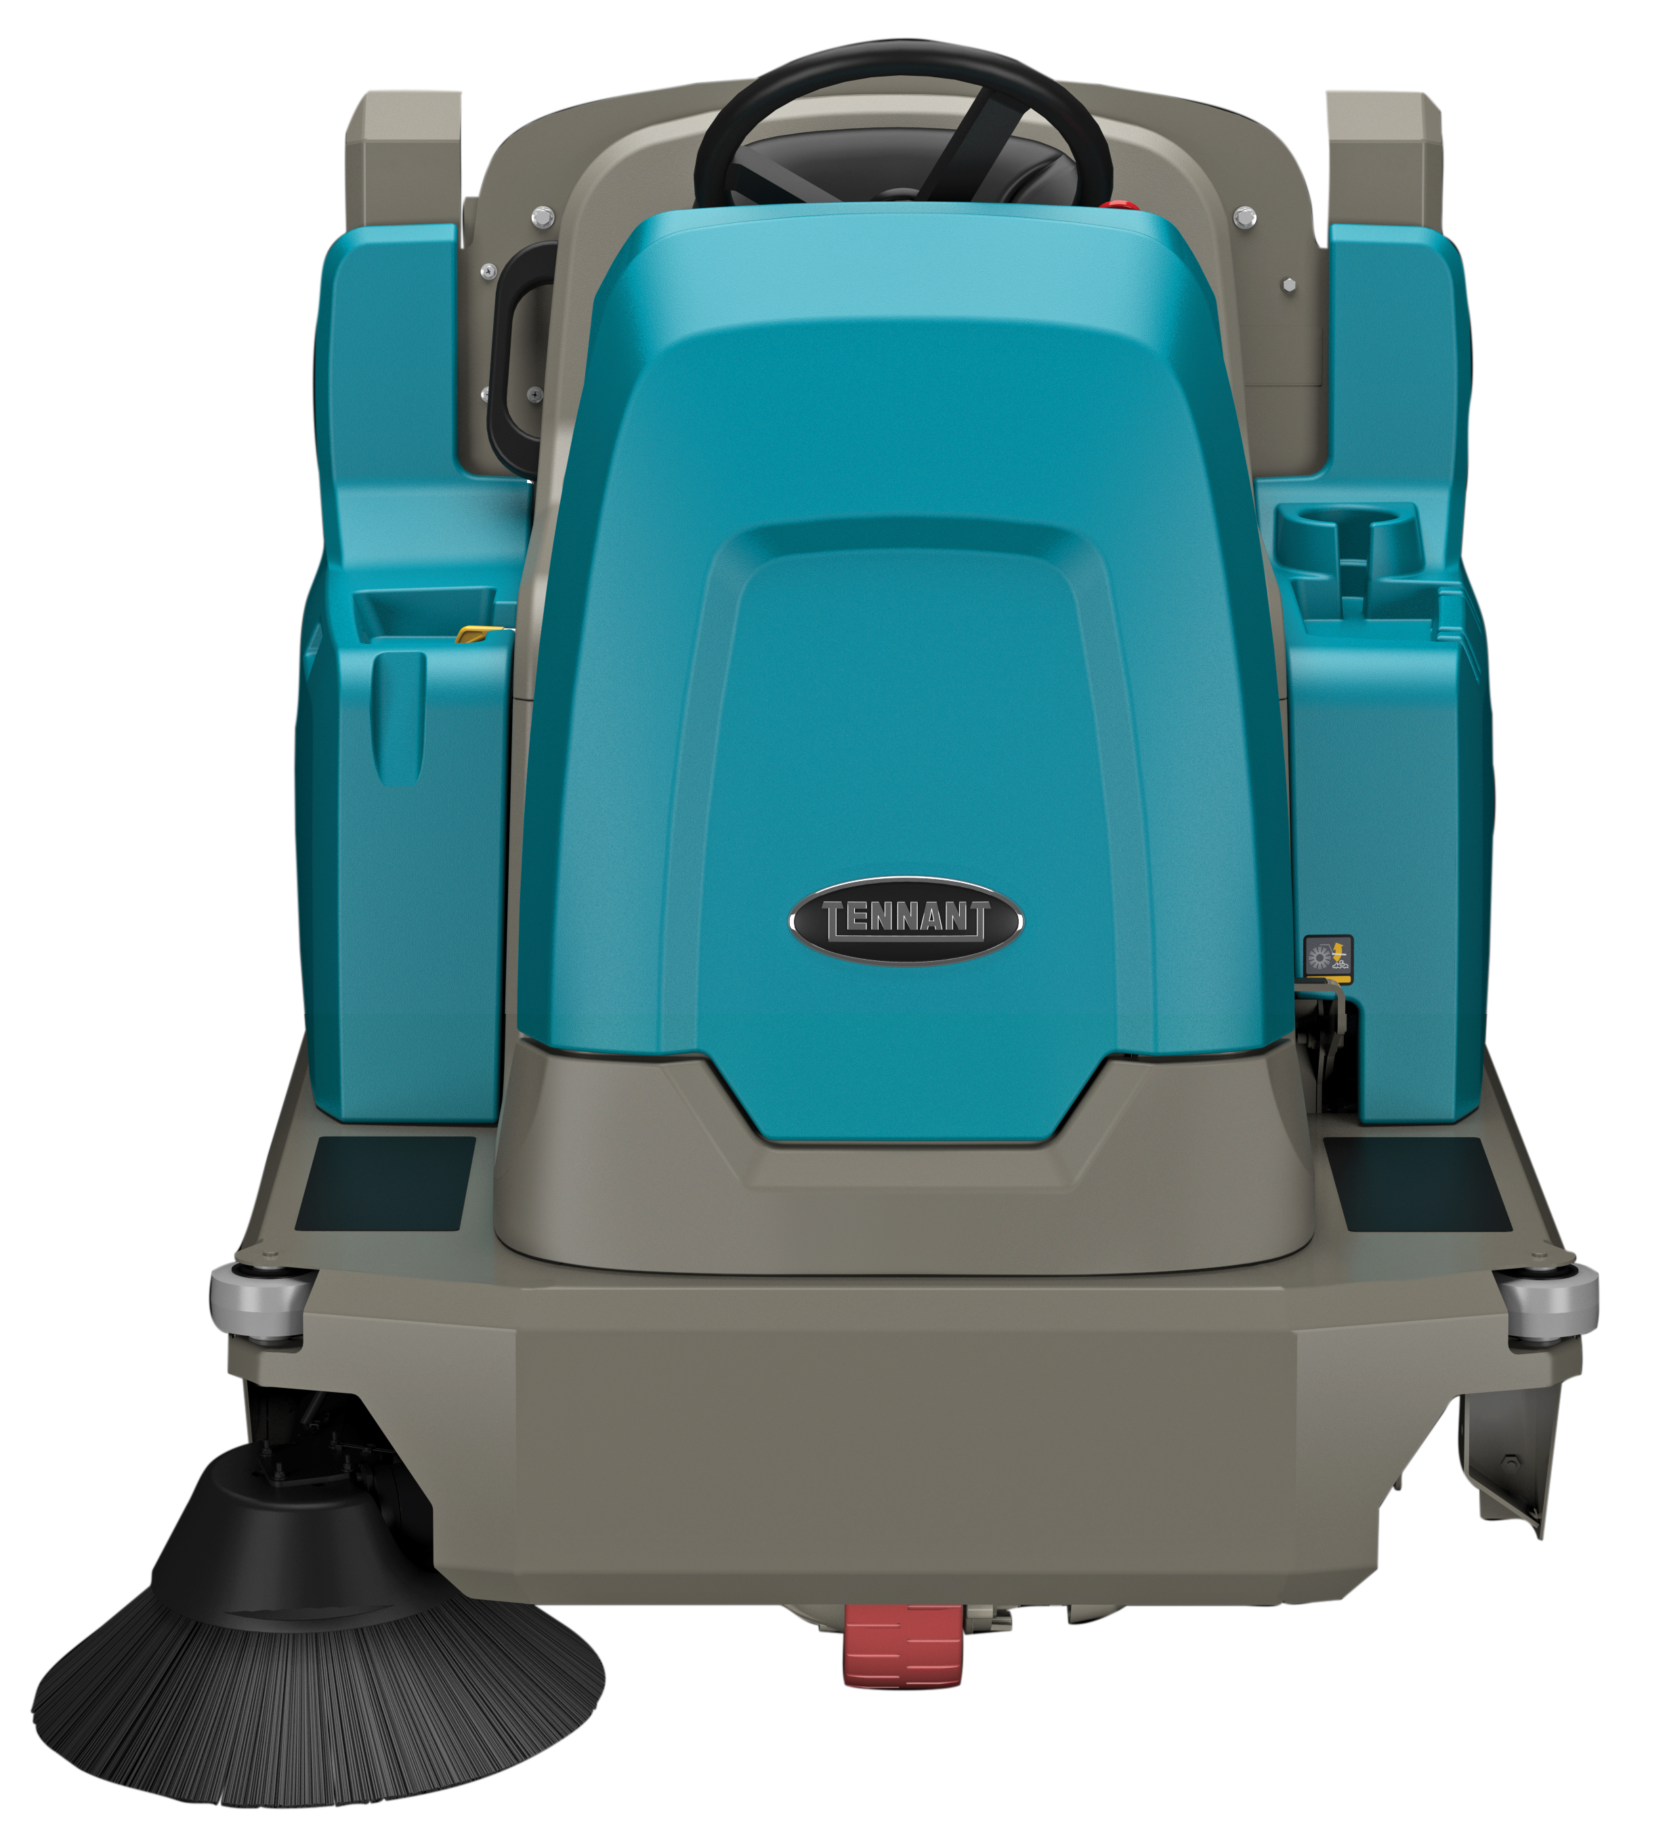


S16 BATTERY RIDE-ON SWEEPER
ADVANTAGES
Reduce Costs to Clean
  Excellent sweeping and edge-cleaning
  Large hopper capacity and wide sweep path
Maintain Health and Safety
  Exceptional multi-stage dust control
  Fume-free battery operation
Enhance Facility Image
  Proven performance on carpet and hard floors
  Consistent brush pressure regardless of surface
Easy Operation & Maintenance
  Intuitive operator controls
  Tool-free access to main parts

Slide 3


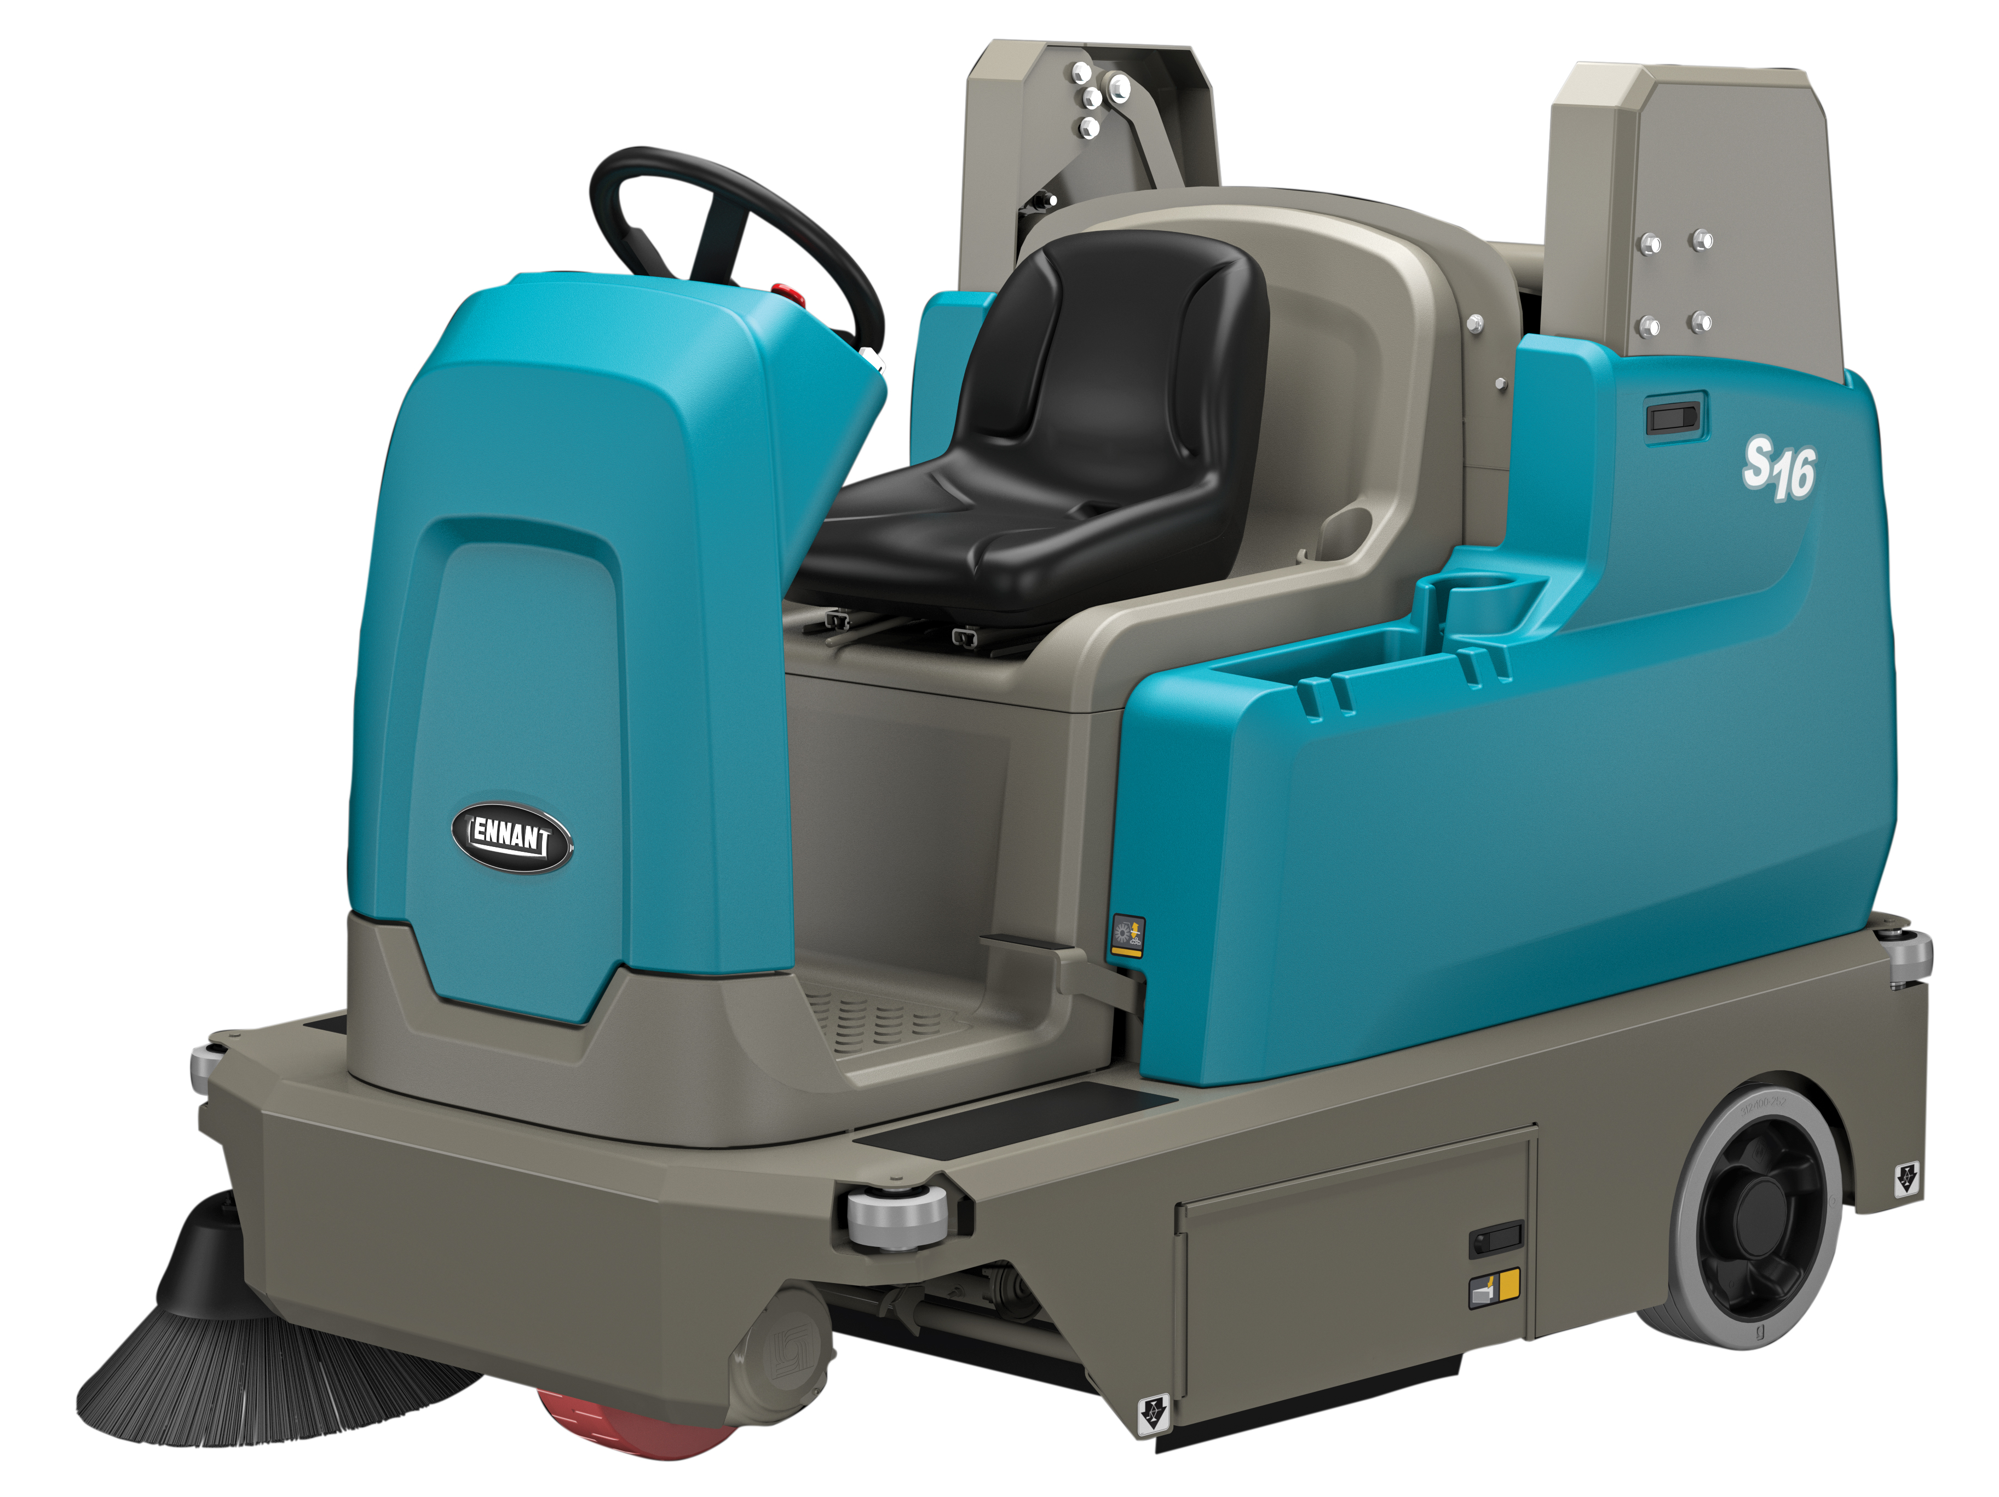


S16 BATTERY RIDE-ON SWEEPER
KEY MARKETS
Warehousing & Logistics
Manufacturing and Aggregate Industry
Outdoor Parking Lots
Hospitality

Slide 4

S16 BATTERY RIDE-ON SWEEPER
BUILT-IN RESULTS
SENTINEL RIDER SWEEPER
BUILT-IN RESULTS
PRODUCT FEATURES FOCUSED ON REDUCING COST & MAINTAINING HEALTH & SAFETY
Reduce Costs to Clean
Excellent sweeping and edge cleaning performance reduce the need for multiple passes.
Optional second sweeping side brush increases productivity by providing a wider sweep path.
Powered high dump eliminates the need to manually handle debris, helping to lower labor costs.
A wide sweep path and large hopper capacity maximize productivity.
FiberShield™ lint screen captures fibers for maximum efficiency when sweeping carpeted surfaces.
Maintain Health & Safety
Multi-stage filtration system and powerful filter shaker maintain air quality by containing dust.
Fume-free cleaning performance helps to maintain a safe environment.
VarioHeight™ handle on the low-dump model provides ergonomic operation for various operators.
Timed filter shaking system effectively cleans the filter and ensures optimal dust control.
Optional FOPS certified overhead guard helps increase safety in the most severe environments.

Slide 5
S16 BATTERY RIDE-ON SWEEPER
BUILT-IN RESULTS
SENTINEL RIDER SWEEPER
BUILT-IN RESULTS
SENTINEL RIDER WEEPER
BUILT TO YO NEEDS
PRODUCT FEATURES FOCUSED ON ENHANCING IMAGE & EASY OPERATION & MAINTENANCE
Enhance Facility Image
MaxPro™ sweeping technology provides consistent brush pressure regardless of surface and debris.
Proven performance on carpeted surfaces helps achieve excellent carpet cleaning results.
Impressive ramp climbing capabilities provide effective sweeping in parking and loading dock areas.
Eco-Mode™ extends runtime and allows for anytime cleaning.
Easy Operation & Maintenance
1-Step™ start button simplifies operation with recent machine settings automatically engaged.
Operator-forward design helps reduce fatigue and increase operator safety and visibility.
Easy-to-identify yellow touch points help simplify preventative maintenance.
No-tool access to all common maintenance items reduces time spent on maintenance.
Available dry vacuum wand provides convenient cleaning off aisle and in tight spaces.

Slide 6
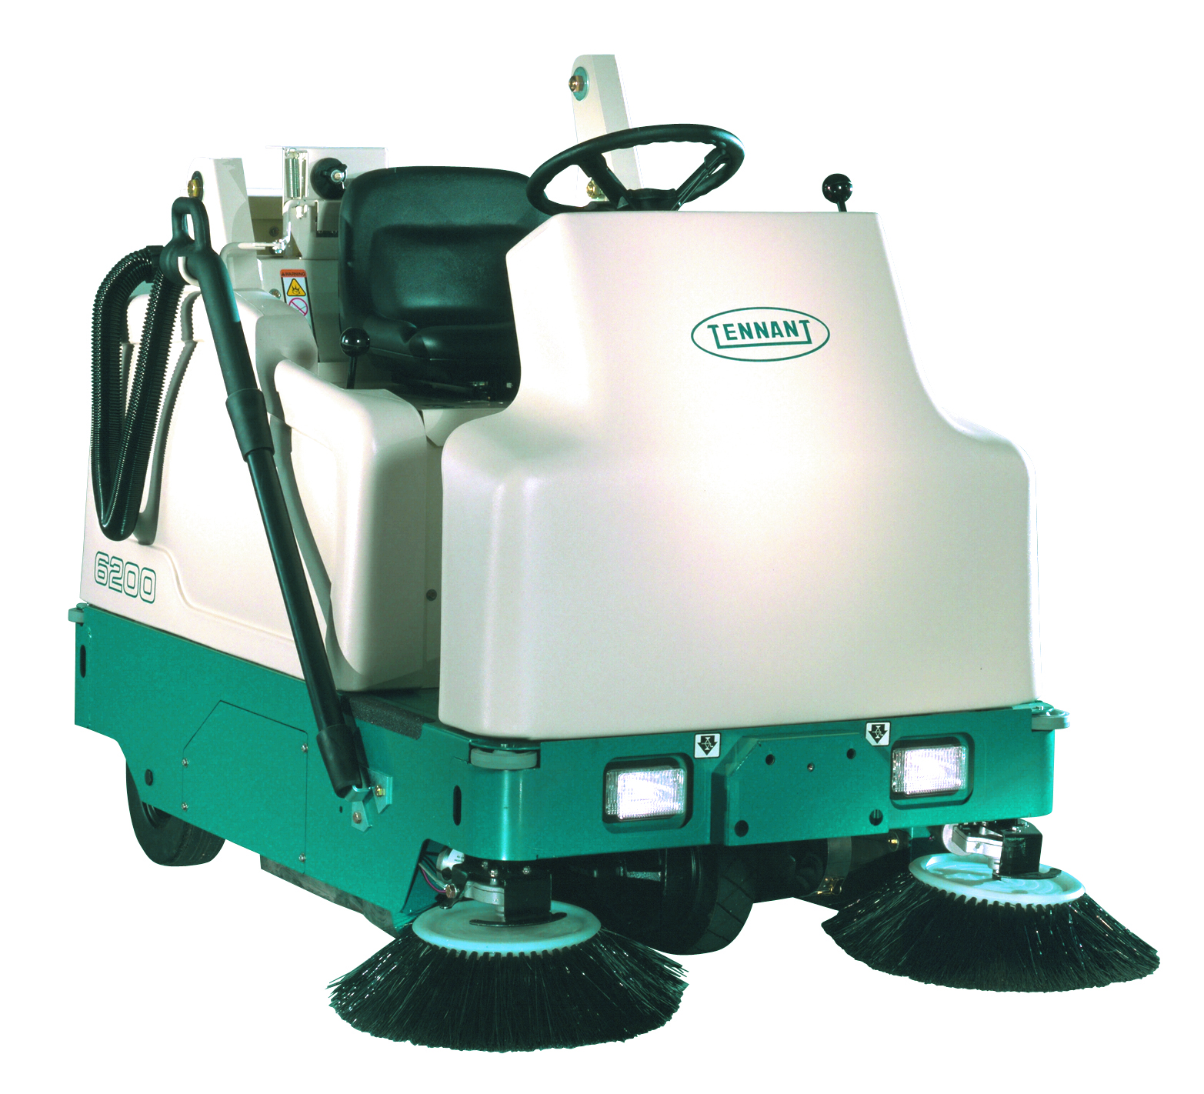
S16 BATTERY RIDE-ON SWEEPER
KEY ENHANCEMENTS
KEY
ENHANCEMENTS
S16
VS
6200
Increased versatility: Available in both high dump and all new low dump configurations, MaxPro™ sweeping technology allows for effective sweeping across a broader surface type and debris set. Additionally, S16 is available with either onboard or offboard battery chargers.
Improved productivity: a 9% wider sweep path than 6200 and 20% larger hopper means the S16 is able clean more area quicker with fewer dumps. Eco-Mode™ allows up to 20% additional runtime vs. standard cleaning mode which leads to more time cleaning between charges.
Improved sweeping performance: S16 features the MaxPro™ sweeping system that automatically provides consistent power to the main brush to deliver consistent cleaning results across various surfaces and debris types. S16 also features 33% longer bristles on the main brush that contributes to better sweeping performance vs. 6200, especially as the main brush wears.
Increased gradeability: S16 climbs grades up to 12 degrees, which is 2 degrees more than the 6200. This allows operators to be able to more effectively clean in parking and loading dock areas.
Enhanced filtering system: A multi-stage filtration system with a powerful filter shaker system maintains air quality by effectively containing dust during the sweeping process. The S16 has 95% more filter area than the 6200 and an extremely effective timed, shaker system that features a shaker plate design. Additionally, S16 is available with HEPA filtration to address the needs of customers wanting to further filter the airflow exhausted from the machine.

Slide 7
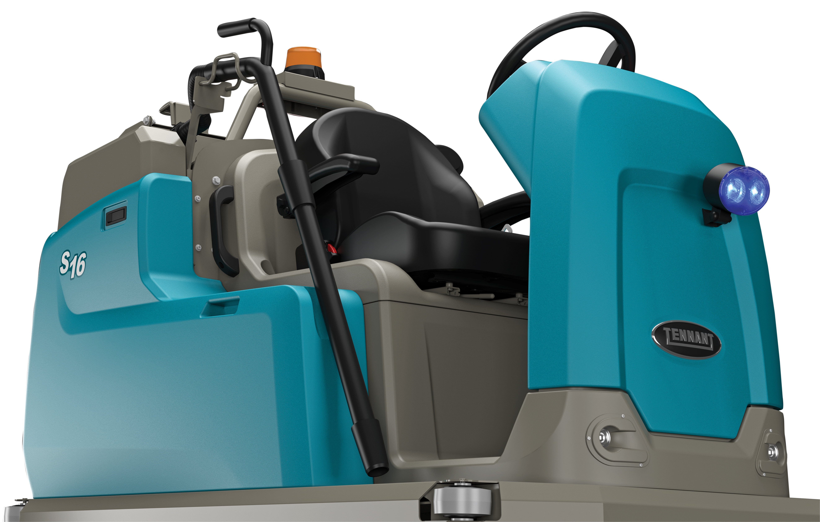
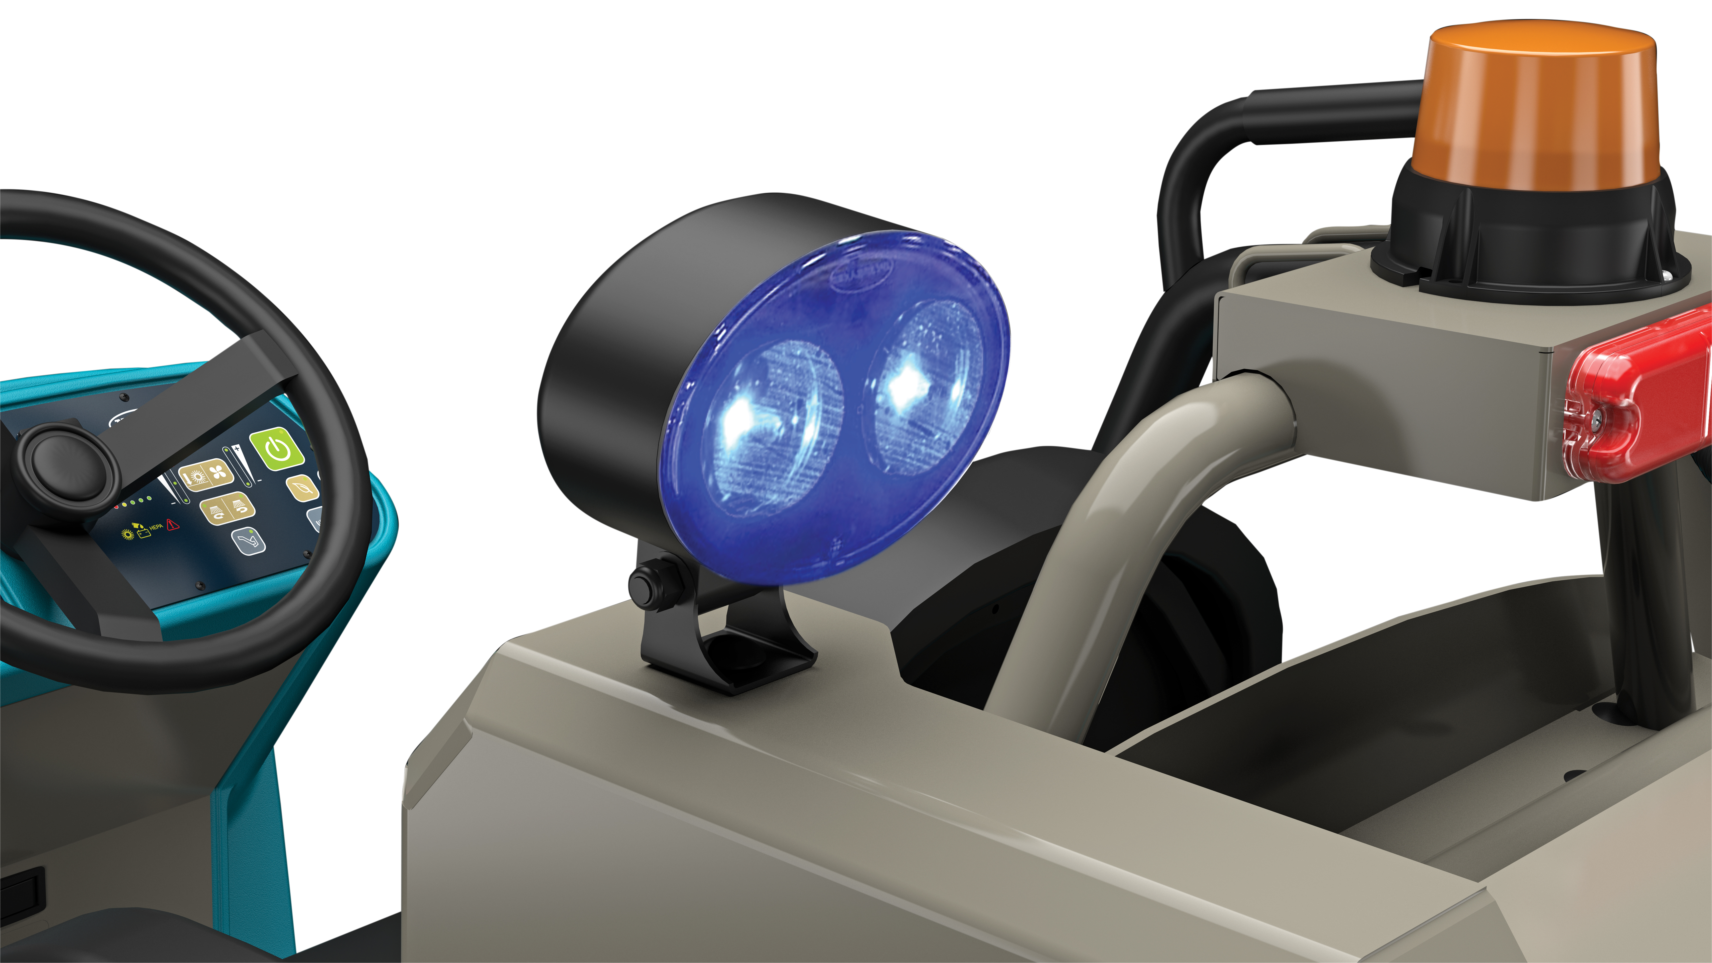
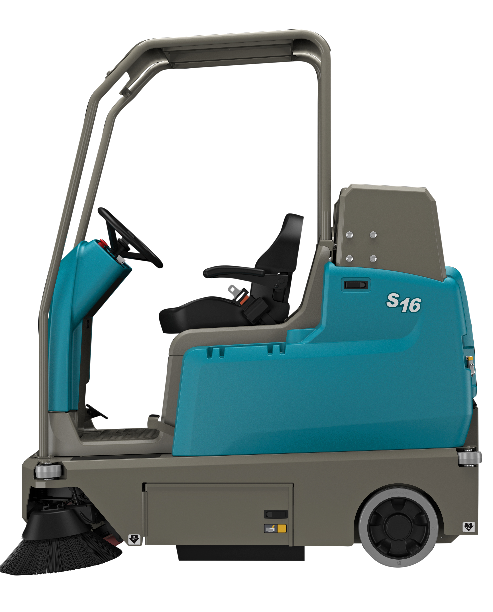
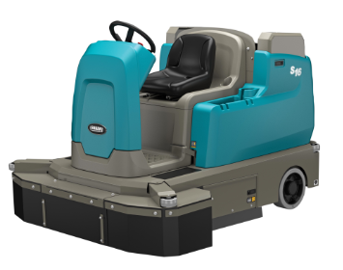
S16 BATTERY RIDE-ON SWEEPER
OPTIONAL FEATURES
Productivity and Ease of Operation:
  Extended sweep path with second sweeping side brush
  Dry vacuum wand
Power:
  Gel and wet battery options
  Onboard and offboard chargers
Technologies:
  IRIS® Fleet Manager
Operator & Machine Protection:
  FOPS certified overhead guard
  Blue light
Dust Control:
  HEPA filtration
  Side brush skirts

Slide 8
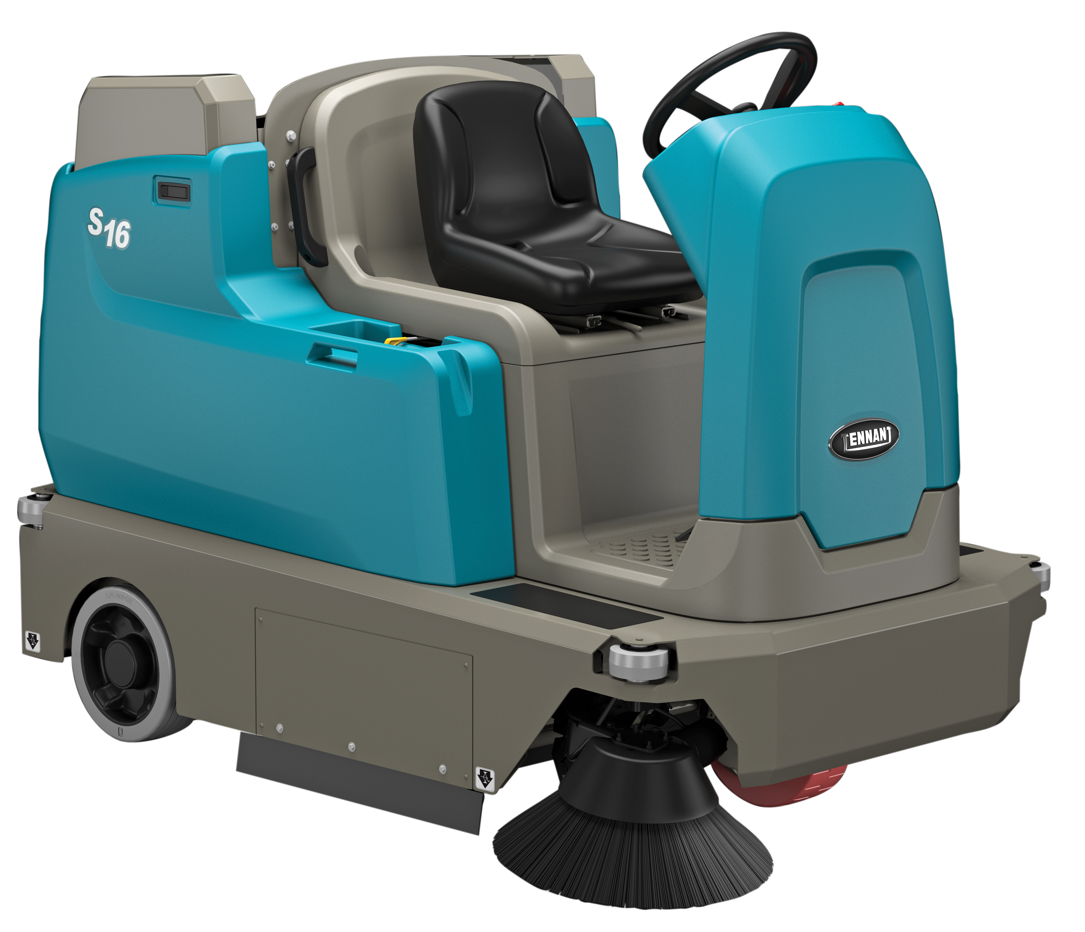
THANK YOU

