Slide 1

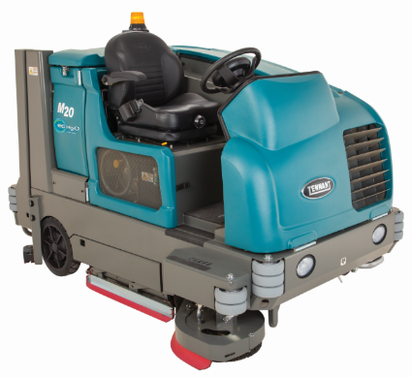
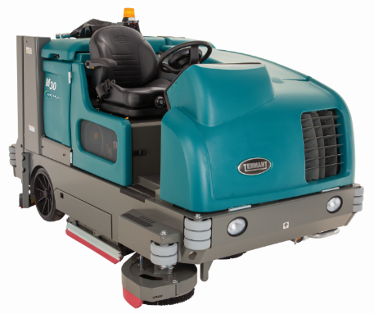
M20/M30
Integrated Rider Sweeper-Scrubbers
Product Applications & Solutions (PAS) Guide
July 2018
CONFIDENTIAL - For Internal Use Only

Slide 2
M20/M30 PAS GUIDE VIEWING INSTRUCTIONS
Select slideshow mode
Press space bar to begin
Make a menu selection or scroll through each slide by pressing the space bar
If using the PDF, slideshow links will not work – must use in PowerPoint

Slide 3
M20/M30 PAS Demo Guide Menu
Click on a topic below. to return
Messages
Enhance Facility Image
Easy Operation & Maintenance
M20/M30 Options
Comparisons
Primary Messaging
Target Verticals Key Attributes
Key Competitive Attributes
Maintain Health & Safety
Reduce Cost to Clean
Menu

Slide 4
M20/M30 Target Vertical Attributes
F&B | Manufacturing | Logistics & Warehousing | Retail
Compliance Safety Quality FSMA FDA USDA Sustainability OSHA | Quality Efficiency Safety OSHA Uptime Inventory Turn Reduce Costs | Quality Efficiency Safety OSHA Uptime Inventory Turn Reduce Costs | Repeat Business Service Safety Consistency Image Competition Concrete Polishing
Auto | Aviation | BSC | Transportation & Parking
Contract Renewals Efficient Production OSHA Uptime/Downtime | Ease of Use Product Offering Service Compliance Image | Ease of Use Decrease Downtime Image Productivity Labor Costs Scheduling Operator Training | Repeat Customers Quality/Clean Image Decrease Costs Profitable Revenue Manage Assets Wisely
Menu

Slide 5





Product Overview – Differentiated Benefits
Reduce Cost to Clean
  Clean more productively
  ec-H2O™ technology
Maintain Health and Safety
Enhance Facility Image
Deliver Easy Operation & Maintenance
  Steering wheel mounted controls
  Increased visibility behind machine with Pro-Panel™
Stands Apart from Competitors:
      High quality and construction
      Simple 1-touch sweeping operation
      Highly customizable solutions
      Field-proven mechanical scrubbing performance
REDUCE COST
TO CLEAN
MAINTAIN HEALTH
& SAFETY
ENHANCE FACILITY IMAGE
EASY OPERATION
& MAINTENANCE
Menu

Slide 6


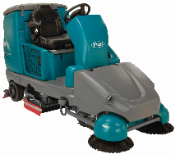
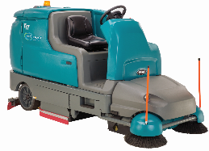
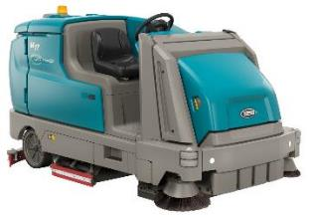
Tennant’s Sweeper Scrubber Product Line
T16
w/Pre-Sweep
T17
w/Pre-Sweep
M17
M20
M30
Large
Battery
Battery
Battery
Engine
Engine
Menu

Slide 7




M20/M30 Primary Messages
Tennant’s M20/M30 are designed to reduce costs to clean, improve facility image & provide safe environment for operator and service personnel. Maximize uptime with simple, steering wheel mounted controls and easy no tools service access.
KEY BENEFITS | Message
Reduce Cost to Clean | Improve productivity by cleaning in a single pass with FloorSmart® integrated cleaning system technology that combines sweeping and scrubbing functions
Maintain Health and Safety | Ensure employee safety with a high capacity multi-level hydraulic rear hopper that eliminates the need to manually handle debris
Enhance Facility Image | Deliver excellent cleaning results with MaxPro²TM hydraulic technology that provides consistent power to the brush drive motors regardless of floor surface changes
Easy Operation & Maintenance | Reduce training and simplify operation with the Touch-n-GoTM control module featuring 1-StepTM start button.
Menu

Slide 8
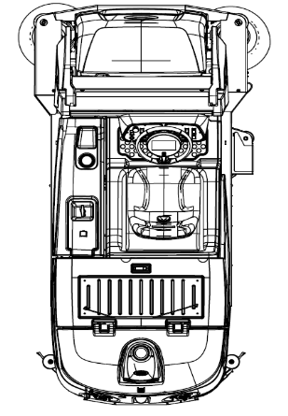
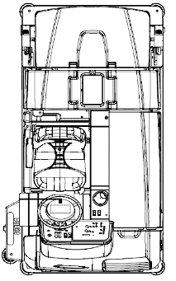
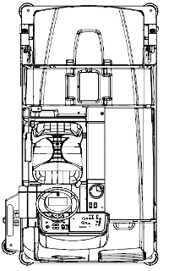
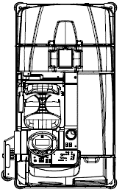
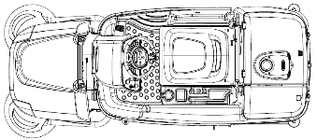
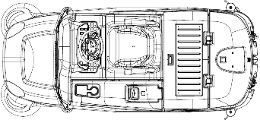
Large Size
Full Range Offering
 | T16 w/ pre-sweep | T17 w/ pre-sweep | M17 | M20 | T20 | M30
Length | 99 inch 2,510 mm | 113 inch 2,870 mm | 112 inch 2,845mm | 95 inch 2,410 mm | 95 inch 2,410 mm | 108 inch 2,745 mm
Width | 41 inch 1,040 mm | 46 inch 1,168 mm | 54 inch 1,372 mm Dual SB Std | 50 inch 1,270 mm | 50 inch 1,270 mm | 58 inch 1,475 mm
Height | 58 inch 1,475 mm | 58.25 inch 1,480mm | 58.25 inch 1,480mm | 58 inch 1,470 mm | 58 inch 1,470 mm | 58 inch 1,470 mm
Menu

Slide 9




M20/M30 Unique Features
Reduce Cost to Clean:
Optional ec-H2OTM maximizes productivity with ec-H2O technology for cleaning up to three times longer than conventional scrubbing
Optional ES® (Extended Scrub) Technology that filters and recycles water recovered solution that can extend cleaning time and increase productivity up to three hours
  Maintain Health and Safety:
UL Approval: Independently tested and certified by Underwriters Laboratories Inc. (UL)
Steering-Wheel-Mounted Controls keeps the operator’s eyes forward and a full frontal shroud protects the operator’s legs and feet
Enhance Facility Image:
MaxPro^{2 TM} advanced Hydraulic Technology provides consistent cleaning performance regardless of floor surface changes
Dura-TrackTM parabolic squeegee with SmartReleaseTM improves water pickup and damage resistance
Deliver Ease of Operation and Maintenance:
Both Pro-Panel™ and Membrane Touch-n-Go™ Control Modules: Operate easily while maneuvering the T20 with the Touch-n-Go™ control module, with cleaning controls placed in the center of the steering wheel allowing the operator’s attention to face forward. The Pro-Panel’s PerformanceViewTM allows the operator to view the cleaning performance behind them, while the rear camera allows the operator to avoid objects while in reverse.
Yellow Touch Points: Save time and money in routine maintenance activity with easy-to-identify, yellow maintenance touch points
Simple Car-Like Foot-Pedal Controls located together provide greater ease of operation
Menu

Slide 10
M20/M30 Product Enhancements and Packages
Product Improvements | Why?
New steering wheel mounted controls | Increased health and safety with easy-forward controls
Optional Pro-PanelTM w/Performance ViewTM | Enables easy operation with numerous features*
Optional high pressure washer [already on M30] | High pressure cleaning on site
15 additional yellow touch points | Increased maintenance and protection
ec-H2O™ reporting through IRIS® | Better management of machine
Dead-man safety switch | If operator leaves seat, the machine stops
* Pro-Panel w/Performance View detailed later in slides
New Bundle Packages | Why?
Productivity package Heavy duty protection package | Side brush, vac wand, spray nozzle HD squeegee protection, overhead guard
Menu

Slide 11


Key Differences
M30
VS
M20
o Larger body: 8 inches (20 cm) wider, 13 inches (33 cm) longer
o Larger hopper: 7.0 ft³ (198 L) for M30 vs 3.9 ft³ (110L) for M20
o Larger solution tanks: 19 gal (72L) larger
o Larger recovery tanks: 22 gal (84 L) larger
o Larger main cleaning path: 8 in (20 cm) wider with 48 inch (1.2 m) brushes
o Large soft ride tires: 2 in (5 cm) larger with 18 in (46 cm) wheels
o Kubota turbo diesel 41 hp, 1.5 L engine @2800 rpm (vs non-turbo 24.8 hp @2300 rpm on M20)
o Optional soft cab with heat and A/C (available without A/C for M20)
o Standard soft ride, non-marking tires (not available on M20)
Menu

Slide 12
Reduce Cost to Clean
Menu

Slide 13

Reduce Cost to Clean
Productivity
ec-H2O™ Cleaning Technology:
Chemical-free cleaning technology provides effective cleaning results while leaving no chemical residue. Scrub up to three times longer with a single tank of water than conventional scrubbing.
Save money by reducing/eliminating use of expensive general purpose detergents with ec-H2O™
Reduce labor and scrub longer with fewer dump/fill cycles than conventional scrubbers.
ec-H2O™ Variable Flow:
The ec-H2O flow rate is now controllable through the normal solution flow button.
Adjustable Flow Rate | Economy | Normal | Heavy
With or without SB on | .70 gpm / 2.65 L/min | 1.4 gpm / 5.3 L/min | 1.4 gpm / 5.3 L/min
Menu

Slide 14
Reduce Cost to Clean
Productivity
Optional Side Brushes:
Choose a side scrubbing brush and extend total scrubbing path to 54 in (1,370 mm) for M20 & 62 in (1,575 mm) for M30 while providing exceptional edge scrubbing capabilities, maximizing productivity (available on cylindrical or disk machines)
Choose a side sweeping brush and extend total scrubbing path to 56 in (1,420 mm) for M20 & 64 in (1,625 mm) for M30 while removing debris from hard to reach edge and corners, maximizing productivity (available on cylindrical machines only)
Automatically raises and lowers with scrubbing system activation, unless turned off, decreasing operator training time and ensuring consistent cleaning results
Adjustable side brush squeegee (for side scrubbing brush) contains water, even in tight turns, for exceptional cleaning results and safer, drier floors
Simple and easy no-tool brush change reduces downtime; quick no-tool conversion from a side scrubbing brush to a side sweeping brush (cylindrical only) offers superior cleaning flexibility
Surrounded by a steel shroud and retractable on impact, protecting both the machine and side brush assembly and designed to reduce maintenance costs
Menu

Slide 15
Reduce Cost to Clean
Productivity
Engines:
M20
Gasoline/LPG (2.0 L)
  40.6 hp / 30.3 kW @ 2,300 rpm
Diesel (1.5 L)
  24.8 hp / 18.5 kW @ 2,300 rpm
M30
Gasoline/LPG (2.0 L)
  40.6 hp / 30.3 kW @ 2,300 rpm
Turbo Diesel (1.5L)
  41 hp / 30.6 kW @ 2,800 rpm
Forward propel speed: up to 8.0 mph / 12.9 km/h
Reverse propel speed: up to 4.0 mph / 6.4 km/h
Benefit of engine machines vs battery
  Continuous run time – ready when you want with no need to charge for long period of time
  Powered by MaxPro² hydraulic technology, which delivers consistent power to the brush drive motors regardless of floor surface changes, reducing component wear and delivering exceptional cleaning results
Menu

Slide 16
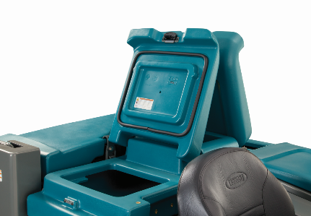
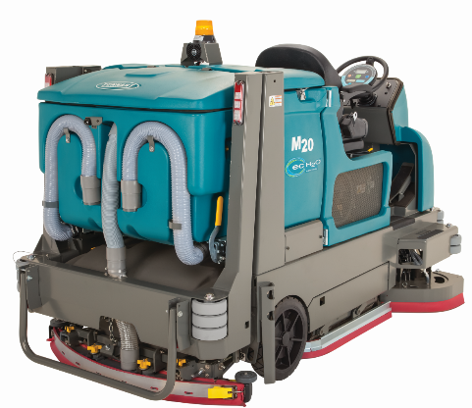
Reduce Cost to Clean
Productivity
Large Solution Tank Capacity:
Maximize time/clean ratio and extend runtime with the
large solution tank. Reduced frequency of dump/fill cycles with ec-H2O™ technology
Large Recovery Tank Capacity:
Save time with large, easy-to-clean recovery tank
Reduce clogs while draining with the large basket that contains debris
Machine | Solution Tank Capacity
M20 | 56 G / 212 L
M30 | 75 G / 284 L
Machine | Recovery Tank Capacity
M20 | 73 G / 276 L
M30 | 95 G / 360 L
Menu

Slide 17
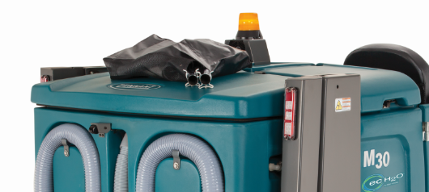
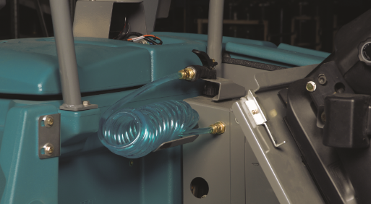
Reduce Cost to Clean
Productivity
Vacuum Wand Attachment:
Convenient and quick "off-machine" spot-cleaning or
spill recovery with the optional vacuum wand.
Stores conveniently in storage tray above battery compartment
Achieve higher machine utilization by expanding its
cleaning footprint to access to hard-to-reach areas
such as under benches, racks, and around obstructions
with the 1.5 inch / 38.1 mm diameter 15 foot / 4.5m long
optional vacuum wand.
Spray Hose Attachment:
Time-saving convenience with machine cleanout and spray-down
using the on-board solution water, eliminating the need to be
near a water source.
Stores behind driver seat for convenient access
Menu

Slide 18
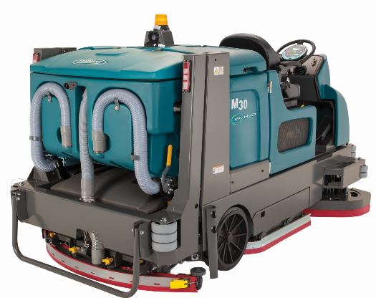
Reduce Cost to Clean
Productivity
Quiet Operation:
Expand cleaning times with quiet operation that enables anytime cleaning with 84 dBA noise levels of the M20/M30 Rider Sweeper-Scrubber (per IEC 60335-2-72, uncertainty Kpa 3 dBA).
Menu

Slide 19

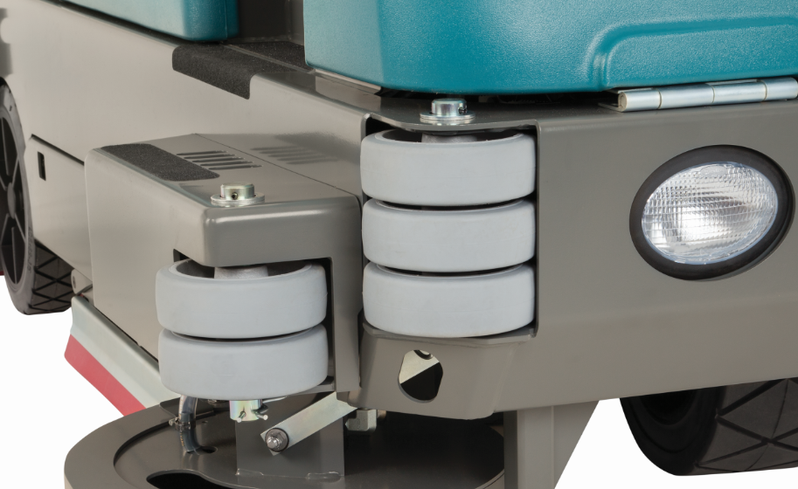
Reduce Cost to Clean
Durability
Wrap Around Steel Bumper – the frame is 4-6 mm thick (depending on part of the frame) and surrounds the entire machine. It isn’t thin steel panels screwed onto plastic like our largest competitor Nilfisk
Cushioned Stacked Rollers provide a layer of protection while maneuvering
FPO
Menu

Slide 20
Reduce Cost to Clean
Durability
Ramp Climb:
Reach more areas with excellent ramp climbing capability with the M20/M30’s Gas, LP, or Diesel powered machines
M20/M30 ramp climb capability:
M20 Ramp Capacity | Standard
Transport Gross Weight | 10° / 18%
Working (Scrubbing) | 8°/ 14%
M30 Ramp Capacity | Standard
Transport Gross Weight | 8° / 14%
Working (Scrubbing) | 5.7°/ 10%
Menu

Slide 21
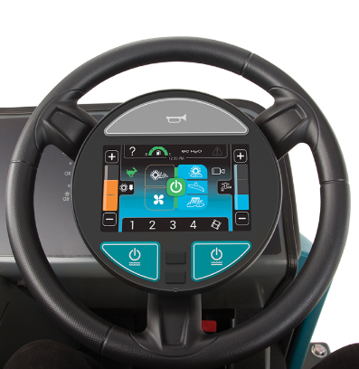
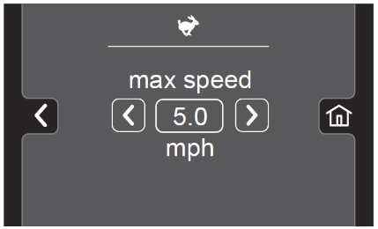
Reduce Cost to Clean
Durability
QA Controls®:
Achieve consistent, cost-effective cleaning by locking in the ideal machine settings, reducing operator errors which can produce poor results.
Pro-Panel™:
Pro-Panel™ allows the supervisor to tailor the machines controls to specific operator log-ins, from performance parameters to the language of warnings and checklists.
Pro-ID™ Operator Log-In functionality prevents unauthorized use and the damage associate with it. Allows speed to be set for each operator.
Pro-Check™ On-Board Checklists provide a means for supervisors to ensure that the check lists are completed before the machine is operational
Both Pro-ID™ and Pro-Check™ can be disabled. Pro-ID™ can be active without Pro-Check™.
Menu

Slide 22
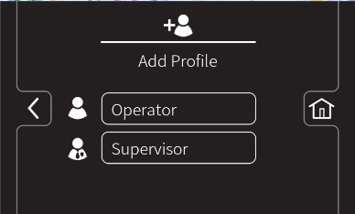
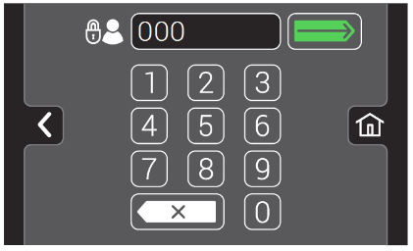
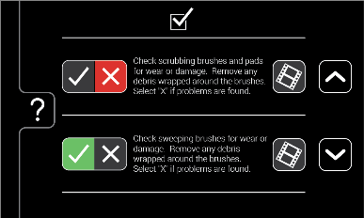
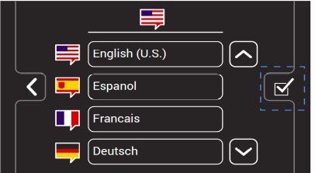
Reduce Cost to Clean
Pro-Panel Advantage
Supervisor Registration of Operator:
  Eliminate unauthorized use and its associated unaccountable damage and set equipment parameters to the operator’s skill and language
Pro-ID™ Operator Log-In:
  ID # passcode required to operate unit (3-9 digits). Will set the unit up per the supervisors settings. For operations using Pro-ID, the customer can set up a mode to allow emergency water recover during off hours. Log In would be determined by Supervisor but could be “911” and could be set up as restricted to water recovery and propelling. Capability of over 100 logins, can delete old logins.
Operator Checklists:
  On-Board checklists will enable management to ensure the checklist is completed and who completed it. Gives operators cues on things to check before beginning. Can be downloaded to USB drive from control panel USB port. Output of checklist info is in the Supervisor’s own language even if operators responded in their own language.
Set to Each Operators Skills and Language:
  Most written commentary and every checklist is set to the operator’s own language (1 of 28).
Menu

Slide 23
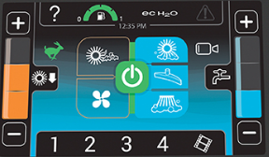

Reduce Cost to Clean
Pro-Panel Advantage
Illuminated Control Buttons Highly Visible
  Most warehouse and many places in manufacturing sites are not well lighted to save overall cost of operation. The Pro-Panel’s unique surface provides EXCELLENT visibility in low light applications. Always know where the controls are, no guesswork. NEVER LEFT IN THE DARK TRYING TO FIGURE OUT WHAT BUTTON TO PUSH.
Gloves are not a Barrier to Operation:
  The touch screen of the Pro-Panel is of a durable “Resistive” construction…allowing the use of gloves during operation, Smart Phones are “Conductive” screens which allow use only with bare hands or specially made gloves.
On-Board Training Videos:
  On-Board videos enable the operator to learn how to operate the basic cleaning functions and refresh their skills after time off to ensure proper operating and basic maintenance procedures are followed
Menu

Slide 24
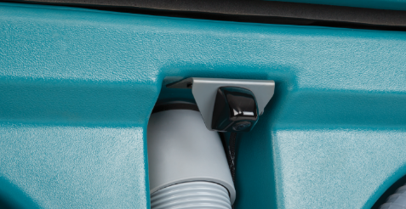
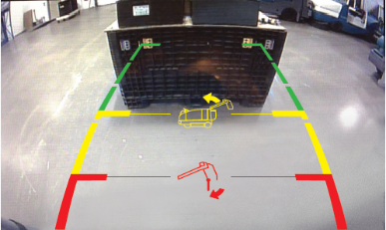
Reduce Cost to Clean
Pro-Panel Advantage
Rear View Camera with PerformanceView™:
  View cleaning performance during operation and view behind the machine in reverse to avoid equipment and facility damage.
  New: Guidelines are incorporated into camera
Zone Settings™:
  Customers can set specific ZONES in their building or set by performance level, or any other combination of characteristics. Note: new functions can be named, but only in one language and will not change by operator
Menu

Slide 25
Maintain Health and Safety
Menu

Slide 26



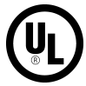
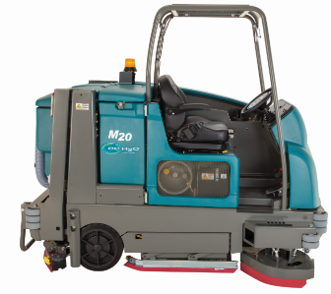
26
Maintain Health and Safety
Facility
CERTIFICATIONS:
UL APPROVED:
Independently tested and certified by Underwriters Laboratories (UL) to UL Type G, LP, D, LPS
Reduce risk of slip-and-fall accidents with ec-H2O™ technology certified by NFSI (National Floor Safety Institute) for delivering a high traction floor surface when used.
ec-H2O™ technology is approved safe by NSF International for use in food, beverage and drug processing locations
Overhead-guard (Optional):
Protect operator by shielding from falling debris.
Menu

Slide 27


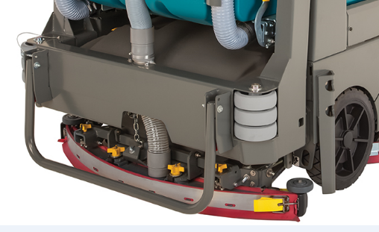
Maintain Health and Safety
Facility
Soft Cushioned Corner Rollers – soften the impact on the facility when the machine runs accidentally strikes a wall or racking. Front and back of machine.
Extraordinary Water Recovery – water recovery is critical when cleaning. The M20/M30’s parabolic squeegee covers the cleaning path extremely well
Menu

Slide 28

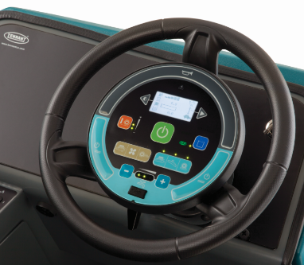
Maintain Health and Safety
Facility
Extend the Cleaning Footprint – clean up along walls and racking with more confidence because you don’t have to run the machine right up along the edge. Clean that RAT line with confidence (F&B need)
Eyes Forward Operation and Car-Like Foot Pedals – Operate easily while maneuvering the M20/M30 with the Touch-N-Go™ control module, with cleaning controls placed in the center of the steering wheel allowing the operator’s attention to face forward.
Menu

Slide 29
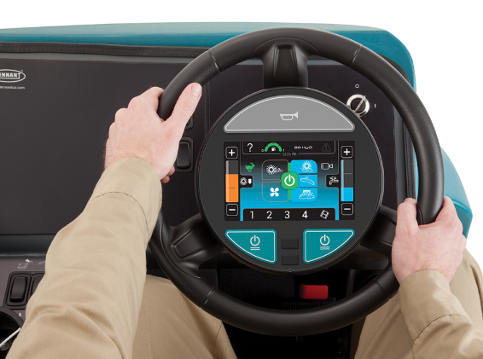
Maintain Health and Safety
Facility
Pro-Panel’s Bright Screen – Provides excellent visibility even in low light conditions commonly found in warehousing and logistics facilities.
Rear View Camera – Provides visibility to the rear of the machine delivering virtual 360°visibility.
  PerformanceView™ – allows for a 3-4 second view of the path of the machine for the operator to inspect the performance of the machine. And to know if the squeegee has something under it causing a streak or if water has spilled on a tight turn.
  Reverse Camera – gives the operator a view behind the machine when backing up. Protects the facility and the machine.
    New: Guidelines
Menu

Slide 30
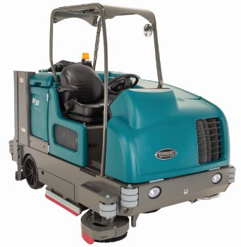
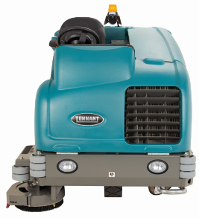
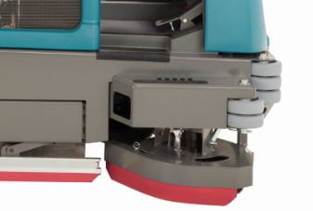
Maintain Health and Safety
Operator
Overhead Guard – protects both the operator and the machine, allowing for safe, effective operation in even the most severe environments.
Full Front Protection– Full Operator Protection from the front. Unlike Nilfisk which exposes the operator’s right leg and foot to impact with objects sticking out from walls or racking.
Menu

Slide 31
Enhance Facility Image
Menu

Slide 32

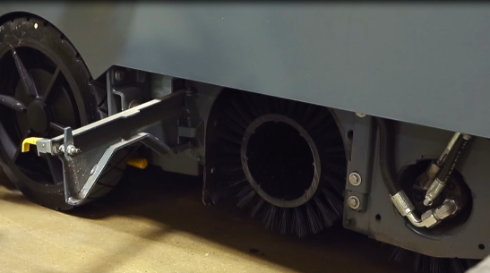
Enhance Facility Image
Clean Floors
32
Cylindrical
Max Down-pressure
Cylindrical 425 lb (193 kg)
Powered by MaxPro² hydraulic technology, which delivers consistent power to the brush drive motors regardless of floor surface changes, reducing component wear and delivering exceptional cleaning results
Menu

Slide 33

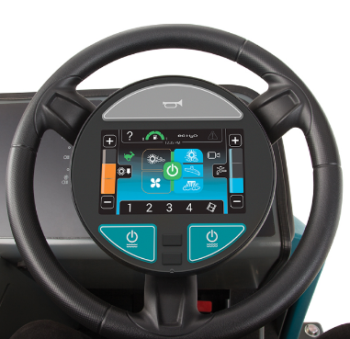
Enhance Facility Image
Clean Floors
Clean Up to the Edge – The side brush enables the machine to run right up to the edge and with the operator further away from the wall gives them confidence that they won’t damage the machine
QA® Controls – allows supervisors to set key settings to have more control over uniform cleaning performance and cost of operation
Pro-Panel™ – allows supervisors to set key settings by specific operators and specific zones for effective cleaning, plus provide training or just a refresh on the controls after an operator returns from vacation.
Menu

Slide 34
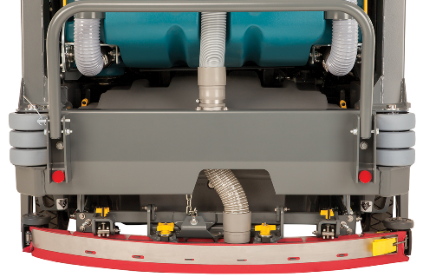
Enhance Facility Image
Dry Floors
Dura-Track™ Squeegee:
Leave floors drier with a parabolic rear squeegee that provides uniform suction across the blade for exceptional water pick-up.
Squeegee Performance/Water Recovery:
Reduce slip and fall potential with a high performance squeegee and a powerful vacuum system that delivers a floor that’s dry in seconds.
Dual Vacuum Fans:
Scrubbing fan:
  1.5 hp / 1.1 kW vacuum fan provides 35 in / 890 mm water lift for exceptional solution recovery
  Sweeping fan:
  1.5 hp / 1.1 kW vacuum fan provides 290 cfm / 8.2 m³/min of airflow for exceptional dust control
Menu

Slide 35
Deliver Easy Operation and Maintenance
Menu

Slide 36

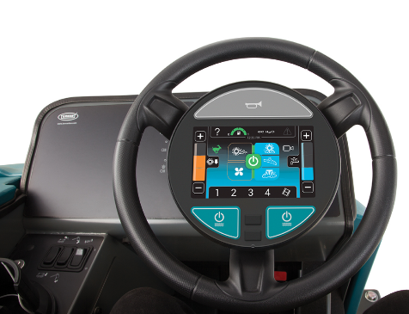
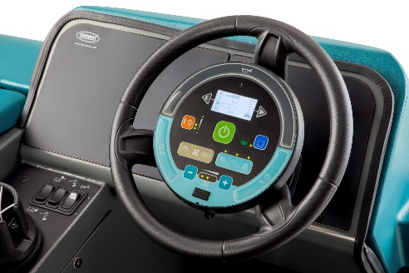
Easy Operation and Maintenance
Operator and Technician
Eyes Forward Operation:
Operate easily while maneuvering the M20/M30 with the Touch-n-Go™ control module, with cleaning controls placed in the center of the steering wheel allowing the operator’s attention to face forward.
Operator Fatigue Reduced with Power Steering:
The M20/M30’s power steering module reduces the steering effort significantly.
Provides positive feedback for a “more-in-control” experience than the other power steering systems where the steering feels so loose and it is a more comfortable experience.
1-Step™ START BUTTON:
Simplify operator training with controls that enable the scrubbing systems to be activated with a single large GREEN button. Operation is also made easy by a system that maintains the most recent operator setting.
Menu

Slide 37
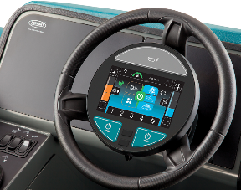
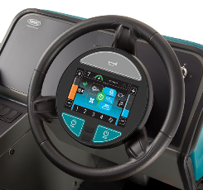

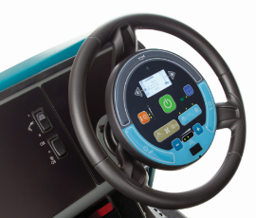
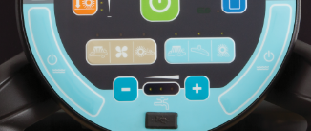
Controls
Pro-Panel™ Technology
M20/M30 will incorporate new State-of-the-Art Control Technology
Pro-Panel™ Controls (LCD Touch Screen) | Standard Controls (Conventional Membrane/Switch)
Place ALL Cleaning Function Controls directly in front of the operator Allows them to actuate controls without having to remove their hands from the steering wheel or their eyes off the direction of travel LCD Screen provides more vibrant and visible control switches in low light warehouse applications LCD Also provides an even more simplified operation and use experience for operators plus: Rear View Camera capability to view cleaning performance (PerformanceView™) and better visibility when reversing. Capacity for Operator Log-In (Pro-ID™) and Checklists (Pro-Check™) …able to be downloaded off machine… for security On-Board videos for operator training Clogged filter operator notification | Place Main Cleaning Function Controls directly in front of the operator Allows them to actuate controls without having to remove their hands from the steering wheel or their eyes off the direction of travel Proven reliability incorporated for four other Tennant Models: T12, T16,T17, and M17 Color Coded to enable ease of use and simplify overall operation. Image to the right shows how the functions have been integrated into the control space
Menu

Slide 38

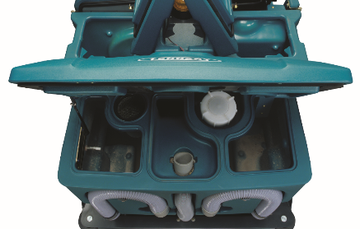
Deliver Easy Operation & Maintenance
Operator
Spray Hose – Time-saving convenience with machine cleanout and spray-down using the on-board solution water, eliminating the need to be near a water source. 15 ft / 4.5m reach.
Easy Access to Recovery Tank –
  Large opening – enables excellent viewing into the recovery tank to seen how well it is cleaned out.
Menu

Slide 39
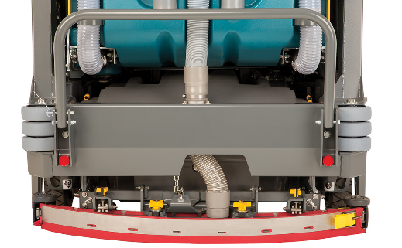
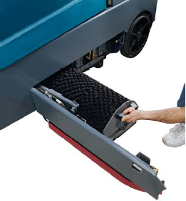
Deliver Easy Operation & Maintenance
Operator/Technician
Yellow Touch Points – Save time and money by ensuring maintenance items get checked and the machine is properly maintained and protected.
No Tool Brush, Filter, and Squeegee Change – Reduce time spent inspecting brushes and change them quickly and easily…most competitors has some level of threaded fastener in their squeegee retention mechanism…
Menu

Slide 40
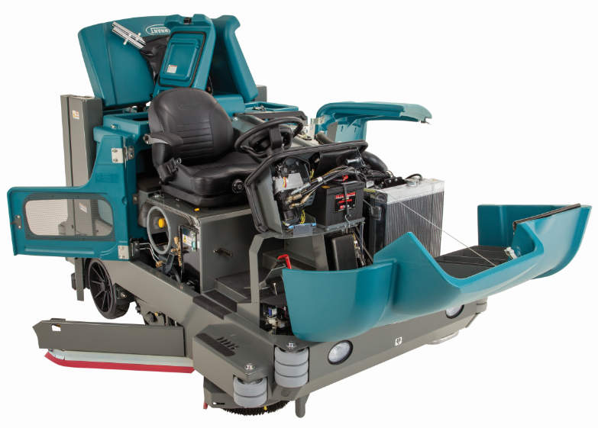
Deliver Easy Operation & Maintenance
Operator/Technician
Easy Access to Components
The quicker a technician can get to a component the sooner the machine is repaired and back on the floor cleaning.
The M20/M30 opens up like a Swiss Army knife for excellent access all around.
Menu

Slide 41
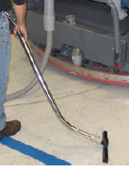
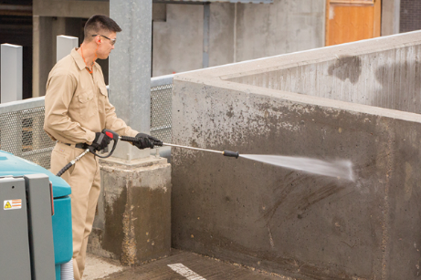
Deliver Easy Operation & Maintenance
Operator/Technician
Vacuum Wand Attachment:
Convenient and quick "off-machine" spot-cleaning or spill recovery with the optional vacuum wand.
Stores conveniently in storage tray above battery compartment
Achieve higher machine utilization by expanding its cleaning footprint to access to hard-to-reach areas such as under benches, racks, and around obstructions with the 1.5 inch / 38.1 mm diameter 15 foot / 4.5 m long optional vacuum wand.
Pressure Washer:
  High pressure cleaning on site
  25 ft / 8 m, 2,200 psi
Menu

Slide 42
M20/M30 Options
Menu

Slide 43
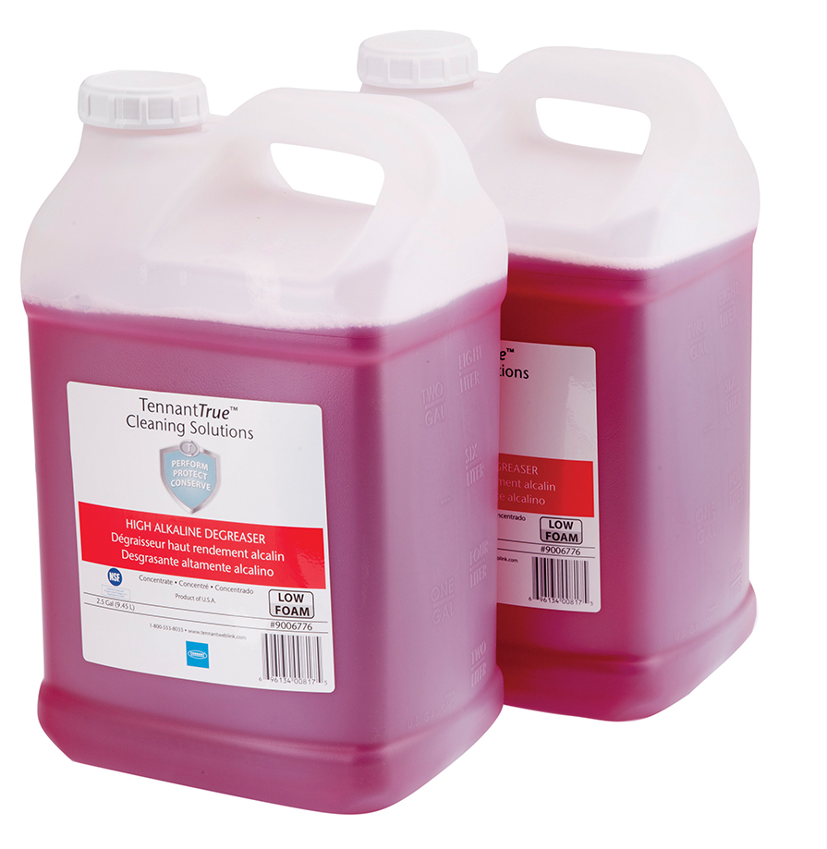















M20/M30 Customizability
>55,000 Combinations
Conventional
ec-H2O™ | Extended Scrub® | Detergent Metering | Scrubbing Side Brush | Pro-Panel™
Spray Hose | Vacuum Wand | HD Squeegee Protection | Overhead Guard | Fire Extinguisher
Pressure Washer | Gas, LP, or Diesel | AV Backup Alarm | High Traction Tires | IRIS®
Menu

Slide 44

Pro-Panel® with WOC Functionality
Wet Only with Conservation Functionality
Description
  A wet only machine that cleans through “wet sweeping” or “water flooding” process
  Conserves time, budget and natural resources
The Pro-Panel® is Standard
  A single touch (leaf button) configures the machine for wet sweeping
  by setting the machine to its lowest water flow and down pressure
Wet Sweeping
  Continual water flow provides moisture around the debris so the
  recovery system can effectively pick it up
  Allowed by OSHA silica dust control housekeeping requirements
Floor Flooding
  Increased water flow uses water to enclose and prevent fine dust from becoming airborne
  Allowed by OSHA silica dust control housekeeping requirements
WOC Benefits
Category | Pro-Panel® | Low Water Flow | Low Down Pressure
Time | Quickly configure machine for wet sweeping with a single touch | Extends scrub time by minimizing dump and fill’s
Budget |  | Fewer tank refills Lower water usage costs | Longer scrub brushes life
Natural Resources |  | Decreases water usage | Reduces the number of worn out brushes in landfills

Slide 45
Comparisons to Tennant Offering
Menu

Slide 46



Key Differentiators in the “M-Line”
 | M17 | M20 | M30
Path | 40-48in / 102-122cm | 40-54 in / 102-137 cm | 48-62in / 122-157cm
Solution | 75G / 285L | 56 G / 212 L | 75G / 285L
Down Force | D: 550 lbs / 250 kg C: 550 lbs / 250 kg | C: 425 lbs / 193 kg | C: 425 lbs / 193 kg
Debris Debris Tray Cylindrical Only | 3.0 ft3 / 85 L 60 inch / 152 cm Power Front Dump | 3.9 ft3 / 110 L Debris Tray 60 in / 152 cm Power Rear Dump | 7 ft3 / 198 L Debris Tray 60 in / 152 cm Power Rear Dump
Battery/Engine | 500AH–930AH C6 Roll-Out Capable | Engine Powered | Engine Powered
Technology | Conventional w/Detergent Metering, ec-H2O™ w/SE Switch, ES® | Conventional w/Detergent Metering, ec-H2O™, ES® | Conventional w/Detergent Metering, ec-H2O™, ES®
H₂O Control | Significantly Reduced Tear Drop, Dual Fan, Articulated Squeegee, and Patent Pending Water Trap | Fixed Squeegee | Fixed Squeegee
Duty Cycle | Heavy Industrial | 24 Hour Heavy Industrial | 24 Hour Heavy Industrial
PGM

