Slide 1
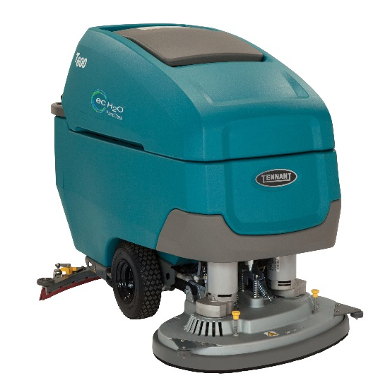
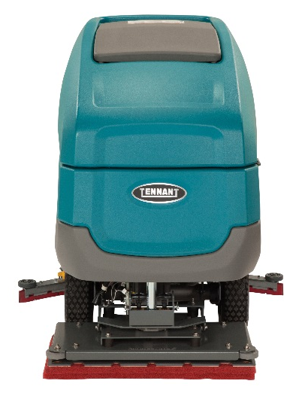
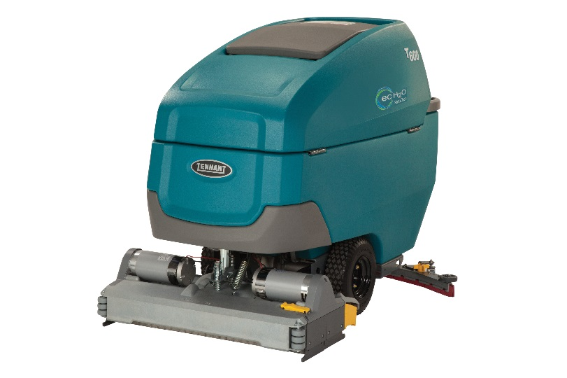
Product Guide (PAS Guide)
Purpose of this internal product guide: Self-train and educate on T600/T600e
Other helpful sources for understanding these products:
Operator’s manual
Brochure
Public Website (videos available)
T600/T600e
Confidential. Do not distribute.

Slide 2
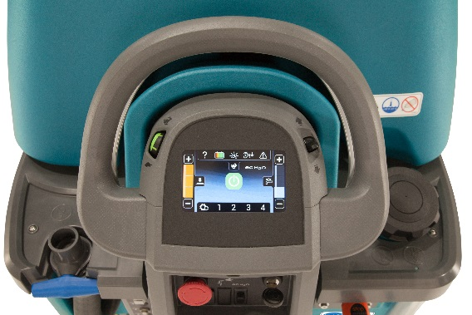
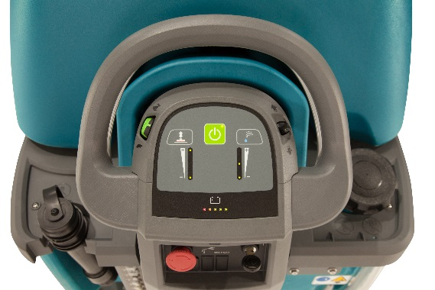
Product Strategy and Value Proposition
Maintain Market Presence with 2-Tiered Product Strategy
T600 – New technologies and features to grow new business and revenue per unit
T600e – Simple, rugged and affordable
T600
T600e
Value Proposition:
Tennant’s new T600 scrubber, with productivity enhancing features, provides high performance on virtually any hard floor surface condition, delivering unmatched versatility and consistent results while lowering cleaning costs.
Value Proposition:
The new Tennant T600e offers effective cleaning results in a no-nonsense, easy to use, rugged design.
Confidential. Do not distribute.

Slide 3
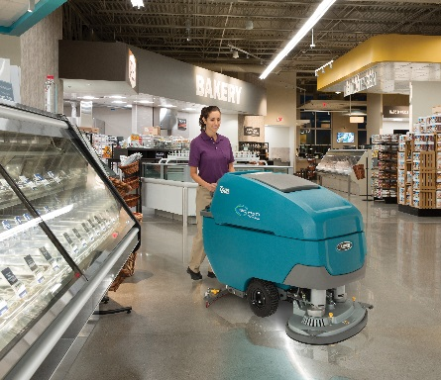
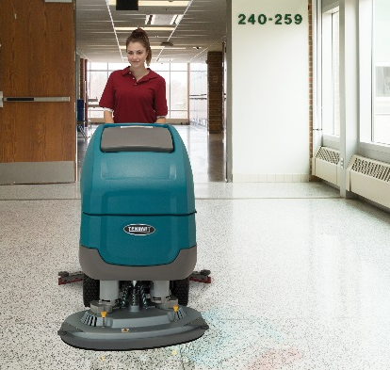
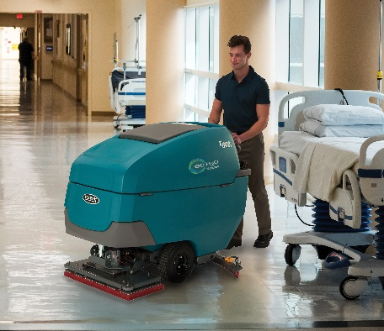
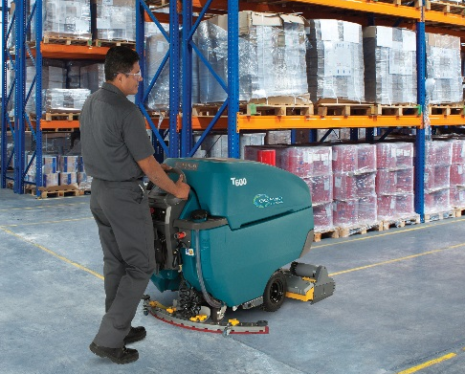
Markets and Applications
MARKET | APPLICATION | FLOOR TYPES
Retail | Aisle ways, check out counters, deli/cafeteria areas | VCT, polished stone, terrazzo, grouted ceramic and porcelain tile, polished concrete
Schools and Universities | Hallways, entryways, kitchens, classrooms, cafeterias | VCT, polished stone, terrazzo, grouted ceramic and porcelain tile
Healthcare | Hallways, entryways, patient rooms, surgical suites, cafeterias, labs, handicapped ramps | VCT, polished stone, terrazzo, resilient flooring, grouted ceramic and porcelain tile
Hospitality | Lobbies, hallways, elevator areas | VCT, polished stone, terrazzo, grouted ceramic and porcelain tile
Logistics/Manufacturing | Aisles, in-and-around equipment, employee cafeterias | Sealed concrete, polished concrete, coated floors
Confidential. Do not distribute.

Slide 4

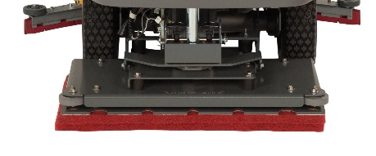

Product Offering – High-Level Overview
Scrub decks:
Battery Offering:
  Standard 240AH battery
  Optional 360AH wet battery
  Optional 210AH Thin Plate Pure Lead battery (sealed)
  No gel batteries – custom solution if desired
Cleaning Technology:
  ec-H2O NanoClean®
  Severe Environment™ Switch available only with ec-H2O NanoClean
  FaST® no longer available (January ‘18)
Dual Disk
28 in / 700 mm
32 in / 800 mm
36 in/ 900 mm
Dual Cylindrical
28 in / 700 mm
32 in/ 800 mm
Orbital
28 in / 700 mm
New
Confidential. Do not distribute.

Slide 5

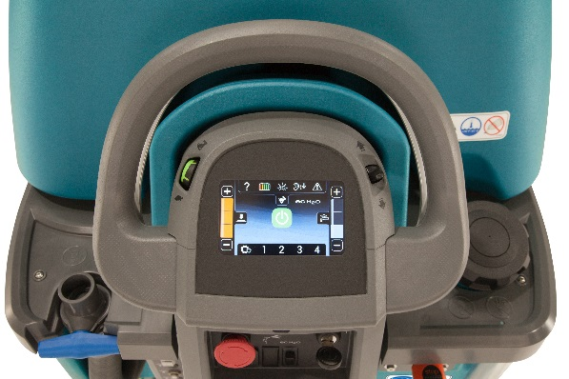
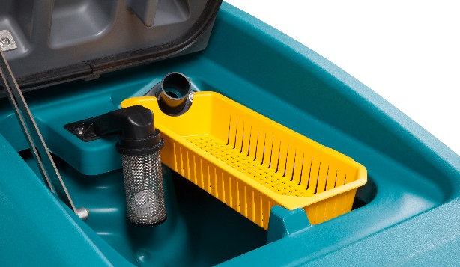
T600/T600e Key Highlights Summary
New Orbital Scrub Head
  Featuring one of the industry’s highest standard down pressures at 170lbs / 77kg, and one of the best isolator warranties – 3 years/2000 hours
Specific configurations tested to UL 583 standard for Type E or Type EE, noted with ETL mark
New controls and improved ergonomic bail design
  Variable bail & green speed control dial with rubber over mold
  Scrub, down-force and water controls centralized on dash panel.
New daily maintenance yellow touch points, including debris tray
Improved water pick-up – re-use of T500/e foot-activated squeegee
New battery compartment drain hose for controlled release of liquids
Confidential. Do not distribute.

Slide 6
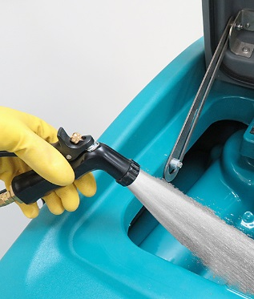
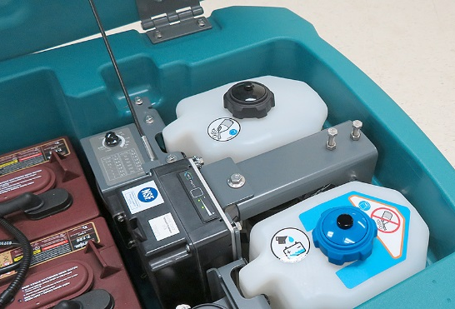
T600/T600e Key Highlights Summary Continued
New technologies for increased productivity and reduced costs
  ec-H2O NanoClean®
  Exclusive Smart-Fill™ Automatic Battery Watering System option (v 2.0)
  IRIS® Asset Manager option
  Heavy Duty Down Pressure Option (800 mm disk only)
T600 only new options:
  EE version
  Pro-Panel® LCD Touch Panel Controls option
  Severe Environment™ switch for tackling trouble spots more efficiently
  Tank Rinse-Out option – Spray nozzle with hose for remote water access
Confidential. Do not distribute.

Slide 7
T600/T600e Complete Standard Features Overview List
1-STEP™ Green Start Scrub Button
Tanks: 32gal/121 L Solution & 37 gal/141 L Recovery
Yellow Debris Tray
Black PVC Pinch Drain Hose w/ Cap
Solution Tank Sight Gauge Hose
Standard (6) 6V 240AH Batteries (Opt. 360 Wet)
On-Board Charger with Power Cord
Closed Machine Venting for Battery Charging
LEED Qualifying Noise Levels Standard
  T600/e – < 69.2 Cylindrical and 69.5 dBA Disk and Orbital
Console controlled water flow/down pressures
On Board Diagnostics
Variable Propel Speed Control Bail
Cast Aluminum Squeegee Frame & Scrub Decks (D/C)
11 Gauge Steel Scrub Deck (Orbital Only)
Down Pressures & Solution Flows
  T600 – 3 std. down pressure settings, 4 water flow settings
  T600e – 2 std. down pressure settings, 4 water flow settings
Rear Water Fill Port
Automatic when engaging propel variable bail:
  Water On / Off and Brush On / Off
  Brush Shutoff at 80% Discharge
Excellent Ergonomic Controls Design
Yellow Maintenance Touch Points
Battery Compartment Drain Hose
Emergency Stop Button
Key Switch for Safety
Rugged Polyethylene Rotomold Tank Construction
Black Non-Marking Polyurethane Tires
Insta-Fit™ No-Tool Pad Driver & Brush Attachment (Disk units)
No-Tool Squeegee Change
Breakaway Squeegee Design w/ Integrated P-Trap
Factory Set Squeegee Assembly for Maximum Recovery
  Can be adjusted if needed with tools
Linatex Squeegee Blades with Tool-less Replacement
Includes Standard Pad Drivers or Scrubbing Brushes
User-Serviceable Solution Filter Bowl
Free Floating Head Skirt – no adjustment required (disk)
Hour Meter
Operators Manual
Maintenance Wall Chart
Jacking Points/Shipping Tie Downs
Sealed Electrical Connectors in Key Areas
T600 ONLY STANDARD FEATURES
Pro-Membrane™ Control Panel w/ 3 Zone Settings™
Supervisor QA Controls™ settings (Lock Out Features)
Quiet-Mode™ (Lowers to 62.2 dBA; extends run-time)
Auto Fill
Integrated Heat Sink for Electronics Protection
Disk scrub motors 1.0 HP/.75 kW, & 300 RPM
Confidential. Do not distribute.

Slide 8
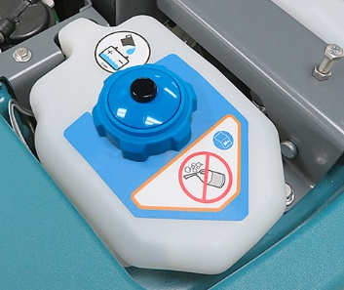
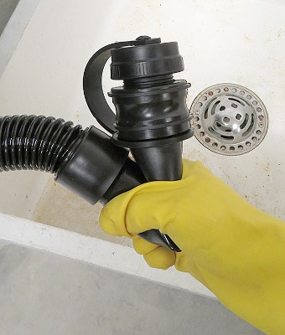
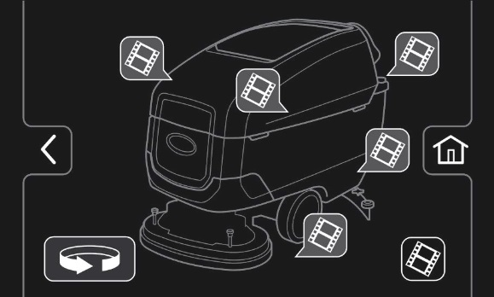
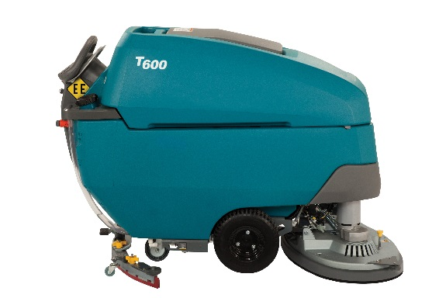
Machine Options
T600/T600e Options
  ec-H2O NanoClean®
  Smart-Fill™ On-Board Automatic Battery Watering (v. 2.0)
  Heavy Duty Down Pressure (800mm disk machines only)
  Specific configurations tested to UL 583 standard for Type E, noted with ETL mark
  IRIS Functionality with Battery Manager
  Polyurethane (oil resistant) Hose with Drain Flow Control Valve
  Parking Brake
  Trailer Transport Kit
T600 Only Options
  Specific configurations tested to UL 583 standard for Type EE, noted with ETL mark
  Severe Environment™ Switch (requires ec-H2O NanoClean)
  Pro-Panel® LCD Screen with Tutorial Videos
  Tank Rinse-Out – Spray Nozzle w/ Hose
Confidential. Do not distribute.

Slide 9
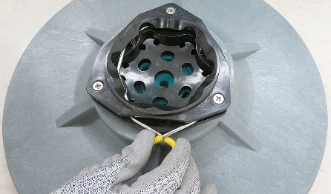
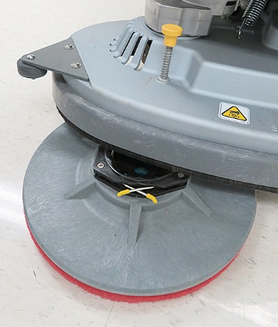
Scrub Head
3 Disk Scrub Head Options – Disk, Orbital and Cylindrical
  T600 3 down pressure settings
    Force varies from 50 lbs/23 kg to as high as 300 lbs/136 kg for optional Heavy Duty Down Pressure*
  T600e 2 down pressure settings
    Force varies from 50 lbs/23 kg to as high as 300 lbs/136 kg for optional Heavy Duty Down Pressure*
Gimbal mount heads, with Insta-Fit™ brush/pad drivers
  Advantages:
    Heads able to flex/conform to varying surface levels
    T600/e specifically designed Insta-Fit™ allows for even easy installation of pad driver and brushes
    Yellow plungers makes pad driver and brush removal quick and simple
    Floating Head Skirt
      Contains water from spinning brushes, especially in corners, helping reduce slip and falls.
    Integrated (yet easily replaceable) front-facing rubber guide wheels minimize wall damage
Insta-Fit™
*See pages 20 & 21 for complete machine specifications details
Confidential. Do not distribute.

Slide 10
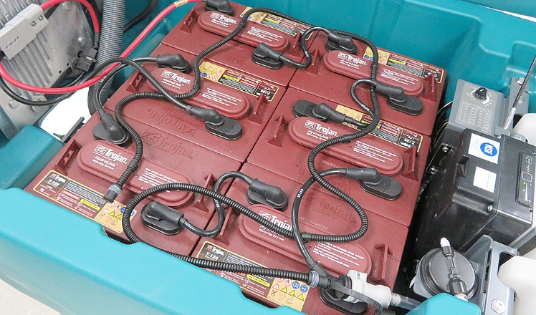
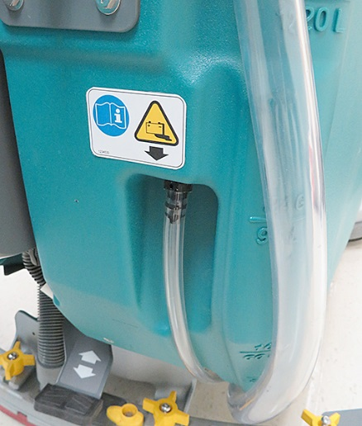
Battery Offering
Three battery offerings:
  Trojan 240AH WET Flooded – Standard
  Trojan 360AH WET Flooded – Option
  Thin Plate Pure Lead 186 AH (sealed) - Option
  No gel offering - specials/custom solution
      Smart-Fill™ Automatic Battery Watering
      Single Point Battery Watering
      Battery compartment drain hose
Confidential. Do not distribute.

Slide 11
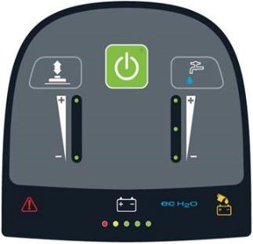
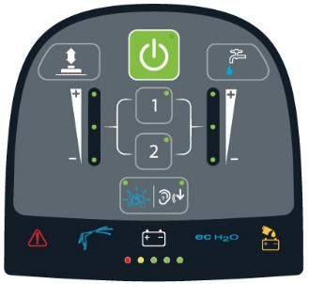
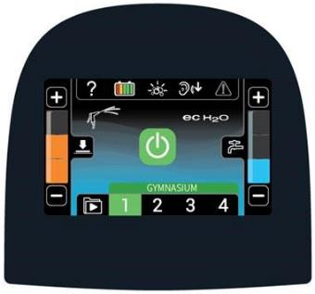
T600e and T600 Controls – Specific Differences
T600e
T600
  Electronic Controls
Base Membrane
Green 1-step scrub start button
4 Water flow settings
2 Down pressure settings
Supervisor limiting controls (new for this machine only)
Electronic Controls
Pro-Membrane™ (Standard)
Green 1-step scrub start button
4 Water flow settings
3 Down pressure settings
Quiet-Mode™ (62.2 dBA)
Supervisor lockout mode
Fault code display, BDI LEDs
3 Zone Settings™
Electronic Controls
Pro-Panel® LCD Touch Screen (Option)
Green 1-step scrub start button
4 water flow settings
3 Down pressure settings
Quiet-Mode™ (62.2 dBA)
Supervisor lockout mode
Fault code display w/ on-screen alert
4 Zone Settings™ w/ customizable labels
Operator ID log-in
28 languages available
On-demand training/maintenance videos
Control Panels
Confidential. Do not distribute.

Slide 12
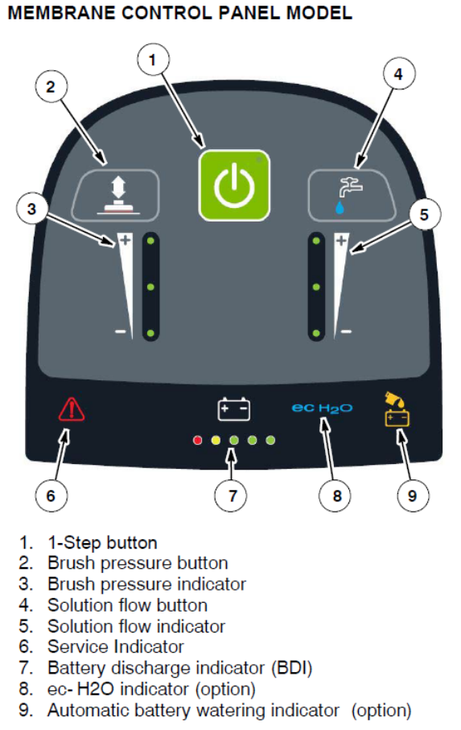
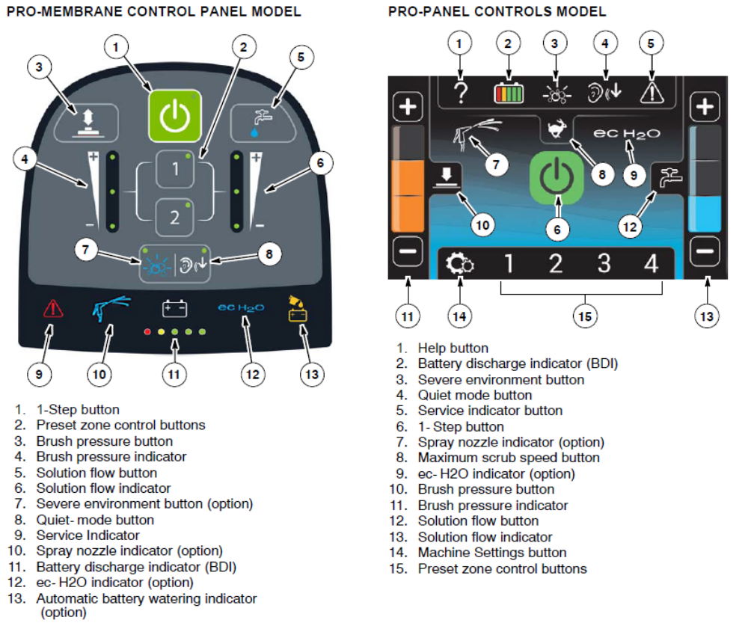
Control Panel Components
T600e
T600
Confidential. Do not distribute.

Slide 13
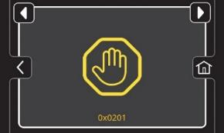
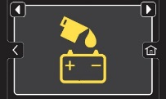
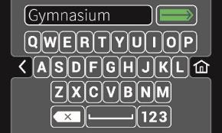
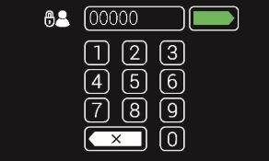
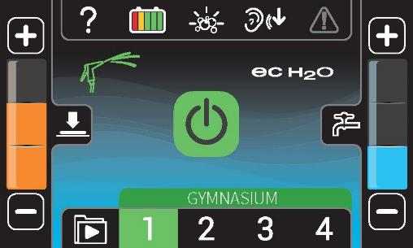
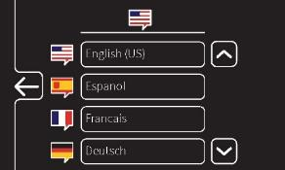
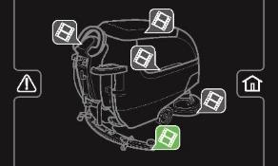
Pro-Panel® LCD Touch Screen – T600 Option Only
Benefits – Makes cleaning and training efficient and easy
Key differentiating features than standard Pro-Membrane
  Fault code display w/ on-screen alert
  4 Zone Settings™ w/ customizable labels
  Operator ID log-in
  28 languages available
  On-demand training/maintenance videos
Sales Tools Available: Pro-Panel sell sheet
Confidential. Do not distribute.

Slide 14
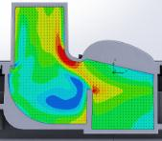
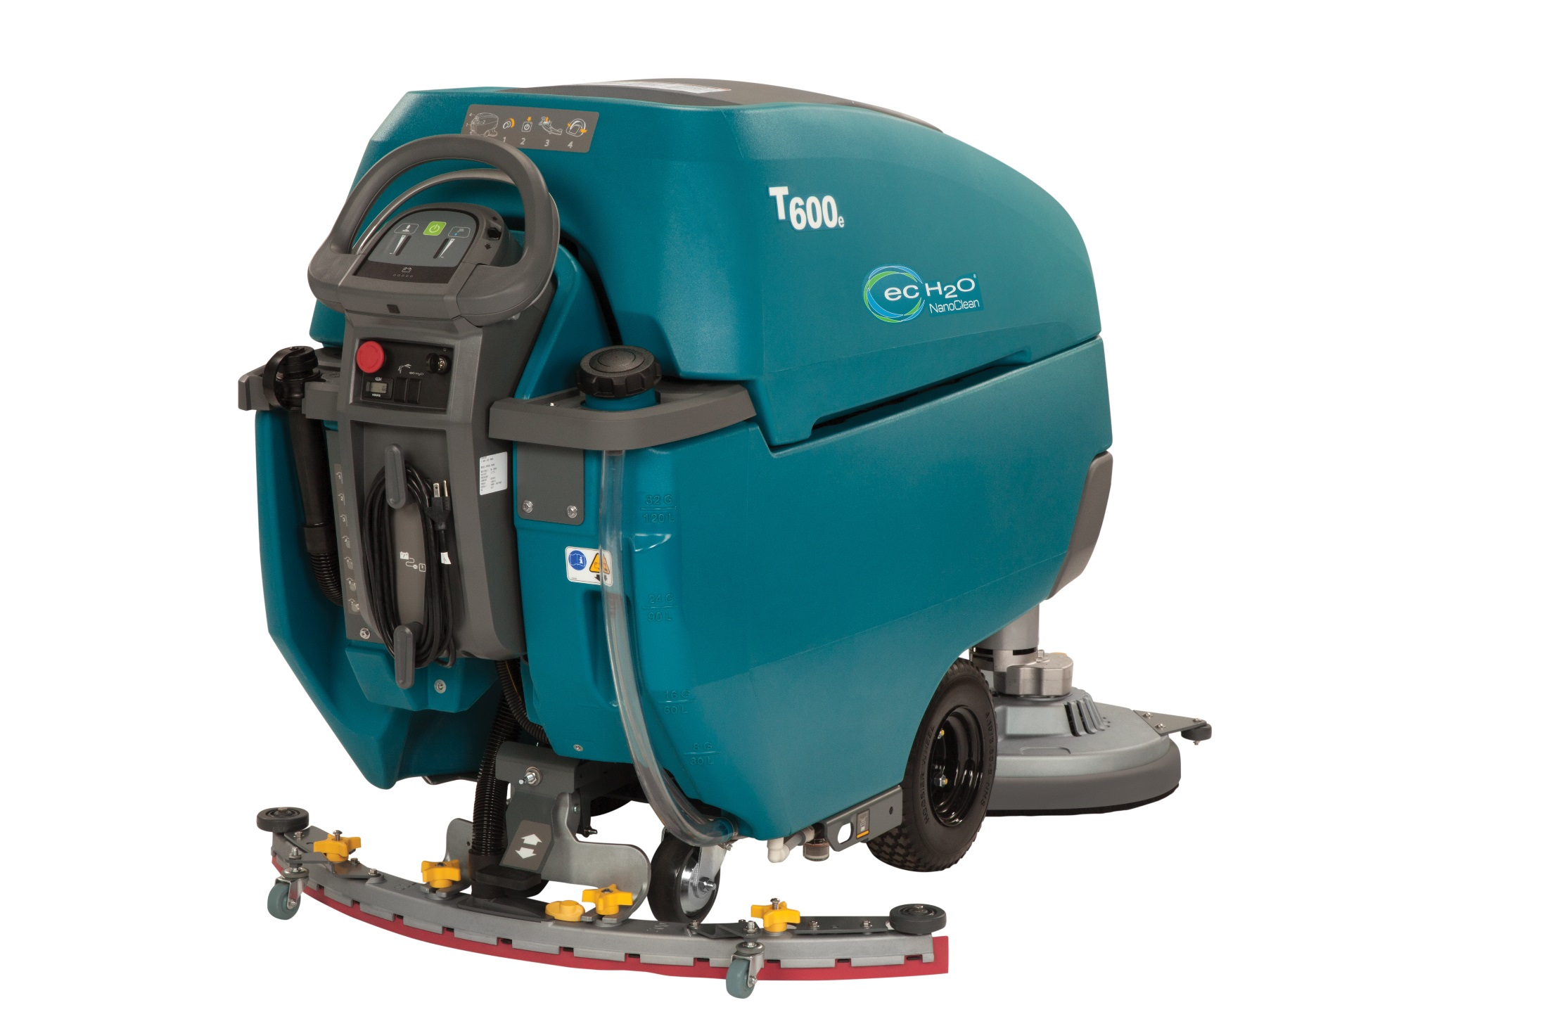
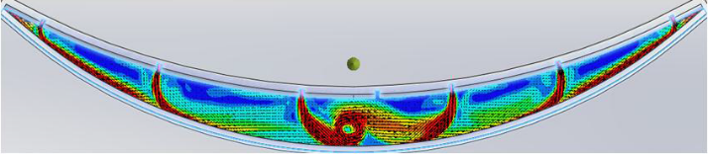
Re-Use of T500/e Squeegee Design
Easy to use – foot operated
2 second delay in vacuum fan shut off (T600 only)
Great water pick up, especially on grouted tile
Fluid Dynamic Analysis
No P-Trap loop
(Less water in hose)
(Shorter distance for air/water to travel)
Integrated P-Trap
(Minimizes water dripping from hose)
Tighter end seal
(More airtight)
Rubber Guide Wheels
(Protect facility and squeegee)
Releases blades
(Easy to replace/rotate blades)
Foot raises and lowers the squeegee with pedal
(No bending to raise and lower squeegee)
(No handle and cable system to loosen over time)
Fast moving air minimizes dead spots
Dead spots causes “splashes” as it moves over floor voids
Fluid Dynamic Analysis
Confidential. Do not distribute.

Slide 15

Squeegee Assemblies Overview
T500 squeegee assemblies reused-as-is
‘Numbering’ scheme on castings based on T-500 head size
Narrow aisle squeegee available for 900 and 800mm machines only
Head Size | Squeegee Size | Narrow Aisle Squeegee Size
900mm disk | 800 mm | 700 mm
800mm cylindrical | 700 mm | 650 mm
800mm disk | 700 mm | 650 mm
700mm cylindrical | 650 mm | NA
700mm disk | 650 mm | NA
700mm orbital | 650 mm | NA
Confidential. Do not distribute.

Slide 16

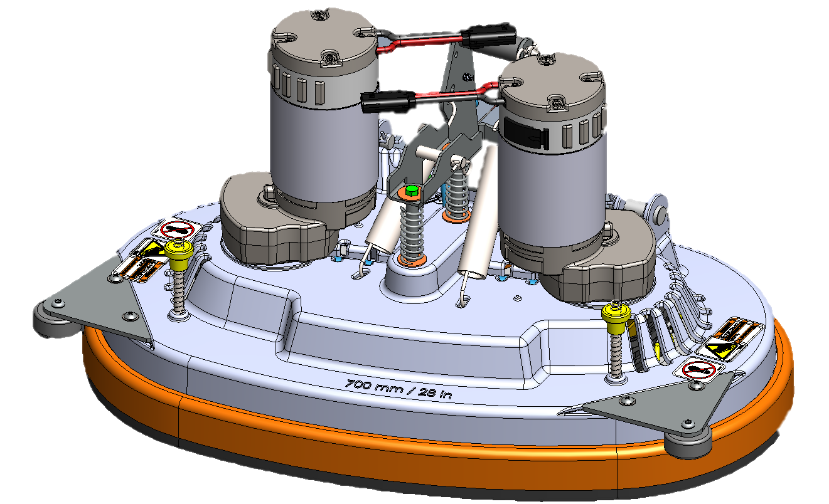
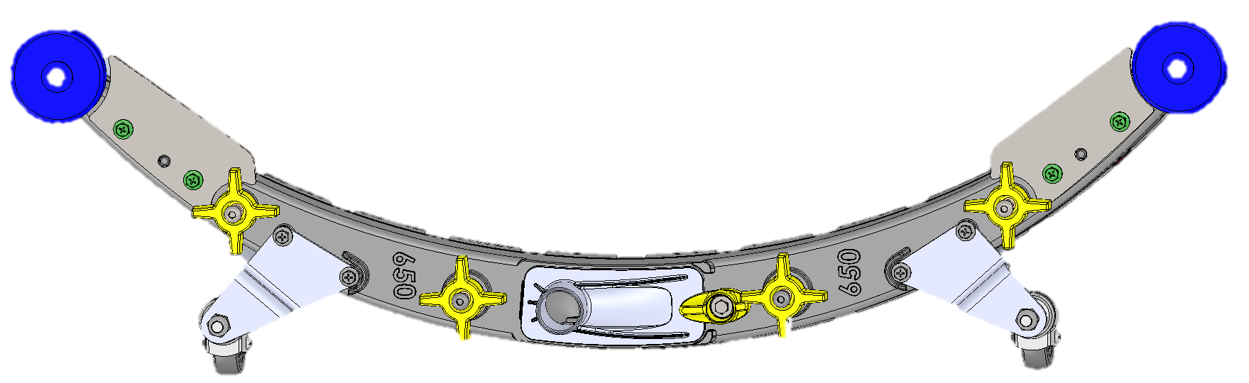
T600 Series Machine Head Size / Squeegee Combination
Machine Head Size
Standard Squeegee Size
Narrow Aisle Squeegee Size
700mm
Disk, Cylindrical or Orbital
650mm
No Narrow Isle Squeegee available in this combination
Please Note:
Head Casting Size will not match Squeegee Casting Size
Please Note: Squeegee Casting Size will not match Head Casting Size
Confidential. Do not distribute.
Notes:
.

Slide 17
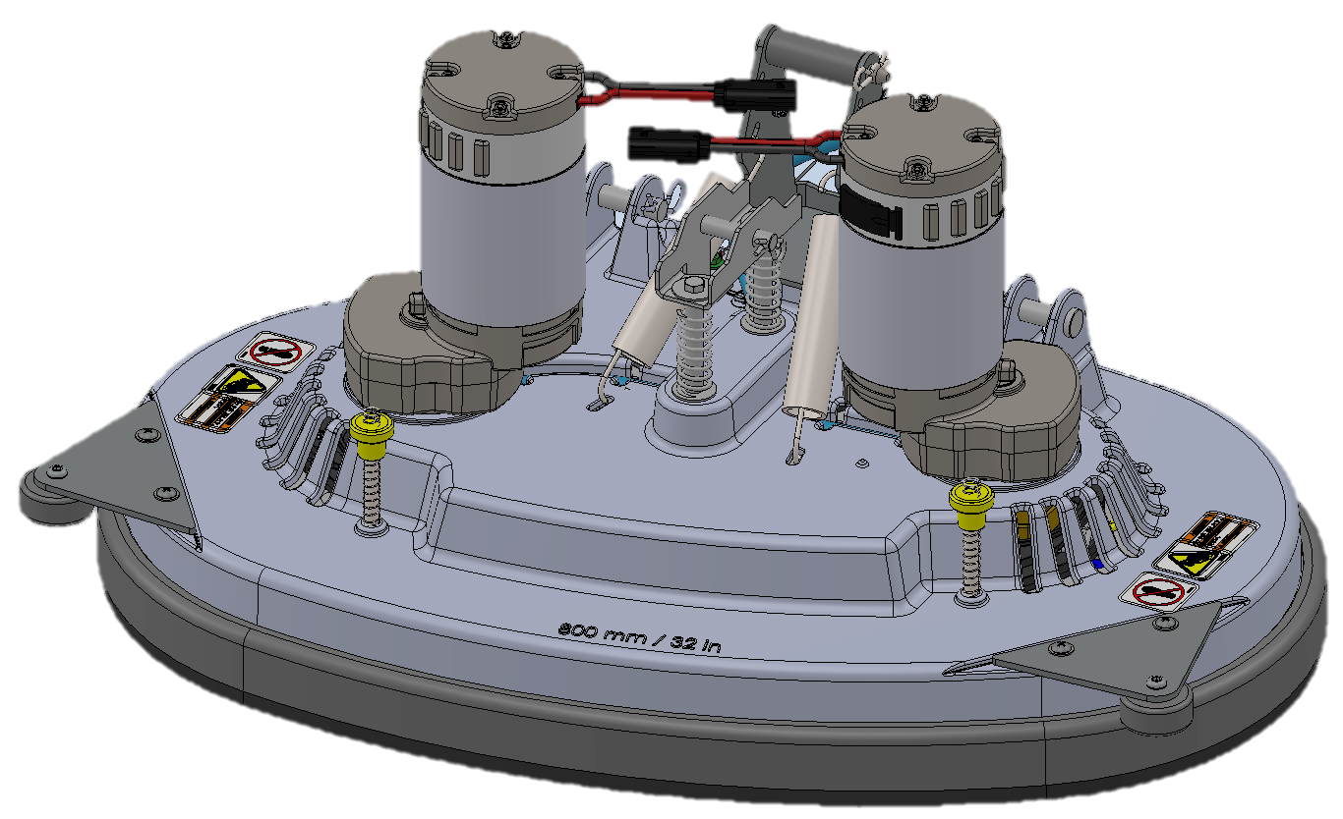
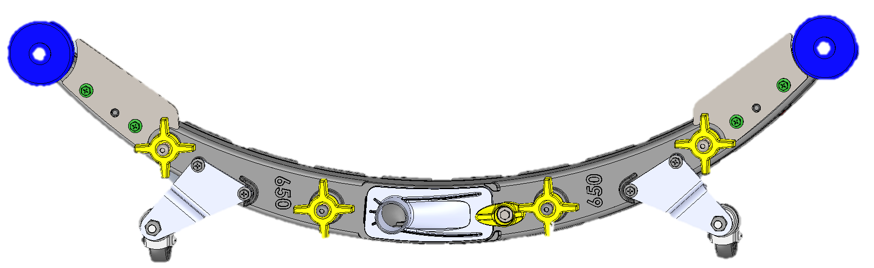
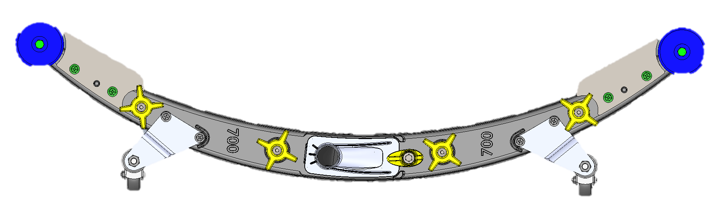
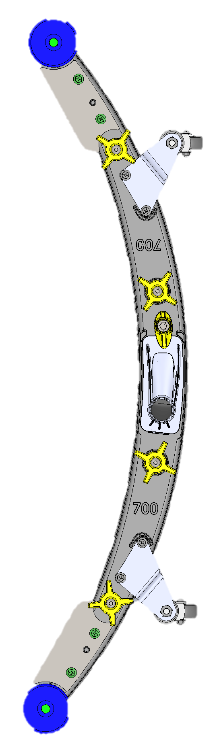
T600 Series Machine Head Size / Squeegee Combination
Machine Head Size
Standard Squeegee Size
Narrow Aisle Squeegee Size
800mm Disk
700mm
650mm
Please Note:
Head Casting Size will not match Squeegee Casting Size
Please Note: Squeegee Casting Size will not match Head Casting Size
Please Note: Squeegee Casting Size will not match Head Casting Size
Confidential. Do not distribute.
Notes:
.

Slide 18
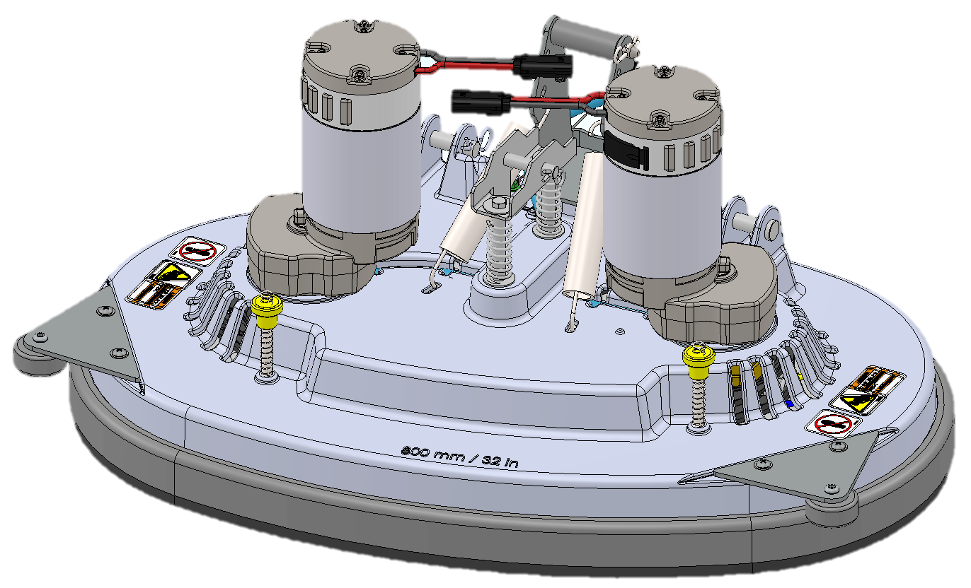
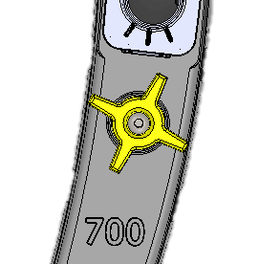
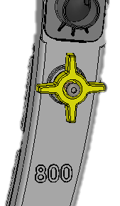
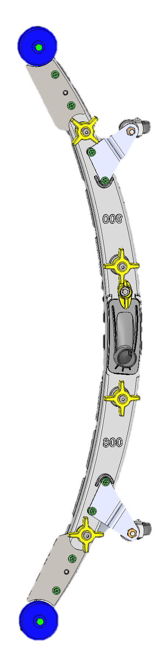
T600 Series Machine Head Size / Squeegee Combination
Machine Head Size
Standard Squeegee Size
Narrow Aisle Squeegee Size
900mm
Disk & Cylindrical
800mm
700mm
Please Note:
Head Casting Size will not match Squeegee Casting Size
Please Note: Squeegee Casting Size will not match Head Casting Size
Please Note: Squeegee Casting Size will not match Head Casting Size
Confidential. Do not distribute.
Notes:
.

Slide 19
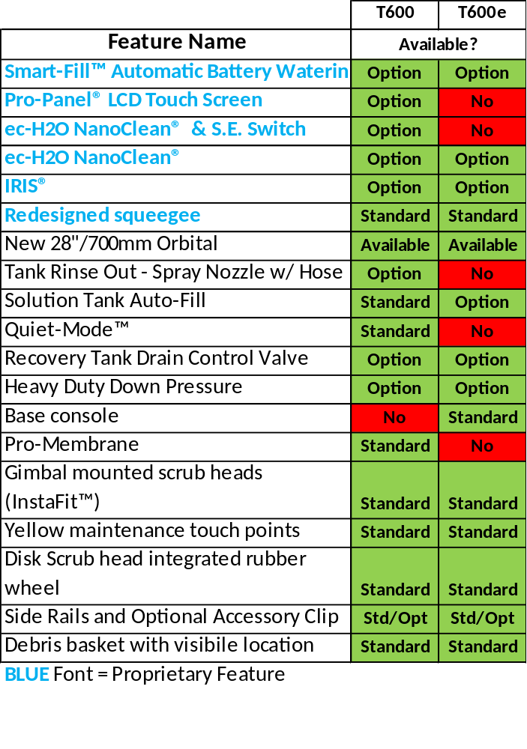
T600/T600e Differences & Feature Availability by Model
Key Differences Between T600 & T600e
Machine Intelligence
  T600 = Main scrub board controller (machine “brains”) with programmable controls; able to offer more features
  T600e = No scrub board controller. Relay-based controls.
Vac Fan
  T600 = 2 second programmed delay to vacuum up remaining water in the hose
  T600e = No programmed delay
Down Pressure Design (orbital head exception)*
  T600 = Current controlled – adjusts as pad wears
  T600e = Fixed positions
Supervisor Mode
  T600 = Yes – both Pro-Membrane and Pro-Panel LCD
  T600e = Unique, supervisor limiting capabilities
    *T600/T600e orbital down pressure is mechanical/position based
Confidential. Do not distribute.

Slide 20
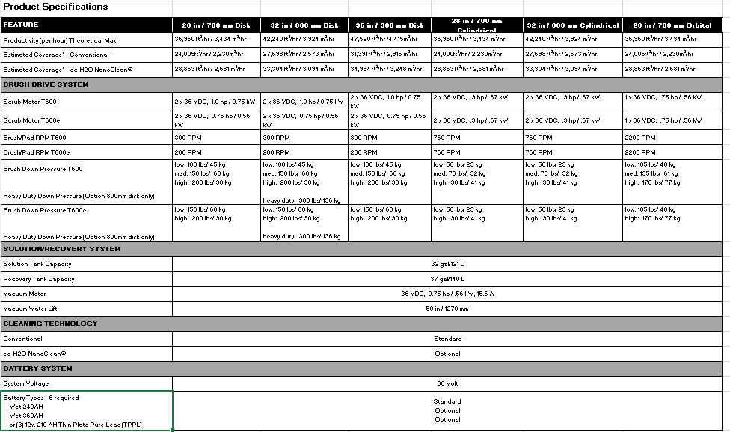
Product Specs – T600/T600e (1 of 2)
Confidential. Do not distribute.

Slide 21
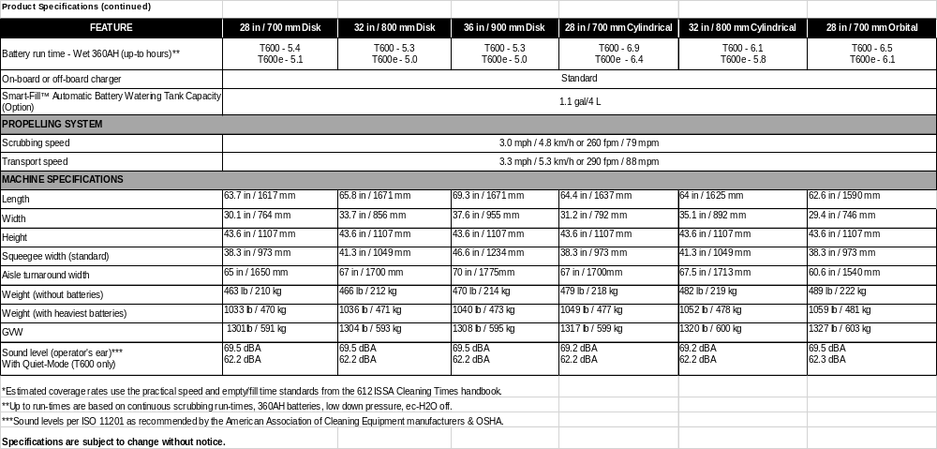
Product Specs – T600/T600e (2 of 2)
Confidential. Do not distribute.

Slide 22



Smart-Fill™ Automatic Battery Watering – Option T600/T600e
Benefits – Patent-Pending On-Board System
  Simple – On-board system means virtually worry-free battery maintenance
  Smart – Automatically fills batteries at the best time in the charging cycle
  Safe – Remove operator’s manual task of checking, opening, and filling batteries
Key Features
  Prevents operators from operating machine on dry batteries – shuts-down scrubbing functions after 10 hours of distilled water tank low level alert
  Control panel alert when 1.1 gal / 4 L on-board distilled water tank is low
      Operator will need to periodically fill distilled water tank – how often varies with usage
  Patent-pending system that monitors the best time to automatically fill batteries from on-board distilled water tank
Requires Trojan® brand batteries
Not available for customer install or field installation. Must be factory installed
Sales Tools Available: Smart-Fill™ sell sheet, “How it Works” video animation (Tennant public website)
Confidential. Do not distribute.

Slide 23




Severe Environment™ Switch (S.E. Switch) – T600 Only
Optional on T600 machines and requires configuration with ec-H2O NanoClean® technology
On-demand system to clean the rare soil that ec-H2O NanoClean is not designed to clean
Extends the use of detergent-free ec-H2O NanoClean
  Enables attaching ec-H2O NanoClean in facilities that were previously hesitant because of small percentage of facilities requiring a more aggressive detergent
  Example: Grocery store produce/deli area soils may only be 20% of store – utilize S.E. Switch on that small area and only use detergent where needed. Remaining 80% can still benefit from detergent-free ec-H2O NanoClean. Helps reduce the use and cost of detergents by not using them unnecessarily on entire store
Uses concentrated detergent – system includes detergent mixing ratio knob. Detergent mixed directly at scrub head, bypassing ec-H2O NanoClean system
Two modes:
  1) 30-sec spot cleaning – Pro-Panel shows 30 sec countdown
  2) Always on for larger spaces
Confidential. Do not distribute.

Slide 24


Orbital Option – T600 / T600e
Maximum versatility – not just a project machine
  Effective and efficient daily cleaning
  Chemical-free floor finish removal with high DP and SPP pads
  Edge and baseboard cleaning
  Effective cleaning of grout lines with green turf pad
700mm head size – 14” x 28” pads
10 isolators significantly minimizes vibrations
  Enhances operator comfort and machine durability
Consistent solution delivery to the floor
Consistent pad pressure on the floor
  Across the entire pad width due to balanced rectangular orbital design
Confidential. Do not distribute.

Slide 25

Orbital Option – T600 / T600e
Aggressive scrubbing
  One of the highest standard down pressures in the industry - up to 170 lbs / 77 kg
    T600 3 down pressures = 105, 135, 170 lbs (48, 61, 77 kg)
    T600e 2 down pressures = 105, 170 lbs (48, 77 kg)
    Means more effective & productive floor finish removal with each pass
  Oscillations:
    2,200 - ¼” (6.4 mm) per minute
T600/T600e
Confidential. Do not distribute.

Slide 26


Orbital Key Selling Points
  This size orbital is about productivity – with highest DP, it delivers:
    Facilities using 28in / 700mm orbital head need productivity
      It’s more important to quickly clean or remove more floor finish and high down pressure helps do that – Tennant has one of the highest down pressures!
    Most customers also use a floor machine for tight areas, like:
      Behind doorways, under drinking fountains, cut lines, etc.
    Corners are low traffic – need to do them less often
    Recessed head reduces potential for head and facility damage
      Some customers do not even allow their operators to get-up against walls
For more information on orbital scrubbing including processes and pads, please reference the Appendix
Confidential. Do not distribute.

Slide 27

Orbital Machines Summary Benefits
Great daily cleaning machine
Tackles a variety of specialty cleaning needs
Superior results on the floor
Saves money
  Multi-functional machine
  Minimize labor costs for floor finish removal
  Edge, chemical-free finish removal
  and baseboard cleaning
  Reduced need for floor stripping chemicals
Great all-purpose machine
Confidential. Do not distribute.

Slide 28

T600 UL 583 Type EE
UL 583: A set of design requirements for electric powered trucks with respect to a risk of fire, electric shock and explosion.
Type E: An electrically powered unit that has minimum acceptable safeguards against inherent fire and electrical shock hazards.
Type EE: Defined as a machine that is Type E and also has its electric motors and all other electric equipment completely enclosed.
Specific T600 configurations (not T600e) are tested to UL 583 standard for Type EE, noted with ETL mark
Confidential. Do not distribute.

Slide 29

T600 EE Configuration
T600 EE Configuration
  800mm disk scrub head only
  Conventional only
    No ec-H2O NanoClean®, SE, or spray nozzle with hose is offered
  Pro-Membrane console
  240 AH batteries (360 AH won’t fit)
  Off board or without charger only
  Standard polyurethane tires
  PVC pinch drain hose
Options
  Manual battery watering is available, but not Smart-Fill™
  Polyurethane (oil resistant) drain hose
  Parking Brake
  Pneumatic and foam tires
  Transport kit/accessory clip is available
Confidential. Do not distribute.

Slide 30







IRIS Asset Manager – T600/T600e Option
IRIS: Intelligent Remote Information System. Technology used to transmit data through the cellular network in order to provide customers with key performance indicators & data related to managing their fleet(s).
IRIS® technology placed on machine
Customer access to data & critical alerts through user friendly portal and/or email push reporting
1
2
3
IRIS PROVIDES:
Critical Alerts based on user preferences
Machine Usage (Hrs. per day, time of day)
Machine Location
ec-H2O™ usage (if applicable)
NEW: Battery charging metrics to identify operator charging behavior and help prolong battery life
  Alerts on opportunity charging, charger malfunction, charge incomplete, low Smart-Fill™ distilled water tank
  Report with % of days machine charged correctly
Service Reporting data (if applicable)
IRIS®/ SMART-FILL INTEGRATION WITH T600/T600e
ALERTS to fill Smart-Fill™ distilled water tank included in IRIS®
Confidential. Do not distribute.

Slide 31


Selling Smart-Fill and IRIS Asset Manager Together
‘ARE YOUR BATTERY REPLACEMENT COSTS HIGH?’
If so, do they know why?
Battery Charging Issues?
If both are issues…
Battery Watering Issues?
IRIS®
See battery charging behavior and machine usage by time of day
Critical alerts: no charge, opportunity charging, add water to Smart-Fill tank
Smart-Fill™ Automatic Battery Watering
Smart-Fill automatically waters batteries at optimal time
Prevents machine from being operated on dry batteries
THE ULTIMATE LINE OF DEFENSE FOR MAXIMIZING BATTERY PERFORMANCE:
Although it’s difficult to ultimately know the exact reasons why a customers’ battery replacement may be high, it is well known that both dry batteries and improper charging can contribute to lower serviceable life more quickly
Smart-Fill combined with IRIS® integration allows customers to receive timely alerts to properly manage their total battery maintenance program – ensuring the distilled water tank is filled and proper charging takes place
Confidential. Do not distribute.

Slide 32




T600/T600e Stone Care, Brushes, Pads, Squeegees
Stone Care Solutions – Diamabrush™
  A chemical-free polishing system that is used with standard cleaning equipment and water that generates no dust
  Full range of tools can be used on Concrete or Terrazzo
  25 grit concrete prep tools all the way to 1,000 (red) and 2,000 (tan) grit tools –
  Replacement tools are available as well
  Routinely clean with the maintenance tools to not only maintain but continually improve the floor’s appearance
  Full restorative capabilities
Brushes
  14”,16” and 18” disks & 28” and 32” cylindrical
  Available in: Nylon, Polypropylene, H.D. Polypropylene, Abrasive and Super Abrasive
  Insta-Fit™ Adapter – The adapter guides the brush or pad driver onto the machine easily, without requiring the operator to line up the brush or pad drive to the hub.
  Brush Wear Indicator - TennantTrue® disk brushes include a brush wear indicator that takes the guesswork out of brush replacement to ensure optimal cleaning performance.
Pads
  14” ,16” and 18” disks & 14” x 28” orbital
  White Polishing, Red Cleaning, Blue Scrubbing, Brown Stripping (disk only), Black Hi-Pro Stripping, Maroon Surface Prep, Purple Diamond Polishing (disk only), Sienna Diamond Polishing (disk only), & Green Turf Pad and Melamine pad (orbital only)
Squeegees - Linatex®, Polyurethane, and Gum Rubber
Confidential. Do not distribute.

Slide 33











T600/T600e Sales Tools and Locations
T600/e Overview
Video
T600/e Demo
Video
T600/e Smart-Fill™
“How-it-Works” Animation
T600
Brochures
T600 Pro-Panel™
Flyer
T600/e Smart-Fill™ Flyer
T600/e/EE
P&C Guide
Full Sales Tools List:
PAS Guide (this PowerPoint file)
Spec Sheet
FAQ
Customer Presentation
Salient Characteristics
Deep Dive Product Comparison
Smart-Fill™ Animation
LCD Pro-Panel Brochure
T600/e How to Demo
Video
T600/e How to Operate Video
T600 EE
Brochure
T600e
Brochure
Sales Tools Locations:
Sales Tools Hub – folder on your desktop
My Account– log-in through tennantco.com
Tennantco.com Public Website (videos & photos)
Confidential. Do not distribute.

Slide 34
Addressing Key Customer Needs
Environmental Health and Safety
Cost to Clean
Enhancing Facility Image
Environmental Health & Safety
  Slip & Falls
  Chemical Handling & Storage
  Improper equipment operation
  Ergonomics
Enhance Facility Image
  Cleaning equipment performance
  Proper use of equipment
  Following proper cleaning processes
Cost-to-Clean
Chemical & Water Costs
Labor & Training Costs
Safety Costs
Service Costs
Confidential. Do not distribute.

Slide 35



Cost to Clean
ec-H2O NanoClean® reduces need for detergents and saves water
Pro-Panel® LCD touchscreen minimizes training
Zone Settings™ with customizable labels simplifies cleaning processes
Yellow touch points simplifies routine maintenance
Accessory clip expedites secondary cleaning tasks
T600e simple-to-operate and rugged
Confidential. Do not distribute.

Slide 36






Enhancing Facility Image
More applications
More water & down pressure settings
Full stone care maintenance
Tank rinse-out (spray nozzle w/ hose)
T600 Zone Settings™ eliminate guesswork and rework
28in (700mm)
32in (800mm)
36in (900mm)
Dual Disk
28in (700mm)
32in (800mm)
Dual Cylindrical
28in (700mm)
Orbital
Pro-Membrane™
Pro-Panel™
Confidential. Do not distribute.

Slide 37

Environmental Health and Safety
ec-H2O NanoClean® technology is NFSI certified
Redesigned squeegee with yellow touch points, p-trap
Tutorial videos may help reduce slip & falls or other worker compensation claims
Ergonomic Design
  Foot activated squeegee minimizes bending
  Wider handle improves machine operation
  Speed control and propel direction switch within easy reach
Confidential. Do not distribute.

Slide 38

Addressing Customer Needs
Confidential. Do not distribute.

Slide 39

T600 / T600e Summary
Taking cleaning to the next level
  Innovation in machine controls
  Enhanced detergent-free cleaning
Additional revenue per unit opportunities
  Tennant technologies
Expanding into new markets
  T600e – simple, reliable and more affordable
Improved cleaning cost for our customers
  Process improvements
  Lower acquisition costs
Confidential. Do not distribute.

Slide 40
Appendix

Slide 41

Not All Orbital Machines Are Alike
The orbital environment can be harsh unless you design for it
T600 and T600e orbital design insures machine durability, operator comfort and superior performance on the floor
10 isolators minimize vibration enhancing operator comfort and machine durability
Rubber guide wheels on the corner prevent facility damage
No water entrapment in bearings mitigates corrosion
Through pad solution delivery means superior cleaning performance on the floor
Rectangular head allows for edge and baseboard cleaning
Confidential. Do not distribute.
Notes:
KEY POINTS ON WHAT IS BETTER –
Isolators and bearings are key pain points
ISOLATORS – important because of operator fatigue (itchy hands) – “VIBRATIONAL INDUCED HYSTIMINE” also can literally “shake machine apart”
BEARINGS – WATER GETTING OUT – tried to make sure that water wouldn’t get in, but if it does, it can get out.
RECTANGULAR HEAD – Allows for cut lines, getting into corners, along edges
VIDEO ANIMATION - Mike

Slide 42

Baseboard Cleaning
  Orbital machine provides a quick and easy way to clean baseboards
  Process:
    Apply red backer pad to the machine
    Using the hook and loop strips, attach a wet cleaning pad to the red backer pad.
    Make sure to off-set the wet cleaning pad
    as shown in the picture to the right.
    Pad type dependent on baseboard
    material and soil load
    Scrub with the water turned on
Confidential. Do not distribute.

Slide 43





Orbital Pad Types – The darker the color, the more aggressive
Orbital Pad Backer w/ Hook and Loop Tape
The pad backer allows for compression of the working pad to the floor for optimal scrubbing or removal of floor finish. Uniquely designed to prevent the working pad from falling off during use or transportation.
3M™ White Polishing Pad
Use the white polishing pad for light cleaning to help remove soil and soft scuff marks with minimal dulling of finish
3M™ Red Cleaning Pad
Red pads are designed for everyday cleaning and light scrubbing to remove light soil, scuff marks and black heels
3M™ Blue Scrubbing Pad
The blue pad is used in heavy-duty scrubbing. It removes dirt, spills, and scuff while leaving a clean, prepared surface.
3M™ Black Hi-Pro Stripping Pad
The black Hi-Pro stripping pad’s unique open construction resists loading and clogging. It is to be used fast removal of finish and consistent stripping
Confidential. Do not distribute.

Slide 44



Orbital Pad Types – Specialty Pads
Melamine Pad
The Melamine pad is made of an open-cell polymeric foam that products outstanding results when cleaning VCT, Terrazzo, Tile, Concrete and Epoxy floors. Effective at removing black marks and restores tile and grout without using harsh chemicals. This pad is an excellent choice for Teknoflor® and Marmoleum® floors.
Green Turf Pad
The green turf pad is designed to clean grouted tile floors, such as restrooms, and is capable of cleaning deep into grout lines. It is also effective on terrazzo, non-slip surfaces, concrete, Teknoflor®, Marmoleum® and other uneven floors.
3M™ Surface Prep Pad
The surface prep pad is designed for heavy-duty scrubbing for floor finish removal prior to recoating. It prepares wood, vinyl tile, sheet vinyl, marble, terrazzo and concrete floors for finish applications.
Confidential. Do not distribute.

Slide 45


Orbital With Green Turf Pad
Excellent cleaner of raised, textured and grouted surfaces
Pad compresses into grout lines and/or textured flooring
Heavy duty turf material provides exceptional cleaning performance
Ideal for a variety of floors, including:
  Deep grouted tile
  Concrete
  Pirelli flooring
  And so on…
Grouted Tile
Textured Floor
Cleaned with Tennant orbital machine with green turf pad
Confidential. Do not distribute.

Slide 46

Orbital – Melamine Pad
Works without detergents or harsh chemicals
Remove marks and stains from most porous surfaces
They may be safely used to pull out dirt from all hard surfaces
Effective on:
  Vinyl
  Marmoleum / Teknoflor® flooring
  (No wax vinyl flooring)
  Porcelain
  Terrazzo
  Concrete
  Ceramic tiles
After
Before
Confidential. Do not distribute.

Slide 47

Surface Prep Pad – Floor finish removal
Remove floor finish
  Re-coat without the cost and time of total floor finish removal
Finish removal without expensive stripping chemicals
  No chemicals and reduced labor time = lower costs
  Quicker facility accessibility
Safe environment
  Stripping chemicals can create slippery floor
  conditions increasing chance of slip and fall accidents
  Reduction in potentially harmful VOC’s
  May require personal protective equipment
Environmentally friendly
  No introduction of chemicals into the waste stream
Example: Surface Prep Pad Results
Confidential. Do not distribute.

Slide 48



Traditional Floor Stripping Vs. Floor Finish Removal
Traditional Floor Stripping
  Dry mop or sweep floors prior to stripping process
  Flood floor with stripping chemical - Wait a minimum of 10 minutes
  Double scrub twice with scrubber before removing slurry on third pass or…
  … Multiple passes with floor machine and recover slurry with wet dry vac
  Mop or scrub with neutralizer or water to negate possible chemical reaction
  Once floor is dry, apply 4 to 8 layers of floor finish – limited to four layers per day
Process Involves
  Harsh chemicals to emulsify floor finish
  Slippery stripping chemicals can increase risk of slip and falls
  May require personal protective gear (boots, safety glasses, gloves, etc.)
  Slurry can splash on baseboards causing a secondary cleaning process
  Floor is closed off for an extended period of time
  Stripping chemicals and VOC’s can be harmful to the environment
*Source: The Official ISSA 612 Cleaning Times & Tasks
Confidential. Do not distribute.

Slide 49




Chemical-Free Floor Finish Removal Process
  Process
  Dry mop or sweep floors prior to scrubbing
  Use hook and loop strips on red backer pad to attach Surface Prep Pad
  Attach red backer pad with the Surface Prep pad to machine
  Scrub floor with water until floor has a dull appearance
  Scrub floor to remove any remaining dust on the floor. Allow floor to dry.
  Dry mop floor with microfiber cloth or 3M Easy Trap
  Apply floor finish as directed by finish manufacturer
  Benefits
  No use of potentially caustic, slippery stripping chemicals
  Regain floor shine quickly
  Floor closed off for a short period of time
  Postpone costly and timely stripping process
Red backer pad with hook and loop strips
Surface Preparation Pad
Confidential. Do not distribute.

Slide 50





Tennant Walk-Behind Battery Scrubber Context
 | T500 / T500e | 5700/5680 | T600/T600e
Scrub Path | Disk: 26in/650mm, 28in/700mm, 32in/800mm Cylindrical: 28in/700mm Orbital: 28in/700mm | Disk/Cylindrical: 28in/700mm, 32in/800mm, 36in/900mm | Disk: 28in/700mm, 32in/800mm, 36in/900mm Cylindrical: 28in/700mm & 32in/800mm Orbital: 28in/700mm
Tank Size | Solution: 22.5g / 85 L Recovery: 27 g / 102 L | Solution: 30 g / 114 L Recovery: 40 g / 151 L | Solution: 32 g / 121 L Recovery: 37 g / 141 L
Productivity Lowest to Highest | ec-H2O NanoClean 23,124 ft² / 2,148 m² – 27,323 ft² / 2,538 m² | ec-H2O NanoClean 23,400 ft² / 2,175 m² – 30,600 ft² / 2,845 m² | ec-H2O NanoClean 28,863 ft² / 2,681 m² – 34,964 ft² / 3,248 m²
Tool Attachment | Dual Disk: Gimbal Mount | Dual Disk: Gimbal Mount | Dual Disk: Gimbal Mount
Confidential. Do not distribute.

Slide 51
Changes from 5700/5680 to T600/T600e
List of T600/T600e Updates from 5700/5680
  Bigger tank sizes – Solution = 32g / 121 L Recovery = 27g / 140 L
  New Scrub Head
        New Orbital – 28in/700mm
  Controls – New ergonomic controls – Speed dial and propel direction switch in easy reach. All down pressures right on the console (vs. strap on 5680)
    T600e = New base membrane control panel with electronic water flow control
    T600 = Pro-Membrane™ controls standard. Optional Pro-Panel™ LCD touch screen
  Change of the solution/recovery tank orientation
    Solution tank is on the bottom/recovery tank is on the top
  T500 squeegee with improved water pick-up, improved squeegee blade replace/rotate, and foot activated with integrated P-trap with ¼ turn knob
  T600/T600e = on board charger standard, off board optional
  Eliminated gel batteries, standard 240AH LA with optional 360 AH LA or optional sealed 186 AH Thin Plate Pure Lead batteries
  New yellow touch points
  T600/e = Standard debris basket with easy accessibility
  T600/e auto fill = Standard on T600, option on T600e
  T600 Only = New Standard Quiet-Mode™ lowers sound level on the fly – 62.2 dBA
  New battery compartment drain hose
  Removed FaST Technology, Power wand, dual vac motors, squeegee lift in reverse (5700XP)
Confidential. Do not distribute.

