Slide 1
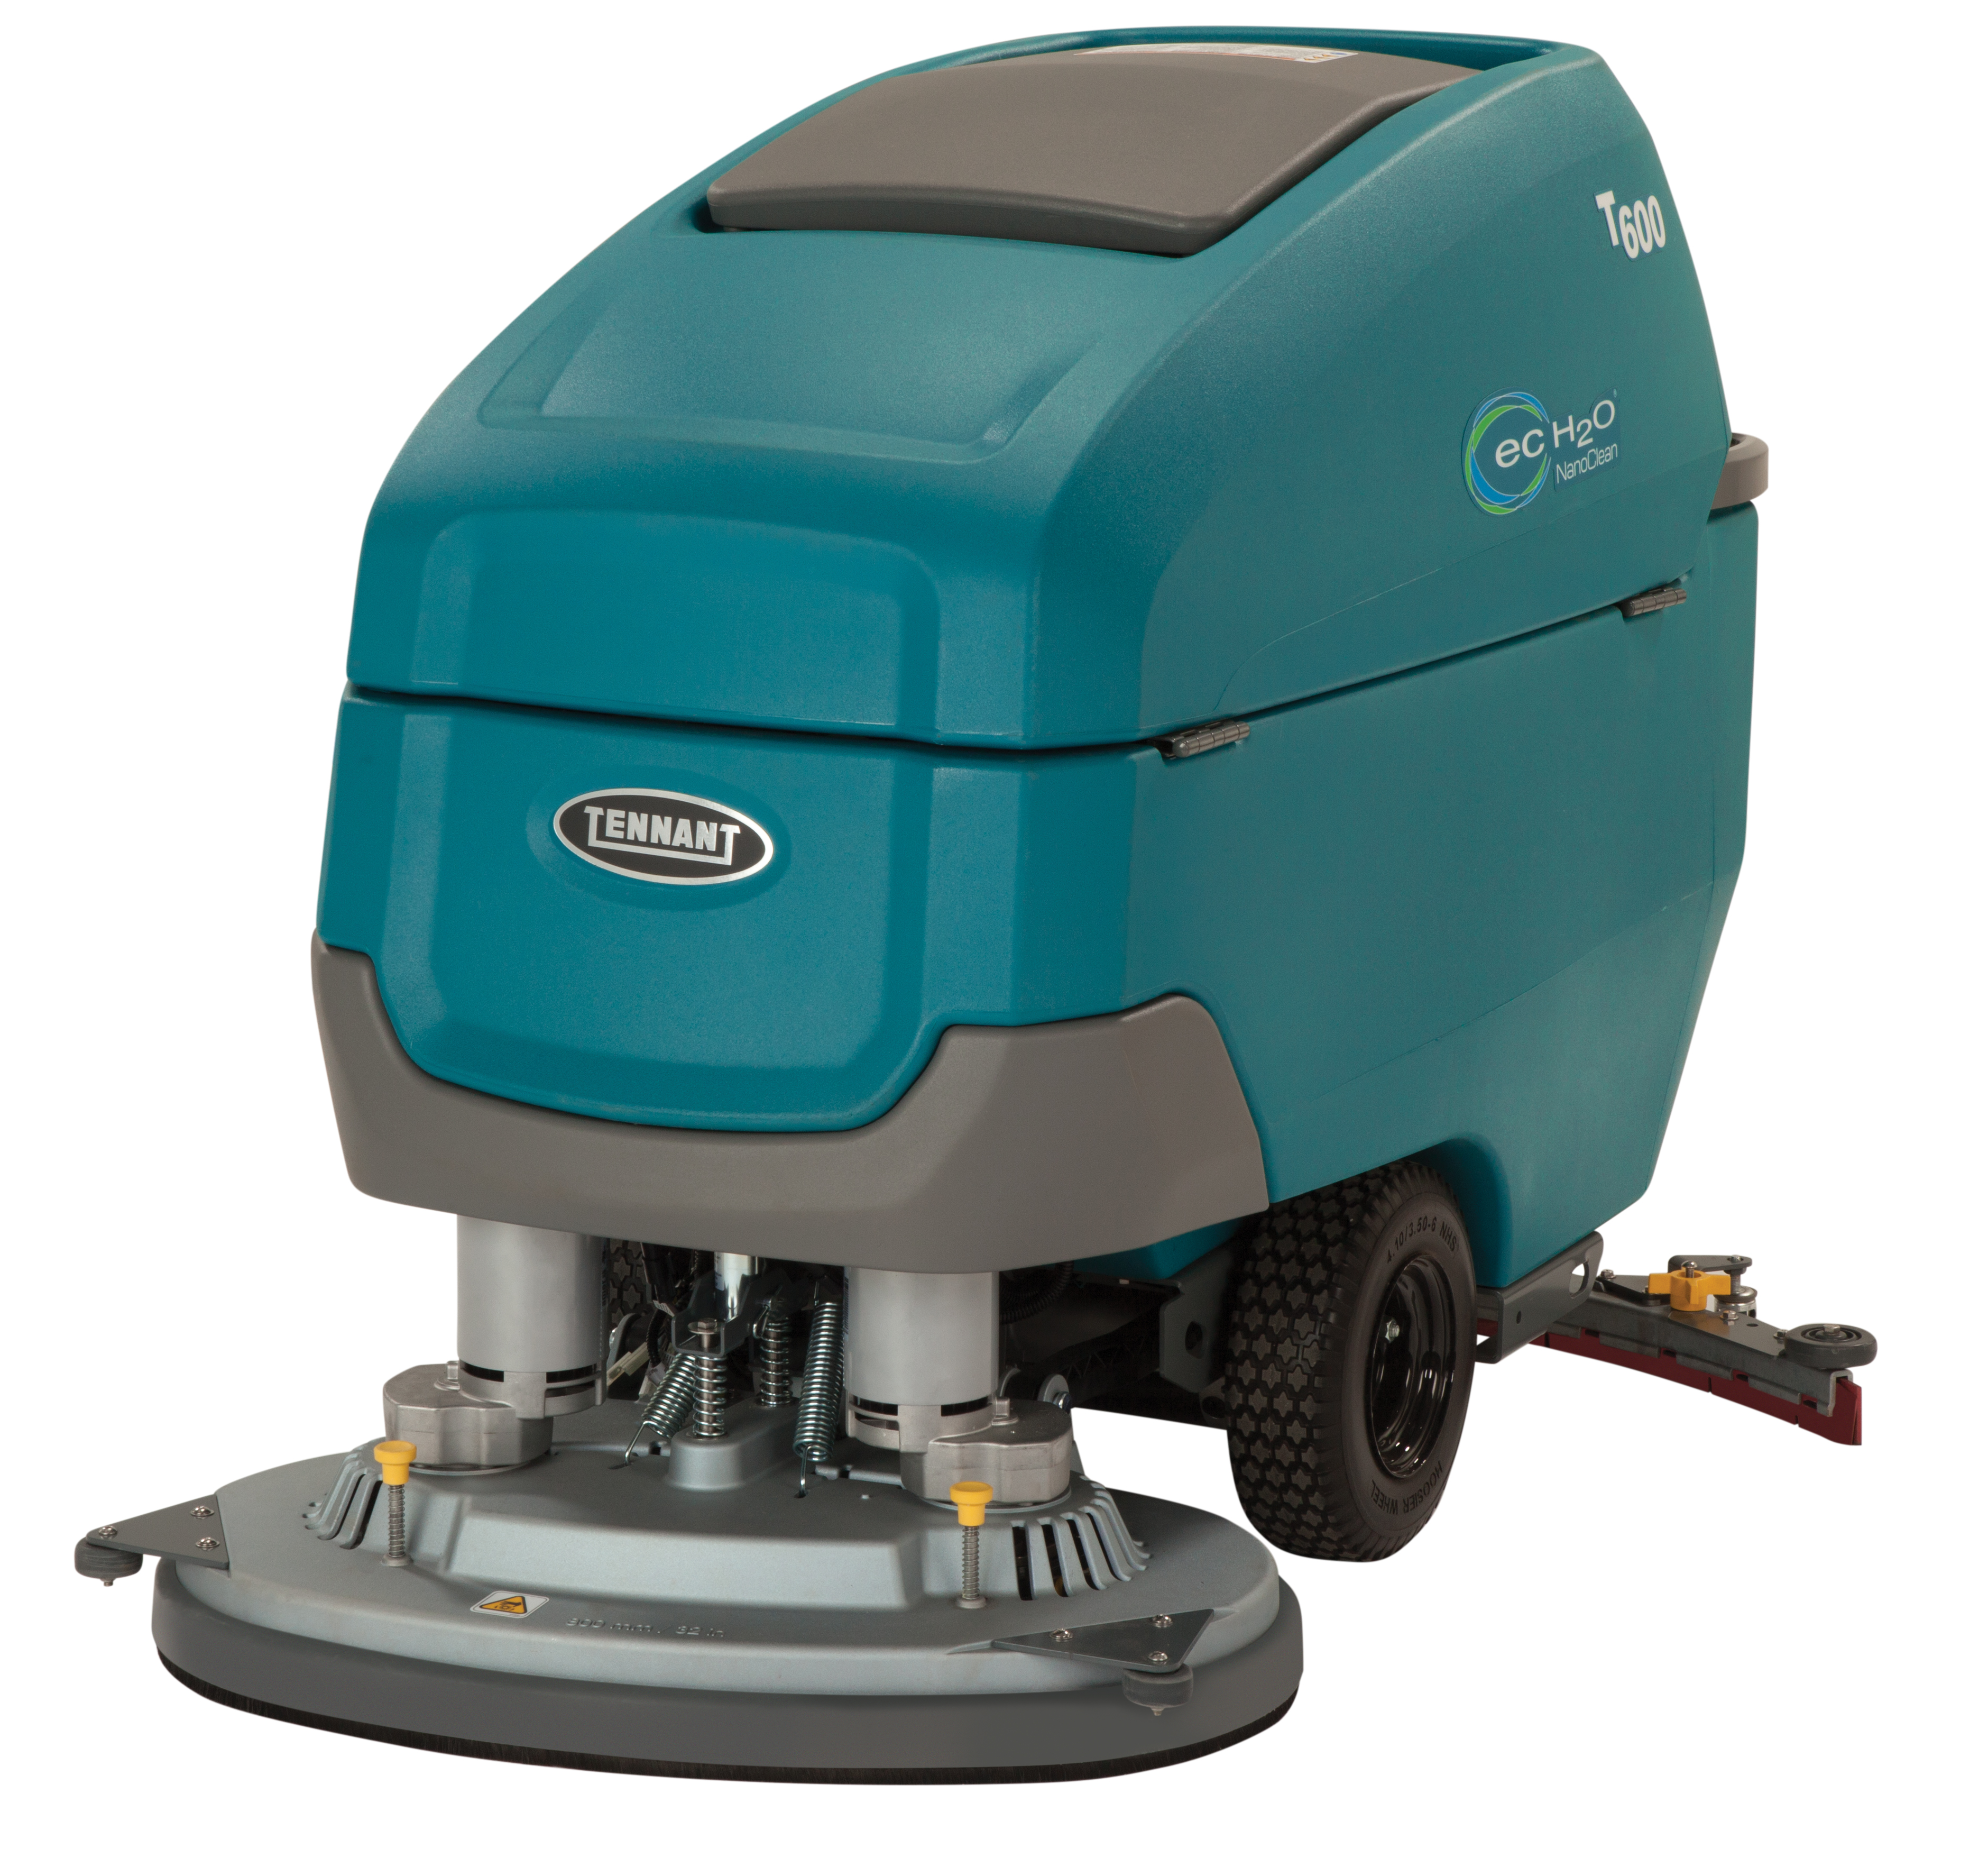
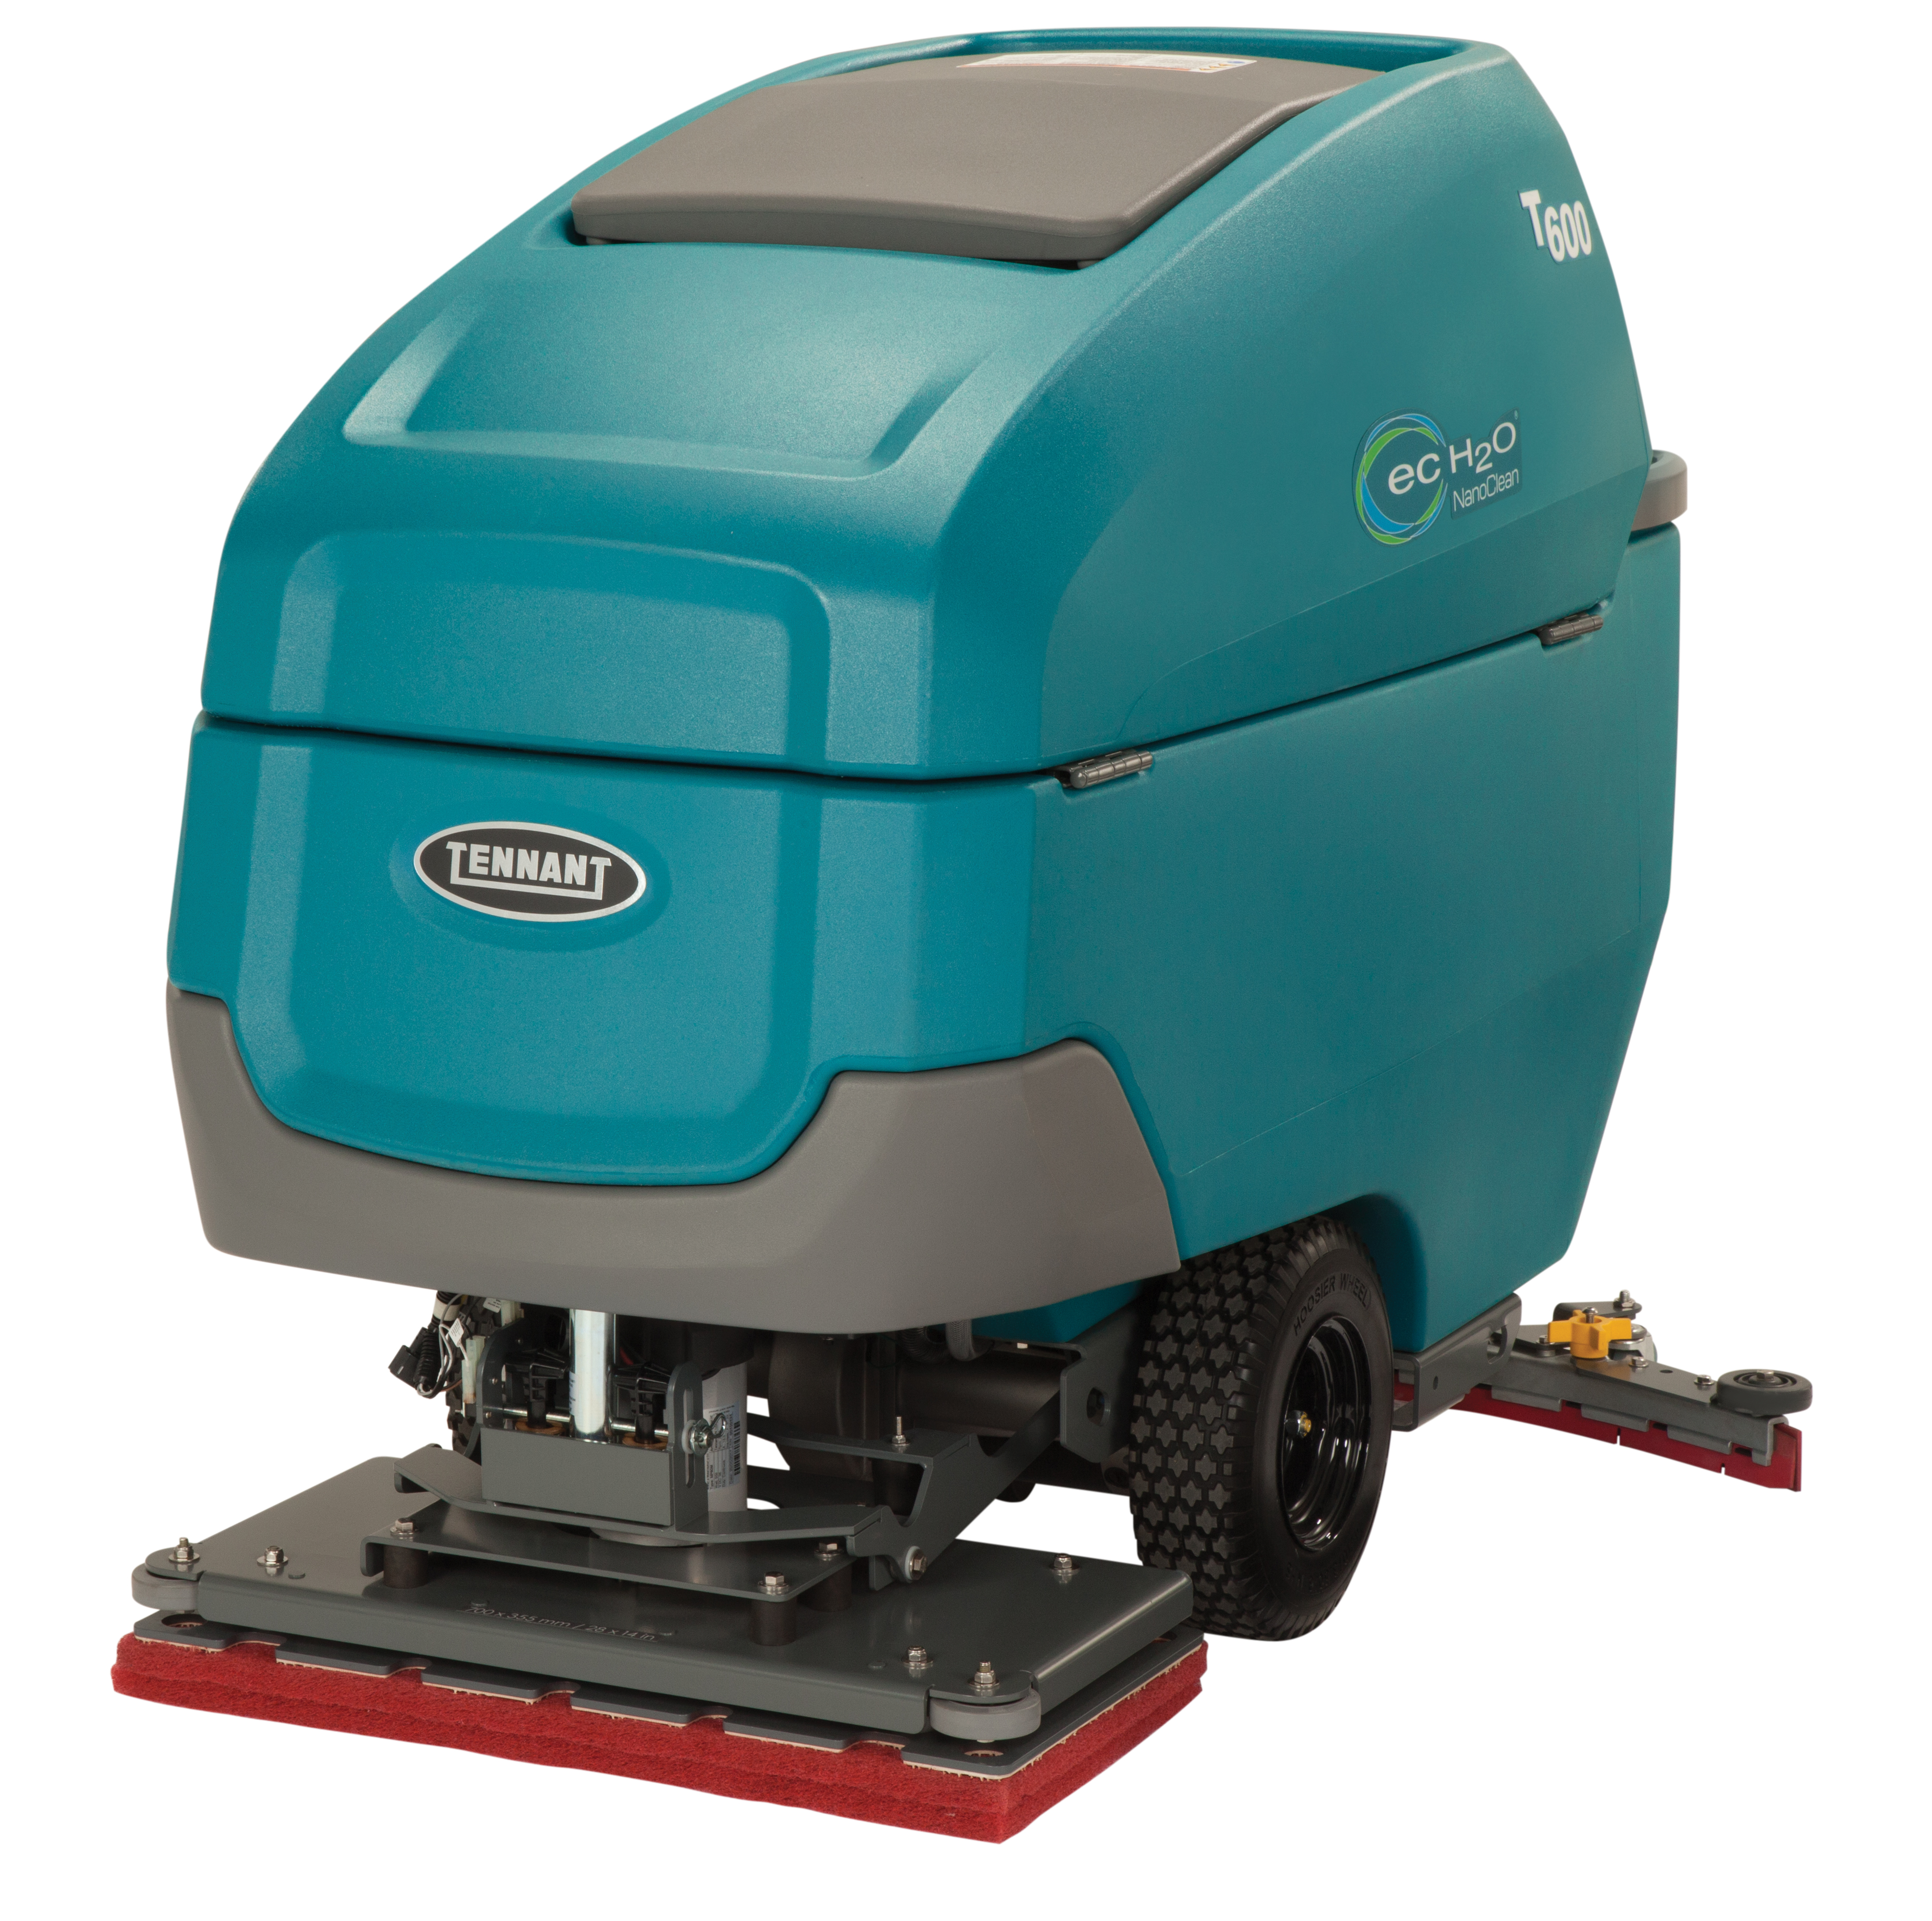
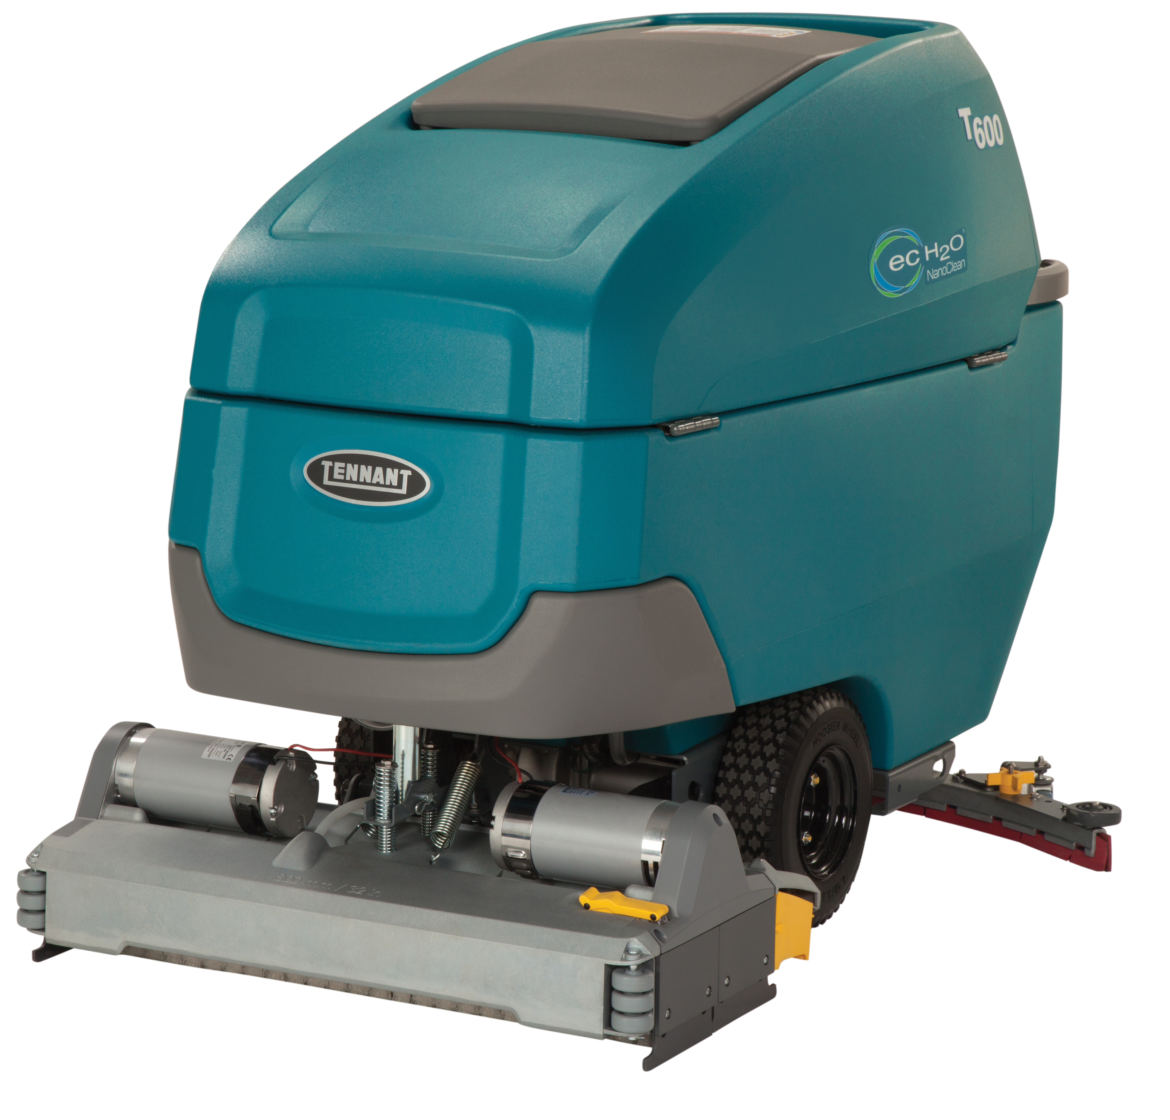
T600 WALK-BEHIND SCRUBBER
PRESENTER NAME MONTH.DATE.YEAR

Slide 2




T600
ADVANTAGES
Reduce costs to clean
  Maximize investment with a wide range of cleaning options
  Save time and money on battery maintenance and help increase battery performance
Maintain health and safety
  Virtually eliminate the need for caustic floor finish removal chemicals with orbital scrub head
  Reduce risk of slips and falls with improved water pick-up
Enhance facility image
  Reduce noise levels to as low as 62.2 dBA with optional Quiet-Mode™ low dBA setting
  Easily standardize cleaning operations with customizable Zone Settings™ with labels on the Pro-Panel® LCD touch screen
Minimize environmental impact
  Reduce environmental impact with detergent-free cleaning technologies
  Reduce the amount of water required to clean

Slide 3



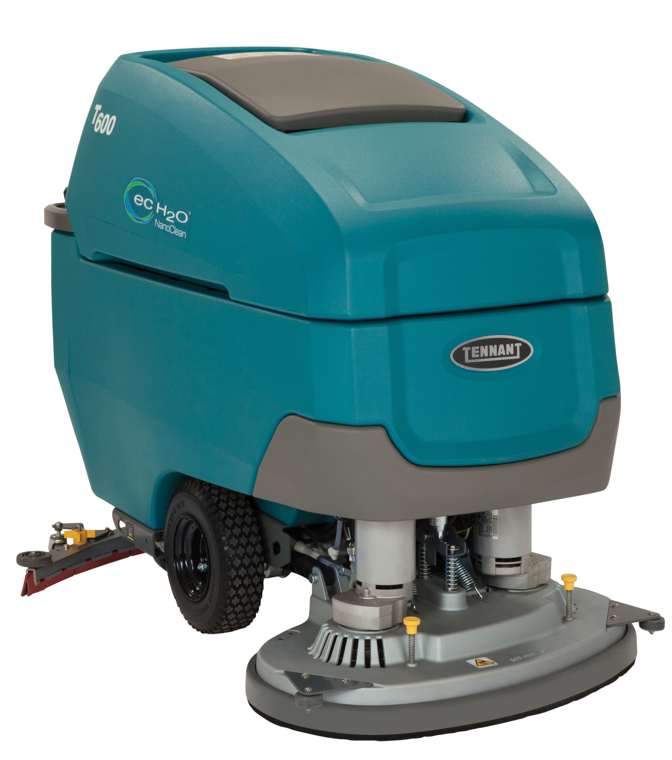


T600
KEY MARKETS
Retail
Healthcare
Education
Hospitality
BSC/Office
Logistics/Manufacturing

Slide 4

T600
KEY DIFFERENTIATORS
SENTINEL RIDER SWEEPR
BUILT-IN RESULS
PRODUCT FEATURES FOCUSED ON REDUCING COST & MAINTAINING HEALTH & SAFETY
Reduce Cost to Clean
Maximize battery productivity with the exclusive patent-pending Smart-Fill™ technology, an optional on-board automatic battery watering system.
Save money and significantly reduce labor costs with optional ec-H2O NanoClean® technology that eliminates chemical purchasing, storing, handling and mixing.
Clean virtually any hard surface condition and maximize your return on investment with a wide range of cleaning heads, including a 28 in/ 700mm orbital option.
Take advantage of large-capacity solution and recovery tanks to clean effectively with fewer dump-fill cycles.
Help reduce costly breakdowns and simplify training and preventative daily maintenance with yellow touch points on common maintenance areas.
Maintain Health & Safety
Enhance operator comfort and control with ergonomic design and easy-to-use machine controls including a variable speed bail.
Reduce handling of daily cleaning chemicals with optional ec-H2O NanoClean® technology.
Make battery maintenance safer with Smart-Fill™ automatic battery watering system that removes the task of checking, opening, and filling flooded batteries.
Minimize the risk of slip-and-fall accidents with the optimized water recovery system.

Slide 5
T600
KEY DIFFERENTIATORS
SENTINEL RIDER SWEEPER
BUILT-IN RESULTS
SENTINEL RIDER WEEPER
BUILT TO YO NEEDS
PRODUCT FEATURES FOCUSED ON ENHANCING IMAGE AND EASY OPERATION & MAINTENANCE
Enhance Facility Image
Achieve a consistent clean with optimal water recovery that minimizes streaks and maximizes soil removal.
Improve water pick-up and virtually eliminate water drips after cleaning with redesigned squeegee and integrated p-trap.
Take the guesswork out of cleaning and ensure consistent performance with operator lock-out, on-demand tutorial videos and Zone Settings™ with customizable labels using Pro-Panel® LCD touch screen technology.
Clean tougher soils like heavy oils by dispensing detergent on demand with ec-H2O NanoClean® equipped with the optional Severe Environment™ switch.
Easy Operation & Maintenance
Reduce training and simplify operation with intuitive controls and optional Pro-Panel® LCD touch screen technology.
Increase ease of filling the scrubber with standard auto-fill.
Simplify preventative maintenance with easy-to-identify yellow maintenance touch points.
Easily clean out the recovery tank with the optional on-board spray nozzle and hose.
Quickly identify when brushes need replacement with the built-in yellow brush wear indicator.

Slide 6
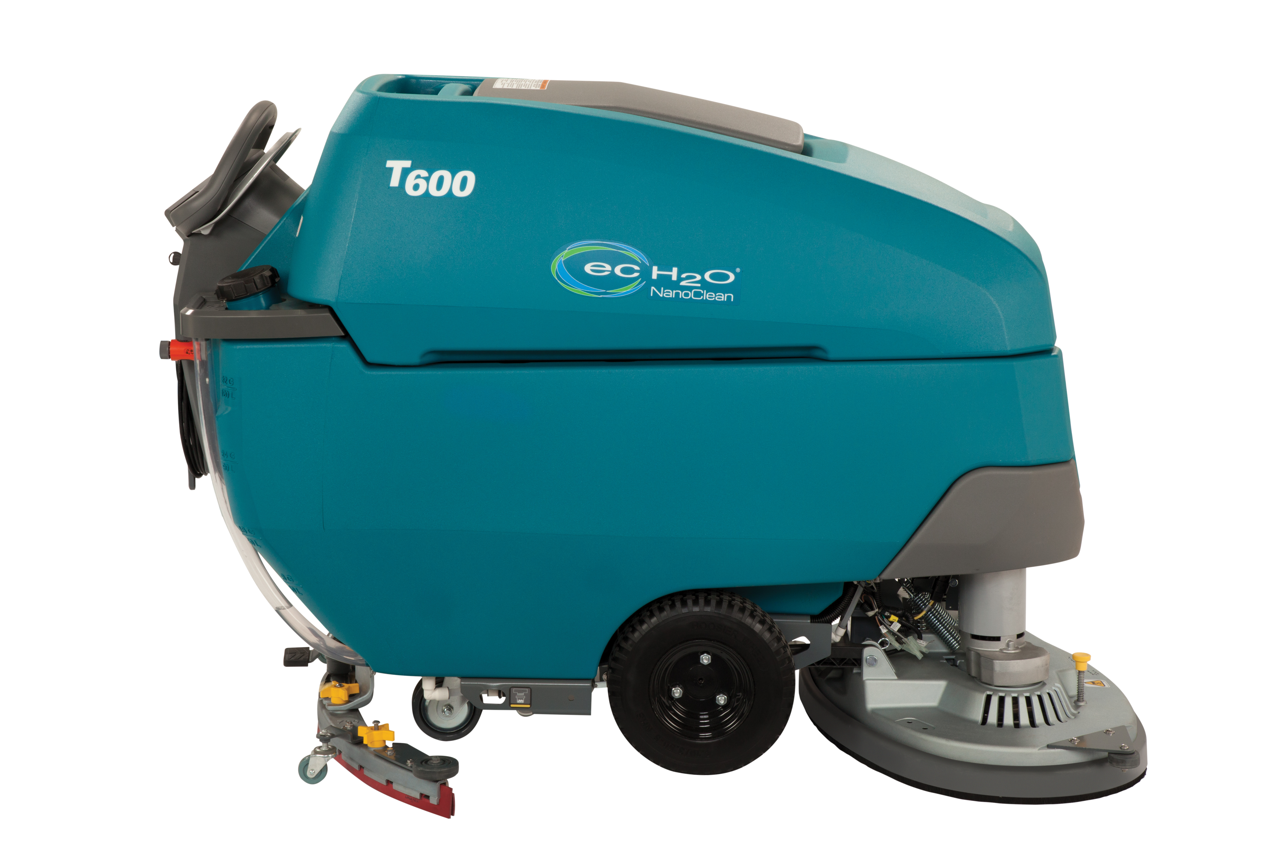
T600
KEY DIFFERENTIATORS
SENTINEL RIDER SWEEPER
BUILT-IN RESULTS
SENTINEL RIDER WEEPER
BUILT TO YO NEEDS
PRODUCT FEATURES FOCUSED ON MINIMIZING ENVIRONMENTAL IMPACT
Minimize Environmental Impact
Reduce water consumption and the use of daily floor cleaning chemicals with optional detergent-free ec-H2O® NanoClean technology.
Minimize noise levels to as low as 62.2 dBA and allow for easy daytime cleaning without disruption with the Quiet-Mode™ setting.
Virtually eliminate the need for caustic floor stripping chemicals with the use of the orbital scrub head which allows for chemical-free floor finish removal.
Ensure and validate compliance with sustainability initiatives and help realize projected chemical, packaging and water savings through optional IRIS® Asset Manager’s ec-H2O NanoClean® usage reporting.

Slide 7
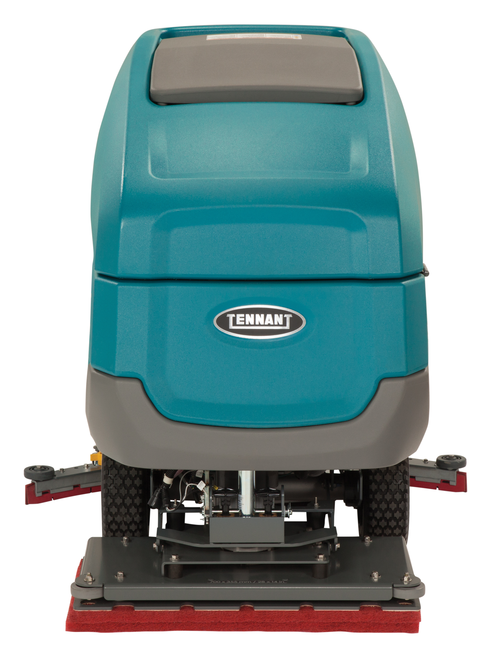
T600
OPTIONAL FEATURES
Productivity and ease of operation:
  Smart-Fill™ automatic battery watering
  Pro-Panel® LCD touch screen technology with customizable Zone Settings™ with labels
  On-board spray nozzle and hose for tank rinse-out
Solution technologies:
  ec-H2O NanoClean® technology with Severe Environment™ Switch
Operator & machine protection:
  Chemical-free floor finish removal with orbital cleaning head
  Gray, oil resistant polyurethane recovery tank drain hose with
  flow control valve
Asset management:
  IRIS® Asset Manager

Slide 8
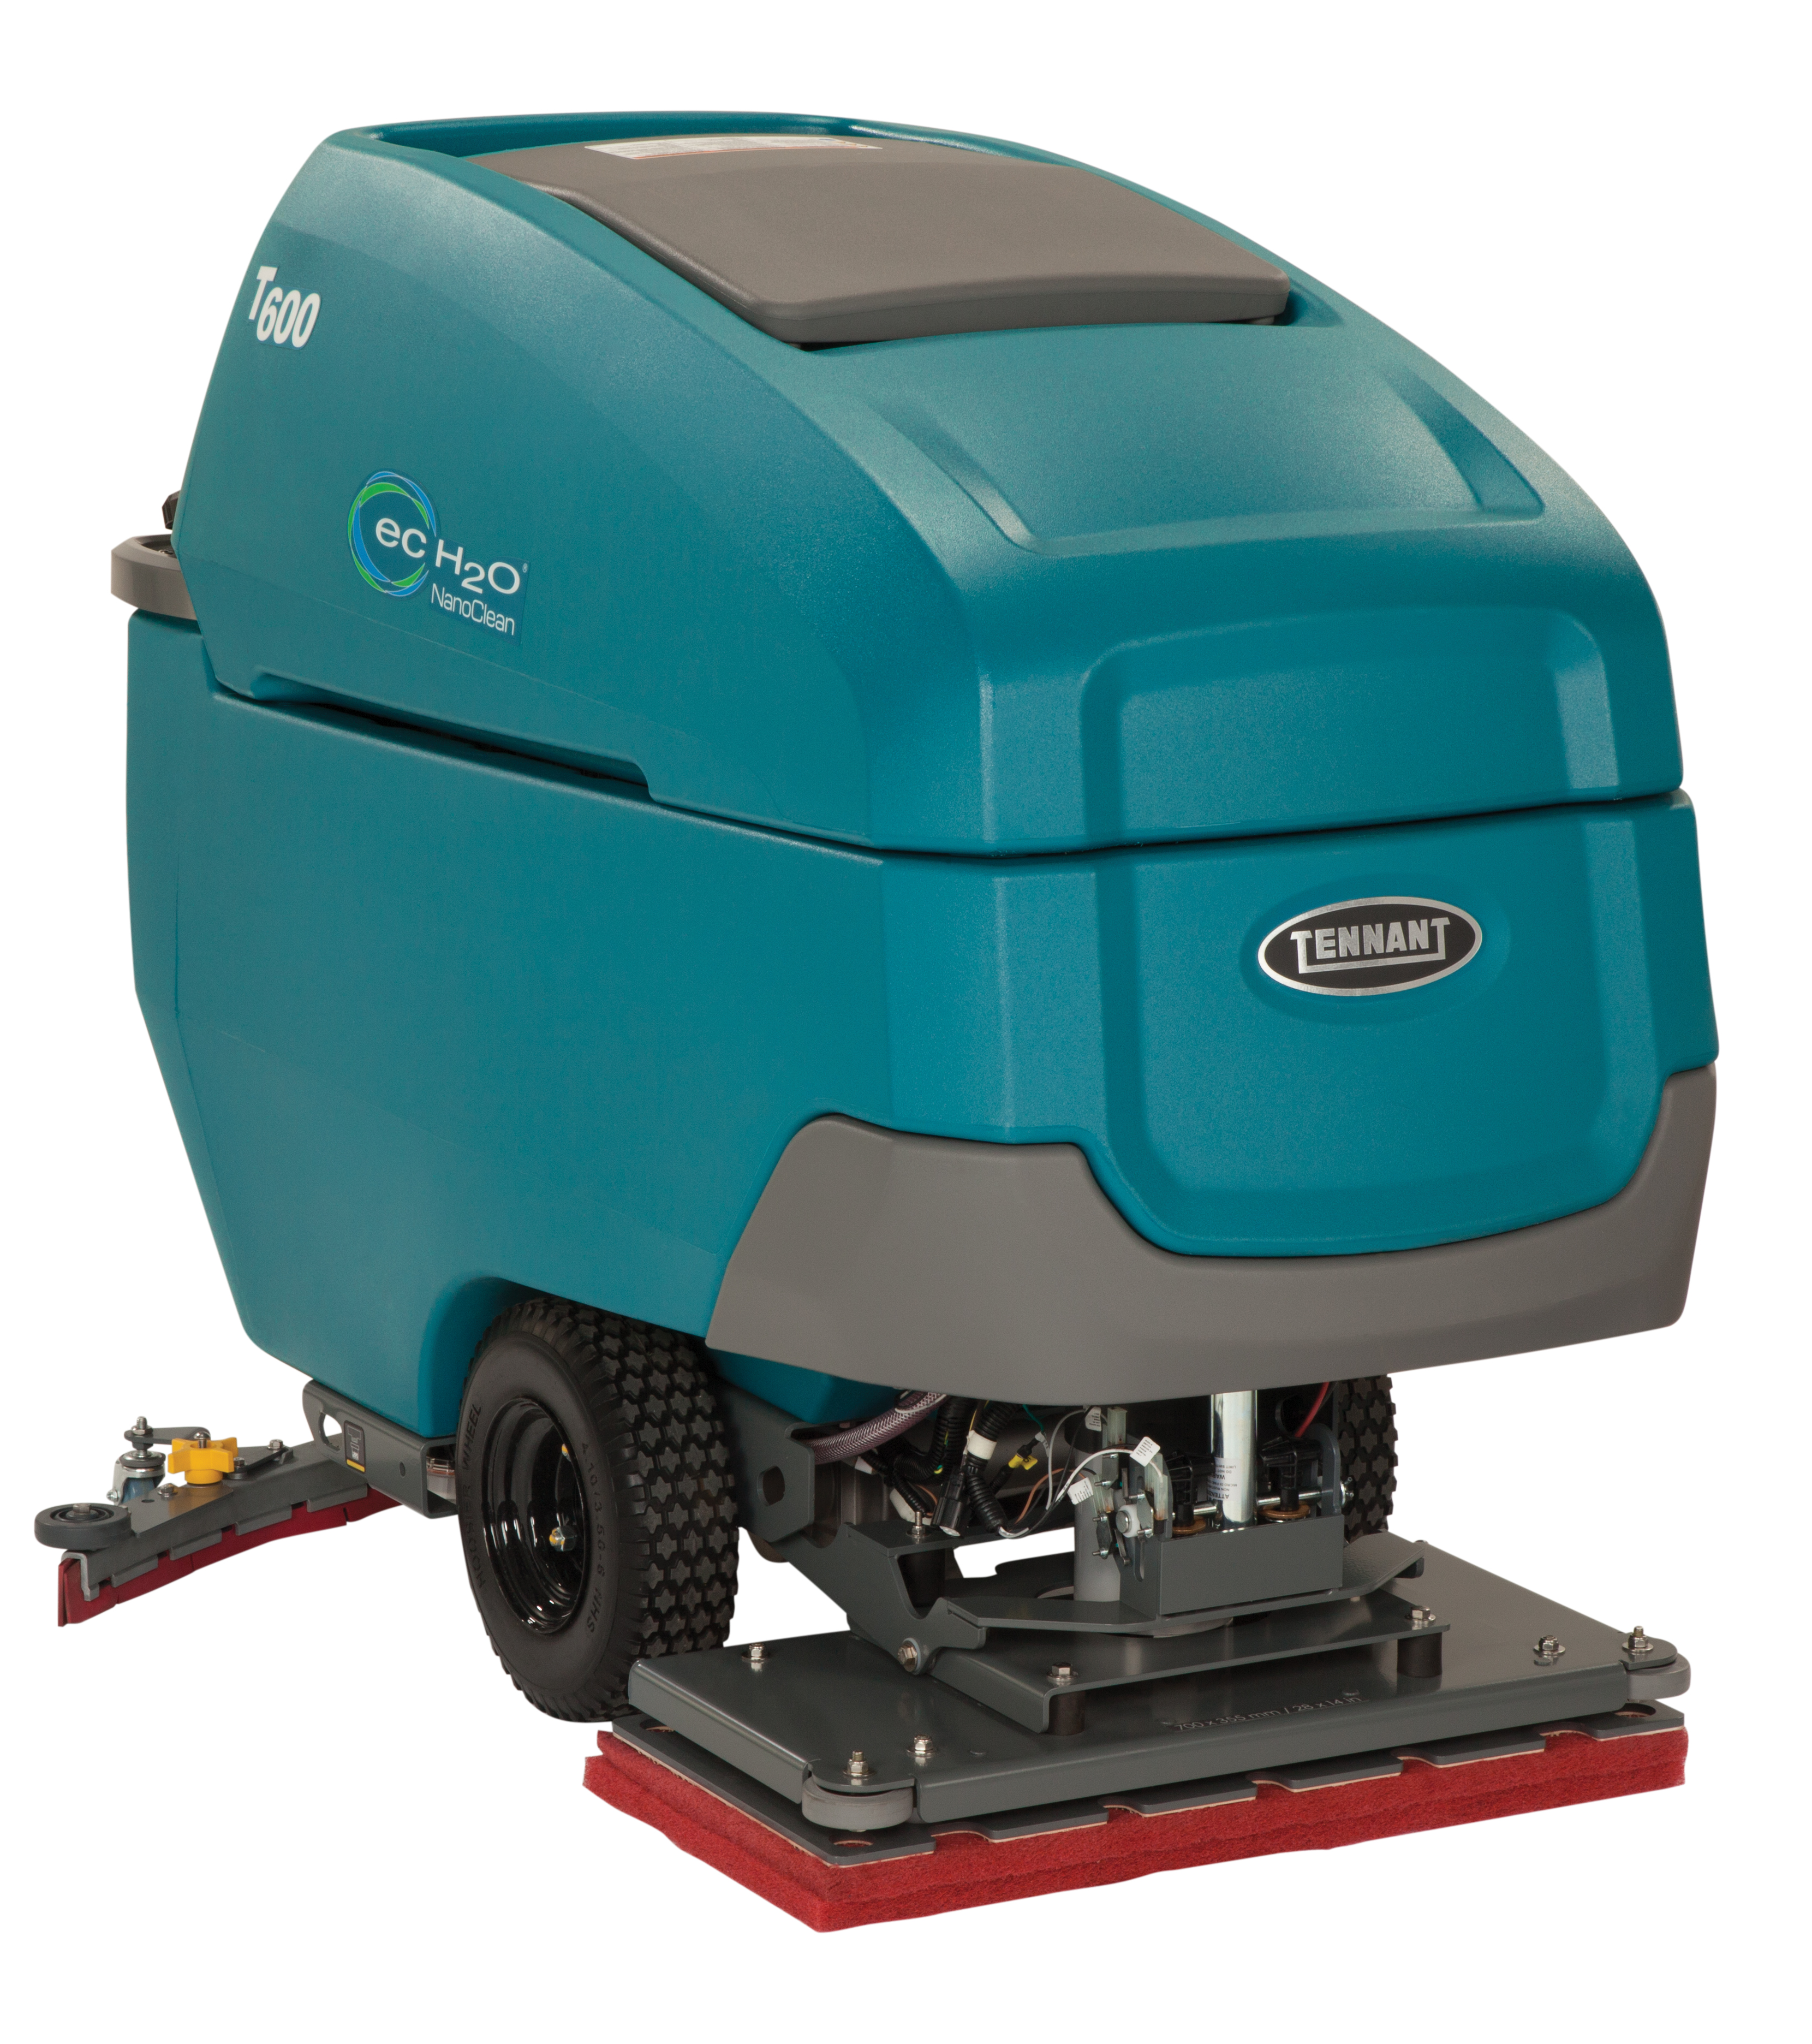
THANK YOU

