Slide 1
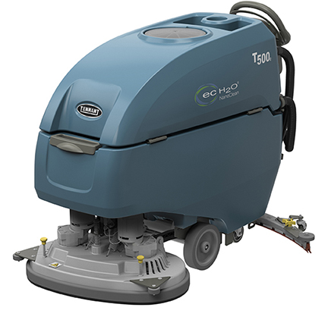
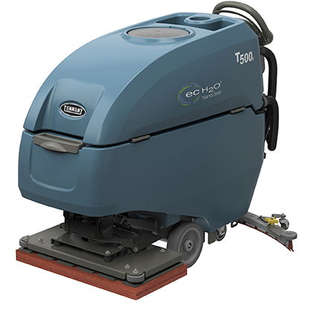
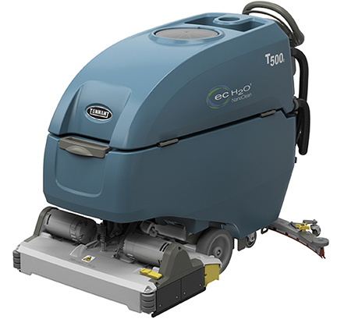
T500e WALK-BEHIND SCRUBBER
PRESENTER NAME MONTH.DATE.YEAR

Slide 2




T500e
ADVANTAGES
Reduce costs to clean
  Maximize investment with a wide range of cleaning options
  Save time and money on battery maintenance and help increase battery performance
Maintain health and safety
  Virtually eliminate the need for caustic floor finish removal chemicals with orbital scrub head
  Reduce risk of slips and falls with redesigned squeegee and integrated p-trap
Enhance facility image
  Virtually eliminate water drips left behind with an integrated p-trap and improved water pick-up
  Reduce the risk of contact with dirty recovery water and decrease the need for secondary cleaning operations caused from spills with optional controlled recovery flow valve
Minimize environmental impact
  Reduce environmental impact with detergent-free cleaning options
  Reduce the amount of water required to clean
©2017 The Tennant Company
Rev 1/6/17 1

Slide 3



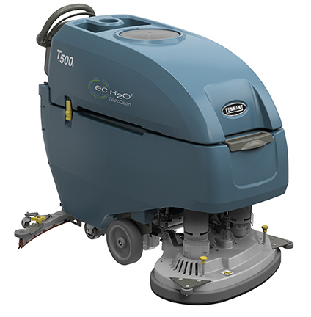


T500e
KEY MARKETS
Retail
Healthcare
Education
Hospitality
BSC/Office
Logistics/Manufacturing

Slide 4

T500e
KEY DIFFERENTIATORS
SENTINEL RIDER SWEEPR
BUILT-IN RESULS
PRODUCT FEATURES FOCUSED ON REDUCING COST & MAINTAINING HEALTH & SAFETY
Reduce costs to clean
Clean virtually any hard surface condition and maximize your return on investment with a wide range of cleaning options, including a 28 in / 700 mm orbital head option.
Reduce costs to clean and maximize battery productivity with the exclusive patent-pending Smart-Fill™ technology, an on-board, virtually worry-free battery watering system.
Save time and money on battery maintenance and help increase battery performance with the patent-pending on-board Smart-Fill™ automatic battery watering system paired with IRIS® Asset Manager, which provides reporting on battery charging behaviors.
Reduce costs to clean, increase productivity and simplify operator training with the T500e's suite of innovative technologies, such as ec-H2O NanoClean® technology, IRIS® Asset Manager, and Smart-Fill™ automatic battery watering.
Effectively remove floor finish without expensive stripping chemicals with the 28 in / 700 mm orbital cleaning head option.
Maintain health & safety
Reduce handling of daily cleaning chemicals with use of optional ec-H2O NanoClean® technology.
Virtually eliminate the need for caustic floor stripping chemicals with the use of the orbital scrub head and surface prep pad, which allows for chemical-free floor finish removal.

Slide 5
T500e
KEY DIFFERENTIATORS
SENTINEL RIDER SWEEPER
BUILT-IN RESULTS
SENTINEL RIDER SWEEPR
BUILT-IN RESULS
SENTINEL RIDER WEEPER
BUILT TO YO NEEDS
PRODUCT FEATURES FOCUSED ON ENHANCING IMAGE & EASY OPERATION & MAINTENANCE
Enhance facility image
Evenly and effectively remove floor finish with one of the highest standard orbital down pressure settings at 170 lb / 77 kg
Validate cleaning, differentiate your operations and develop optimal cleaning program protocols with IRIS® Asset Manager's data driven reporting technology.
Trust in the orbital cleaning head's quality and durability with a 2,000 hour/3 year isolator warranty.
Minimize environmental impact
Reduce the use of daily floor cleaning chemicals with optional detergent-free ec-H2O NanoClean® technology.
Ensure and validate compliance with sustainability initiatives and help realize projected chemical, packaging and water savings through IRIS® Asset Manager ec-H2O NanoClean® usage reporting.
Reduce the amount of water required to clean due to optimal down pressure, high RPMs and ec-H2O NanoClean® technology.

Slide 6
T500e
KEY FEATURES
KEY
ENHANCEMENTS
Increase productivity
  Innovative suite of optional technologies: Smart-Fill™ automatic battery watering, ec-H2O NanoClean® technology, IRIS® Asset Manager, and electronic control panel
  Optimal down pressure and high RPMs help quickly and effectively clean dirty floors
  Clean virtually any hard surface condition and maximize your return on investment with a wide range of cleaning options, including an orbital head option
Lower costs to clean
  Smart-Fill™ on-board automatic battery watering saves time and money on battery maintenance
  Yellow touch points help prevent breakdowns and simplify machine maintenance
  Smart charger reduces risk of battery damage while charging
  Durable orbital cleaning head with a 2,000 hour/3 year isolator warranty
Maintain health & safety
  Redesigned squeegee and integrated p-trap improve water pick-up and prevent water from dripping on the floor after cleaning
  Actuated scrub head controls provide simple and ergonomic machine operation
  Optional Recovery Flow Control Valve reduces risk of contact with dirty recovery water
Minimize environmental impact
  Consistent down pressure and high RPMs improve cleaning performance by reducing the amount of water required to clean
  Optional ec-H2O-NanoClean® technology can reduce the need for daily use of chemicals

Slide 7
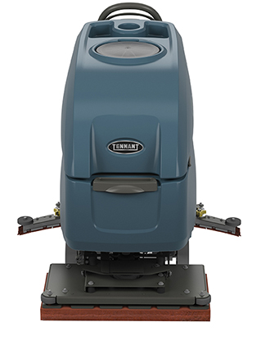
T500e
OPTIONAL FEATURES
Productivity and ease of operation:
  Smart-Fill™ automatic battery watering
Solution technologies:
  ec-H2O NanoClean® technology
Operator & machine protection:
  Chemical-free floor finish removal with orbital cleaning head
  Gray, oil resistant polyurethane recovery tank drain hose
  with flow control valve
Asset management:
  IRIS® Asset Manager

Slide 8
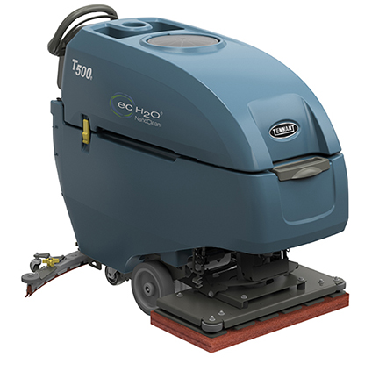
THANK YOU

