Slide 1
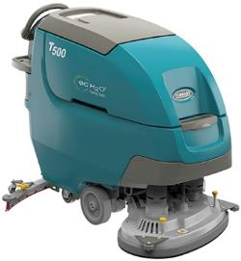
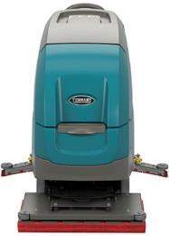
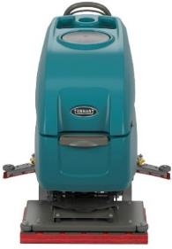
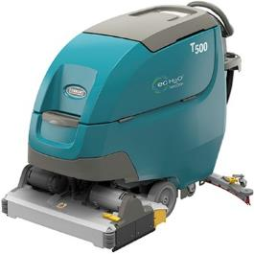
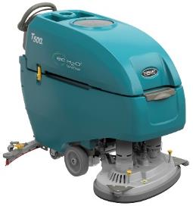
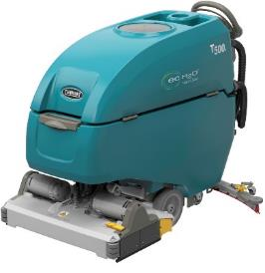
Product Guide (PAS Guide)
Purpose of this internal product guide: Self-train and educate on T500/T500e
Other helpful sources for understanding these products:
Operator’s manual
Brochure
Public Website (videos available)
T500
T500e
Confidential. Do not distribute.

Slide 2
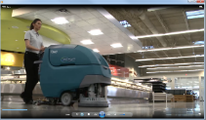
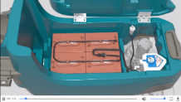
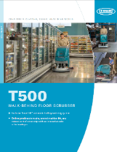
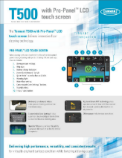
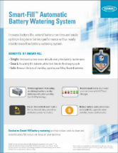
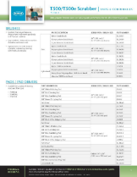
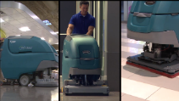
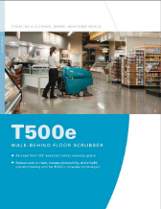
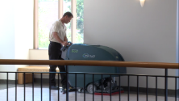
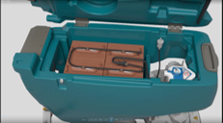
T500/T500e Sales Tools and Locations
T500 Overview
Video – 0:40
T500 Demo
Video – 3:40
T500 Smart-Fill™
“How-it-Works” Animation
T500
Brochure
T500 Pro-Panel™
Flyer
T500/T500e Smart-Fill™ Flyer
T500 / T500e
P&C Guide
Full Sales Tools List:
PAS Guide (this PowerPoint file)
Spec Sheet
FAQ
Customer Presentation
Salient Characteristics
Orbital Brochure
Benefit Statements
Product Comparison
Competitive Comparisons
Short Feature Videos
T500e Demo
Video – 3:00
T500e Smart-Fill™
“How-it-Works” Animation
T500e
Brochure
Sales Tools Locations:
Sales Tools Hub – folder on your desktop
My Tennant – log-in through tennantco.com
Tennantco.com Public Website (videos & photos)
Confidential. Do not distribute.

Slide 3
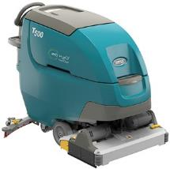
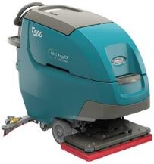

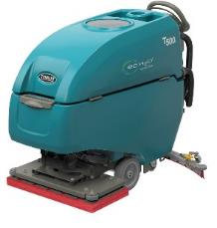
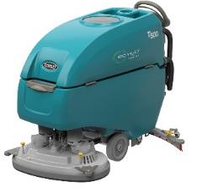
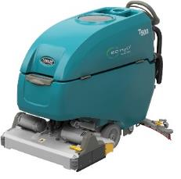
Product Strategy and Value Proposition
Maintain Market Presence with 2-Tiered Product Strategy
T500 – New technologies and features to grow new business and revenue per unit
T500e – Simple, rugged and just as affordable as previous “e” model
T500
T500e
Value Proposition: Tennant’s new T500 scrubber, with productivity enhancing features, provides high performance on virtually any hard floor surface condition, delivering unmatched versatility and consistent results while lowering cleaning costs.
Value Proposition: The new Tennant T500e and Nobles SS500 offer effective cleaning results in a no-nonsense, easy to use, rugged design.
Confidential. Do not distribute.

Slide 4
T500/T500e New Key Highlights Summary
New scrub head sizes & technologies
  Featuring new 28in/700mm orbital with one of the industry’s highest standard down pressures at 170lbs / 77kg, and best isolator warranties – 3 yrs/2000 hrs
Increased average run-time even with smaller battery size – up to 20% (T500)
New high-output battery size option – 260AH Wet
Improved water pick-up from redesigned, foot-activated squeegee
New controls and improved ergonomic steering grip design
New daily maintenance yellow touch points
New technologies for increased productivity and reduced costs
  New exclusive Smart-Fill™ Automatic Battery Watering System option
  IRIS® Asset Manager option
T500 only new options:
  Pro-Panel™ LCD Touch Panel Controls option
  Severe Environment™ switch option for tackling trouble spots more efficiently
  Solution Tank Auto-Fill option for reliable solution tank filling
  Tank Rinse-Out option – Spray nozzle with hose for remote water access
Confidential. Do not distribute.

Slide 5
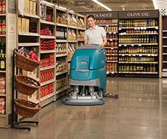
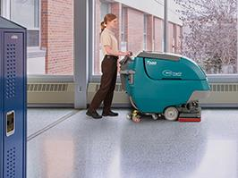
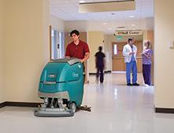
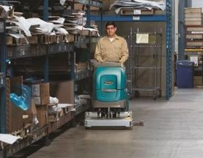
Markets and Applications
MARKET | APPLICATION | FLOOR TYPES
Retail | Aisle ways, check out counters, deli/cafeteria areas | VCT, polished stone, terrazzo, grouted ceramic and porcelain tile, polished concrete
Schools and Universities | Hallways, entryways, kitchens, classrooms, cafeterias | VCT, polished stone, terrazzo, grouted ceramic and porcelain tile
Healthcare | Hallways, entryways, patient rooms, surgical suites, cafeterias, labs, handicapped ramps | VCT, polished stone, terrazzo, resilient flooring, grouted ceramic and porcelain tile
Hospitality | Lobbies, hallways, elevator areas | VCT, polished stone, terrazzo, grouted ceramic and porcelain tile
Logistics/Manufacturing | Small spaces, congested aisles, in-and-around equipment, employee cafeterias | Sealed concrete, polished concrete, coated floors
Confidential. Do not distribute.

Slide 6
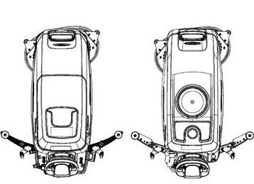


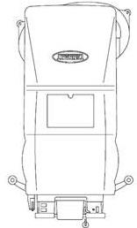
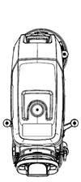
Tennant Walk-Behind Battery Scrubber Context
 | T300/T300e | T500 / T500e | 5700/5680
Scrub Path | Single Disk: 17in/430mm, 20in/500mm Dual Disk: 24in/600mm Cylindrical: 20in/500mm Orbital: 20in/500mm | Disk: 26in/650mm, 28in/700mm, 32in/800mm Cylindrical: 28in/700mm Orbital: 28in/700mm | Disk/Cylindrical: 28in/700mm, 32in/800mm, 36in/900mm
Tank Size | Solution: 11g / 42 L Recovery: 14g / 53 L | Solution: 22.5g / 85 L Recovery: 27 g / 102 L | Solution: 30 g / 114 L Recovery: 40 g / 151 L
Productivity Lowest to Highest | ec-H2O NanoClean 9,668 ft² / 898 m² – 18,906 ft² / 1,756 m² | ec-H2O NanoClean 23,124 ft² / 2,148 m² – 27,323 ft² / 2,538 m² | ec-H2O NanoClean 23,400 ft² / 2,175 m² – 30,600 ft² / 2,845 m²
Tool Attachment | Single/Dual Disk: 3-Lug Standard Insta-Click™ Optional | Dual Disk: Gimbal Mount | Dual Disk: Gimbal Mount
Confidential. Do not distribute.

Slide 7
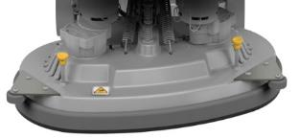
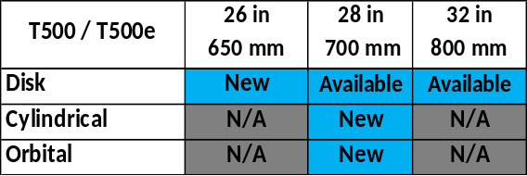
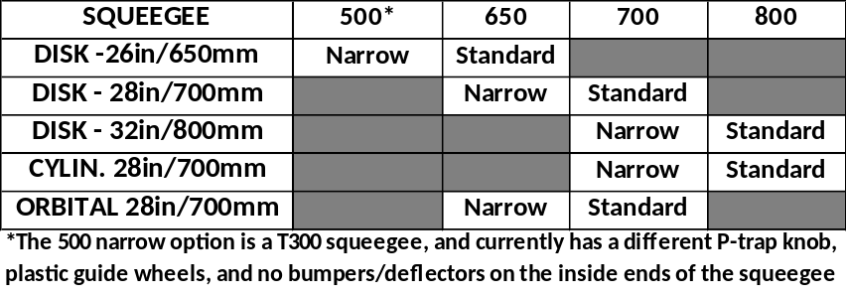
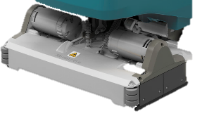
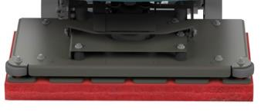
NEW Product Offering – High-Level Configuration Overview
Scrub deck changes:
  New 26in/650mm DUAL DISK replaces 24in/600mm
  New 28in/700mm CYLINDRICAL replaces 26in/650mm & 32in/800mm
  New 28in/700mm ORBITAL head
Battery Offering:
  New standard 225AH wet battery replaces 240AH
  New optional 260AH wet battery
  New optional 220AH sealed AGM replaces 200AH
Cleaning Technology:
  FaST technology is no longer available
Dual Disk
26 in / 650 mm
28 in / 700 mm
32 in / 800 mm
New
Dual Cylindrical
28 in / 700 mm
New
Orbital
28 in / 700 mm
New
Confidential. Do not distribute.

Slide 8
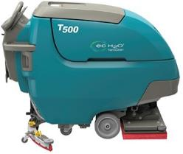
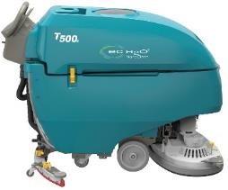
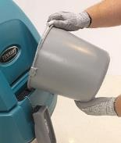
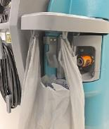
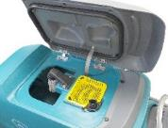
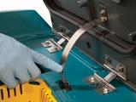
Changes from Old T5/T5e to New T500/T500e
List of T500/T500e Updates from T5/T5e
  Same tank sizes – Solution = 22.5g / 85 L Recovery = 27.0g / 102 L
  New Scrub Heads – 5 total configurations
    New Dual Disk – 26in/650mm (replaces 24in/600mm)
        New Cylindrical – 28in/700mm (replaces 26in/650mm, 32in/800mm)
    New Orbital – 28in/700mm
  Controls – New ergonomic controls – Speed dial and propel direction switch in easy reach
    T500e = New base membrane control panel with electronic water flow control
    T500 = Pro-Membrane™ controls standard. Optional Pro-Panel™ LCD touch screen
  New redesigned squeegee with improved water pick-up, improved squeegee blade replace/rotate, and foot activated with integrated P-trap
  Eliminated 240AH, shift to 225AH (std); Added 260AH (opt) and 220AH AGM (opt)
  New yellow touch points
  T500 = New easy-access front bucket-fill location, integrated side rails
  T500 Only = New debris basket location and easy accessibility
  T500 Only = New Standard Quiet-Mode™ lowers sound level on the fly – 62 dBA
  Removed solution tank large drain port access (previously on rear of T5)
  New optional features – overview list on slide 10
  Removed FaST Technology, Power Wand, Pneumatic and Foam-Filled Tires
Confidential. Do not distribute.

Slide 9
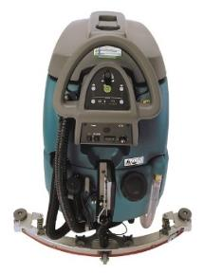
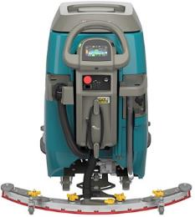
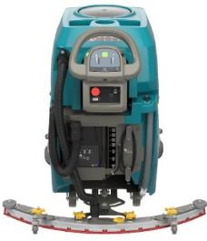
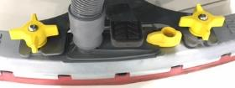

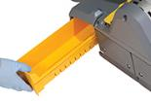
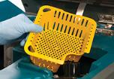
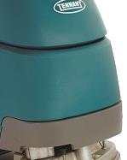
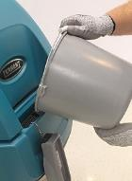
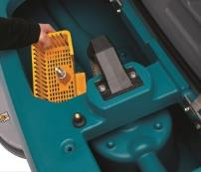
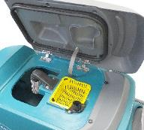
Visual Changes from Old T5/T5e to New T500/T500e
Changes shown in photos…
  Controls – New ergonomic controls
  New redesigned squeegee
  New yellow touch points
  T500 New easy-access front bucket-fill location, integrated side rails
  T500 New debris basket location and easy accessibility
  Removed solution tank large drain port access (previously on rear of T5)
T5
T500
T5e
T500e
T500/T500e
T500/T500e
T500
T5
T500
T5
T500
Confidential. Do not distribute.

Slide 10
T500/T500e Complete Standard Features Overview List
1-STEP™ Green Start Scrub Button Memory Controls
Tanks: 85 L/22.5 gal Solution & 102 L/27.0 gal Recovery
Black PVC Drain Hose w/ Cap; Solution Tank Sight Gauge Hose
Standard (4) 6V 225AH Batteries (Opt. 260 Wet & 220 AGM)
On-Board Charger with Power Cord
Closed Machine Venting for Battery Charging
Extremely Low Noise Levels Standard
  T500 – <67 dBA Disk and Orbital, Cylindrical
  T500e - <67.4 Disk and Orbital, <68.3 Cylindrical
On Board Diagnostics
Cast Aluminum Squeegee Frame & Scrub Decks (D/C)
11 Gauge Steel Scrub Deck (Orbital Only)
Down Pressures & Solution Flows
  T500 – 3 down pressure settings, 4 water flow settings
  T500e – 2 down pressure settings, 4 water flow settings
Front Water Fill Port
Automatic when engaging propel bail:
  Water On / Off and Brush On / Off
  Brush Shutoff at 80% Discharge
Excellent Ergonomic Controls Design
Yellow Maintenance Touch Points
Battery Tray
Emergency Stop Kit
Key Switch for Safety
Rugged Duramer™ Tank Construction
Gray Non-Marking Tires
100% Water Recovery in 180º Turns w/ Standard Squeegee
Insta-Fit™ No-Tool Pad Driver & Brush Attachment (Disk units)
No-Tool Squeegee Change
Breakaway Squeegee Design w/ Integrated P-Trap
Factory Set Squeegee Assembly for Maximum Recovery
Linard(F)/Linatex(R) Squeegee Blades w/ Tool-less Replacement
Includes Standard Pad Drivers or Scrubbing Brushes (Select 1)
Free Floating Head Skirt – no adjustment required (disk)
Hour Meter
Operators Manual
Jacking Points/Shipping Tie Downs
Sealed Electrical Connectors in Key Areas
T500 ONLY STANDARD FEATURES
Fully Sprayable Hygenic® Recovery Tank
Supervisor QA Controls™ settings (Lock Out Features)
Quiet-Mode™ (Lowers to 62 dBA; extends run-time)
Recovery Tank Debris Tray
Integrated Accessory Rails with Bag Hang Hooks
Pro-Membrane™ Control Panel w/ 3 Zone Settings™
Integrated Heat Sync for Electronics Protection
Confidential. Do not distribute.

Slide 11
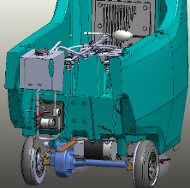



Productivity Enhancing Options
T500/T500e Options
  ec-H2O NanoClean®
  NEW Smart-Fill™ On-Board Automatic Battery Watering
  NEW Enhanced IRIS Functionality – Battery Manager
  Polyurethane (oil resistant) Hose with Drain Flow Control Valve
  Parking Brake
T500 Only Options
  Severe Environment™ Switch (requires ec-H2O NanoClean)
  NEW Pro-Panel™ LCD Screen with Tutorial Videos
  NEW Tank Rinse-Out – Spray Nozzle w/ Hose
  NEW Solution Tank Auto-Fill
  Accessory Clips
*More info on options in following pages
Confidential. Do not distribute.

Slide 12

T500 and T500e Differences & Feature Availability by Model
Key Differences Between T500 & T500e
Machine Intelligence
  T500 = Main scrub board controller (machine “brains”) with programmable controls; able to offer more features
  T500e = No scrub board controller. Electronic, but simpler
Vac Fan
  T500 = Up-to 4 sec. programmed delay to vacuum up remaining water in the hose
  T500e = No programmed delay
Down Pressure Design (orbital head exception)*
  T500 = Current controlled – adjusts for pad wear
  T500e = Fixed position – consistent DP on diff. floors
Supervisor Mode
  T500 = Yes – both Pro-Membrane and Pro-Panel LCD
  T500e = No
Controls Console
  T500 = Fixed
  T500e = Lifts with the recovery tank
Charger
  T500 = Concealed
  T500e = Visible on the outside
    *T500/T500e orbital down pressure is mechanical/position based
Confidential. Do not distribute.

Slide 13



T500e and T500 Controls – Specific Differences
T500e
T500
  Electronic Controls
Base Membrane
Green 1-step scrub start button
4 Water flow settings
2 Down pressure settings
Electronic Controls
Pro-Membrane™ (Standard)
Green 1-step scrub start button
4 Water flow settings
3 Down pressure settings
Quiet-Mode™ (62 dBA)
Supervisor lockout mode
Fault code display, BDI LEDs
3 Zone Settings™
Electronic Controls
Pro-Panel™ LCD Touch Screen (Option)
Green 1-step scrub start button
4 water flow settings
3 Down pressure settings
Quiet-Mode™ (62 dBA)
Supervisor lockout mode
Fault code display w/ on-screen alert
4 Zone Settings™ w/ customizable labels
Operator ID log-in
28 languages available
On-demand training/maintenance videos
Control Panels
Confidential. Do not distribute.

Slide 14


Control Panel Components
T500e
T500
Confidential. Do not distribute.

Slide 15



New Squeegee Design – T500 / T500e
Improved sealed design, easy to use – foot operated
2 sec. (std) or 4 sec. (Quiet-Mode) delay in vacuum fan shut off (T500 only)
Great water pick up, especially on grouted tile
Squeegee material – Linard® front / Linatex® rear
Fluid Dynamic Analysis
No P-Trap loop
(Less water in hose)
(Shorter distance for air/water to travel)
Integrated P-Trap
(Minimizes water dripping from hose)
Tighter end seal
(More airtight)
Rubber Guide Wheels
(Protect facility and squeegee)
Bumper guides prevent hooking
(Deflects/articulates squeegee)
Releases blades
(Easy to replace/rotate blades)
Foot raises and lowers the squeegee with pedal
(No bending to raise and lower squeegee)
(No handle and cable system to loosen over time)
Fast moving air minimizes dead spots
Dead spots causes “splashes” as it moves over floor voids
Fluid Dynamic Analysis
Confidential. Do not distribute.

Slide 16


NEW Battery Offering – 225AH Std; 260AH Opt; 220AH AGM Opt
Three battery offerings:
  Trojan 225AH WET Flooded – Standard
  Trojan 260AH WET Flooded – Option
    Benefits:
      Up-to-20%-more average run time and more power than 225AH battery
      This should mean more serviceable life because the battery energy does not deplete as quickly (note: this depends on depth-of-discharge)
  Discover 220AH AGM Sealed – Option
    Benefits:
      Low-maintenance, do not have to water
      However, potentially has lower run-time, lower serviceable life, and is more expensive
      Look to Smart-Fill™ Automatic Battery Watering as a less-expensive alternative
      Battery drain hole location under battery tray
Confidential. Do not distribute.

Slide 17




Battery Run-Times & Comparisons to T5/T5e
Increased average run-time (lowest power draw settings) with smaller 225AH battery compared to previous 240AH battery
  T500 = up-to 20% increased average run-time. T500e = up-to 9% increased average run-time
  Reason for increased run-time: Efficient vacuum fan
    T500 vac fan (6.6in/167mm vs. 5.7in/145mm) more efficient fan, draws less power in standard operation and low noise modes than T5
    T500e vac fan (5.7in/145mm) uses less power than T5e
  No trade-off with water pick-up due to improved sealed squeegee design
      In fact, tests on ceramic tile, a challenging surface for water pick-up, showed both T500/T500e performed better than predecessor modelsT5/T5e
    Lower future battery replacement costs with smaller 225AH batteries
Orbital avg. run-time outperforms other scrub heads’ avg. run time in highest draw settings
  Scrub head motor current draw remains consistent between low and high down pressures
  Means more productivity with one of the highest standard orbital down-pressure settings in the industry at 170lbs / 77kg
Confidential. Do not distribute.

Slide 18



Dual Disk Scrub Head – 3 Options to Choose From
3 Scrub Head Options: 26in / 650mm, 28in / 700mm, 32in / 800mm
  NEW 26in / 650mm – replaces 24in / 600mm head
    The shift away from 24in was driven by market considerations. Offering a 26in head allows Tennant to be more competitive with this size machine
    26in offers customers more range in cleaning productivity – Tennant offers a 24in dual disk in the line-up with T300
RPM: 220
T500 3 down pressure settings (all sizes): 40, 80, 120 lbs (18, 36, 54.5 kg)
T500e 2 down pressure settings – varies by size:
  26in / 650mm = 65, 120 lbs (29.5, 54.5 kg)
  28in / 700mm = 70, 120 lbs (32, 54.5 kg)
  32in / 800mm = 75, 120 lbs (34, 54.5 kg)
Continues using gimbal mount heads, with Insta-Fit™ brush/pad drivers
  Insta-Click™ is NOT on these machines, as they use a gimbal mount
  Advantages to gimbal mount:
    Heads able to flex/conform to varying surface levels
    Insta-Fit™ still allow for easy installation of pad driver and brushes
    Yellow plungers makes pad driver and brush removal quick and simple
    Fixed floating head skirt – helps contain water thrown from spinning brushes, especially in corners, reducing slips and falls.
    New integrated front-facing rubber guide wheels minimizes wall damage
Insta-Fit™
T500
Confidential. Do not distribute.

Slide 19





T500/T500e Stone Care, Brushes, Pads, Squeegees
Stone Care Solutions – Diamabrush™
  A chemical-free polishing system that is used with standard cleaning equipment and water that generates no dust
  Maintenance tools can be used on Concrete or Terrazzo
  1,000 (red) and 2,000 (tan) grit tools – Maintenance only for T500 family
  Replacement tools are available as well
  Routinely clean with the maintenance tools to not only maintain but continually improve the floor’s appearance
Brushes
  13”, 14” and 16” disks & 28” cylindrical
  Available in: Nylon, Polypropylene, H.D. Polypropylene, Abrasive and Super Abrasive
  Insta-Fit™ Adapter – The adapter guides the brush or pad driver onto the machine easily, without requiring the operator to line up the brush or pad drive to the hub.
  Brush Wear Indicator - TennantTrue® disk brushes include a brush wear indicator that takes the guesswork out of brush replacement to ensure optimal cleaning performance.
Pads
  13”, 14” and 16” disks & 14” x 28” orbital (new size)
  New material: Melamine Pad
  White Polishing, Red Cleaning, Blue Scrubbing, Brown Stripping (disk only), Black Hi-Pro Stripping, Maroon Surface Prep, Purple Diamond Polishing (disk only), Sienna Diamond Polishing (disk only), & Green Turf Pad (orbital only)
Squeegees - Linatex®, Polyurethane, and Gum Rubber
Confidential. Do not distribute.

Slide 20




NEW 28” / 700mm Dual Cylindrical – T500 / T500e
Dual brushes allows pre-sweeping maximizing productivity
  Cylindrical brushes help to pick-up light debris into tray
Easy no-tool one side brush removal
Integrated 1-piece debris tray
  Dual side removal – easy to remove
  Drawer style
  0.85 gallon / 3.2 liter capacity
Excellent cleaning performance
  RPM: 1500
  T500 3 Down Pressures: 40, 80, 120 lbs (18, 36, 54.5 kg)
  T500e 2 Down Pressures: 85, 120 lbs (38.5, 54.5 kg)
3 brush types available
  Nylon – general purpose
  Polypropylene – more aggressive
  Super Abrasive – most aggressive
Integrated floating side skirt
  Contains water, especially in turns
Confidential. Do not distribute.

Slide 21

NEW 28in / 700mm Orbital – T500 / T500e
Maximum versatility – not just a project machine
  Effective and efficient daily cleaning
  Chemical-free floor finish removal with high DP and SPP pads
  Edge and baseboard cleaning with head sticking out 2in / 51mm
  Effective cleaning of grout lines with green turf pad
10 isolators significantly minimizes vibrations
  Enhances operator comfort and machine durability
New isolator warranty - the best in the industry
    2,000 hours / 3 year warranty
    Warranty applies to the T300 family
Aggressive scrubbing
  RPM: 2,200
  T500 3 down pressures = 110, 140, 170 lbs (48, 63, 77 kg)*
  T500e 2 down pressures = 110, 170 lbs (48, 77 kg)*
  One of the HIGHEST standard down pressures at 170lbs!
Consistent solution distribution
Consistent floor finish removal edge to edge
Sales Tools Available: T500/T500e Orbital Brochure and Orbital Pad Guide
    *Scrub speed slows from 2.5 mph / 4.0 kph to 2.3 mph / 3.7 kph in high DP
Confidential. Do not distribute.

Slide 22



NEW 28in / 700mm Orbital Key Selling Points
  One of the highest down pressures for mid-size scrubbers 170 lbs / 77kg!
  This means more effective and productive floor finish removal with each pass
  This size orbital is about productivity – with highest DP, it delivers:
    Facilities using 28in / 700mm orbital head need productivity
      It’s more important to quickly clean or remove more floor finish and high down pressure helps do that – Tennant has one of the highest down pressures!
    Most-times, customers also use a floor machine to get ALL tight areas, like:
      Behind doorways, under drinking fountains, cut lines, etc.
    Corners are low traffic – low need to do them often
      Leaves only about a 6” x 6” square
    Recessed head reduces potential for head damage, and facility damage
      Some customers do not even allow their operators to get-up against walls
Confidential. Do not distribute.

Slide 23


T500/T500e Orbital Machines – Summary Benefits
Great daily cleaning machine
Tackles a variety of specialty cleaning needs
Superior results on the floor
Saves money
  Multi-functional machine
  Minimize labor costs for floor finish removal
  Edge, corner, chemical-free finish removal
  and baseboard cleaning
  Reduced need for floor stripping chemicals
T500
T500e
Great all-purpose machine
Confidential. Do not distribute.
Notes:
RESULTS - WHY ARE RESULTS IMPORTANT
Talk about how the test was set up
New machines – REV, BOOST, MicroMag
New pads –SPP
JD Signature FF
Same speed of travel
Water flow rate, finish, etc.
T3 vs. T300 results proved that we were even better

Slide 24


Orbital – T500 / T500e
Consistent solution delivery to the floor
Consistent pad pressure on the floor
  Across the entire pad width due to balanced rectangular orbital design
Aggressive scrubbing
  One of the highest standard down pressures in the industry!
    170 lbs / 77 kg
  Oscillations:
    2,200 - ¼” (6.4 mm) per minute
T500
T500e
Confidential. Do not distribute.

Slide 25

Not All Orbital Machines Are Alike
The orbital environment can be harsh unless you design for it
T500 and T500e orbital design insures machine durability, operator comfort and superior performance on the floor
10 isolators minimize vibration enhancing operator comfort and machine durability
Rubber guide wheels on the corner prevent facility damage
No water entrapment in bearings mitigates corrosion
Through pad solution delivery means superior cleaning performance on the floor
Rectangular head allows for edge and baseboard cleaning
Confidential. Do not distribute.
Notes:
KEY POINTS ON WHAT IS BETTER –
Isolators and bearings are key pain points
ISOLATORS – important because of operator fatigue (itchy hands) – “VIBRATIONAL INDUCED HYSTIMINE” also can literally “shake machine apart”
BEARINGS – WATER GETTING OUT – tried to make sure that water wouldn’t get in, but if it does, it can get out.
RECTANGULAR HEAD – Allows for cut lines, getting into corners, along edges
VIDEO ANIMATION - Mike

Slide 26

Baseboard Cleaning
  Orbital machine provides a quick and easy way to clean baseboards
  Process:
    Apply red backer pad to the machine
    Using the hook and loop strips, attach a wet cleaning pad to the red backer pad.
    Make sure to off-set the wet cleaning pad
    as shown in the picture to the right.
    Pad type dependent on baseboard
    material and soil load
    Scrub with the water turned on
Confidential. Do not distribute.

Slide 27





Orbital Pad Types – The darker the color, the more aggressive
Orbital Pad Backer w/ Hook and Loop Tape
The pad backer allows for compression of the working pad to the floor for optimal scrubbing or removal of floor finish. Uniquely designed to prevent the working pad from falling off during use or transportation.
3M™ White Polishing Pad
Use the white polishing pad for light cleaning to help remove soil and soft scuff marks with minimal dulling of finish
3M™ Red Cleaning Pad
Red pads are designed for everyday cleaning and light scrubbing to remove light soil, scuff marks and black heels
3M™ Blue Scrubbing Pad
The blue pad is used in heavy-duty scrubbing. It removes dirt, spills, and scuff while leaving a clean, prepared surface.
3M™ Black Hi-Pro Stripping Pad
The black Hi-Pro stripping pad’s unique open construction resists loading and clogging. It is to be used fast removal of finish and consistent stripping
Confidential. Do not distribute.

Slide 28



Orbital Pad Types – Specialty Pads
Melamine Pad
The Melamine pad is made of an open-cell polymeric foam that products outstanding results when cleaning VCT, Terrazzo, Tile, Concrete and Epoxy floors. Effective at removing black marks and restores tile and grout without using harsh chemicals. This pad is an excellent choice for Teknoflor® and Marmoleum® floors.
Green Turf Pad
The green turf pad is designed to clean grouted tile floors, such as restrooms, and is capable of cleaning deep into grout lines. It is also effective on terrazzo, non-slip surfaces, concrete, Teknoflor®, Marmoleum® and other uneven floors.
3M™ Surface Prep Pad
The surface prep pad is designed for heavy-duty scrubbing for floor finish removal prior to recoating. It prepares wood, vinyl tile, sheet vinyl, marble, terrazzo and concrete floors for finish applications.
Confidential. Do not distribute.

Slide 29


Orbital With Green Turf Pad
Excellent cleaner of raised, textured and grouted surfaces
Pad compresses into grout lines and/or textured flooring
Heavy duty turf material provides exceptional cleaning performance
Ideal for a variety of floors, including:
  Deep grouted tile
  Concrete
  Pirelli flooring
  And so on…
Textured Floor
Grouted Tile
Cleaned with Tennant orbital machine with green turf pad
Confidential. Do not distribute.

Slide 30

Orbital – Melamine Pad
Works without detergents or harsh chemicals
Remove marks and stains from most porous surfaces
They may be safely used to pull out dirt from all hard surfaces
Effective on:
  Vinyl
  Marmoleum / Teknoflor® flooring
  (No wax vinyl flooring)
  Porcelain
  Terrazzo
  Concrete
  Ceramic tiles
After
Before
Confidential. Do not distribute.

Slide 31

Surface Prep Pad – Floor finish removal
Remove floor finish
  Re-coat without the cost and time of total floor finish removal
Finish removal without expensive stripping chemicals
  No chemicals and reduced labor time = lower costs
  Quicker facility accessibility
Safe environment
  Stripping chemicals can create slippery floor
  conditions increasing chance of slip and fall accidents
  Reduction in potentially harmful VOC’s
  May require personal protective equipment
Environmentally friendly
  No introduction of chemicals into the waste stream
Example: Surface Prep Pad
Confidential. Do not distribute.

Slide 32



Traditional Floor Stripping Vs. Floor Finish Removal
Traditional Floor Stripping
  Dry mop or sweep floors prior to stripping process
  Flood floor with stripping chemical - Wait a minimum of 10 minutes
  Double scrub twice with scrubber before removing slurry on third pass or…
  … Multiple passes with floor machine and recover slurry with wet dry vac
  Mop or scrub with neutralizer or water to negate possible chemical reaction
  Once floor is dry, apply 4 to 8 layers of floor finish – limited to four layers per day
Process Involves
  Harsh chemicals to emulsify floor finish
  Slippery stripping chemicals can increase risk of slip and falls
  May require personal protective gear (boots, safety glasses, gloves, etc.)
  Slurry can splash on baseboards causing a secondary cleaning process
  Floor is closed off for an extended period of time
  Stripping chemicals and VOC’s can be harmful to the environment
*Source: The Official ISSA 612 Cleaning Times & Tasks
Confidential. Do not distribute.

Slide 33




Chemical-Free Floor Finish Removal Process
Red backer pad with hook and loop strips
Surface Preparation Pad
  Process
  Dry mop or sweep floors prior to scrubbing
  Use hook and loop strips on red backer pad to attach Surface Prep Pad
  Attach red backer pad with the Surface Prep pad to machine
  Scrub floor with water until floor has a dull appearance
  Scrub floor to remove any remaining dust on the floor. Allow floor to dry.
  Dry mop floor with microfiber cloth or 3M Easy Trap
  Apply floor finish as directed by finish manufacturer
  Benefits
  No use of potentially caustic, slippery stripping chemicals
  Regain floor shine quickly
  Floor closed off for a short period of time
  Postpone costly and timely stripping process
Confidential. Do not distribute.

Slide 34





Smart-Fill™ Automatic Battery Watering – Option T500/T500e
Benefits – Patent-Pending On-Board System
  Simple – On-board system means virtually worry-free battery maintenance
  Smart – Automatically fills batteries at the best time in the charging cycle
  Safe – Remove operator’s manual task of checking, opening, and filling batteries
Key Features
  Prevents operators from operating machine on dry batteries – shuts-down scrubbing functions after 10 hours of distilled water tank low level alert
  Control panel alert when .66 g / 2.5 L on-board distilled water tank is low
      Operator will need to periodically fill distilled water tank – how often varies with usage
  Patent-pending system that monitors the best time to automatically fill batteries from on-board distilled water tank
Requires Trojan® brand batteries
Not available for customer install or field installation. Must be factory installed
Instructions for freeze protection in operator’s manual – there is a drain valve for the distilled water tank
Sales Tools Available: Smart-Fill™ sell sheet, “How it Works” video animation (Tennant public website)
T500 example
Confidential. Do not distribute.

Slide 35







Pro-Panel™ LCD Touch Screen - T500 Option Only
Benefits – Makes cleaning and training efficient and easy
Key differentiating features than standard Pro-Membrane
  Fault code display w/ on-screen alert
  4 Zone Settings™ w/ customizable labels
  Operator ID log-in
  28 languages available
  On-demand training/maintenance videos
Sales Tools Available: Pro-Panel sell sheet
Confidential. Do not distribute.

Slide 36





Severe Environment™ Switch (S.E. Switch) – T500 Only
Optional on T500 machines and requires configuration with ec-H2O NanoClean® technology
On-demand system to clean the rare soil that ec-H2O NanoClean is not designed to clean
Extends the use of detergent-free ec-H2O NanoClean
  Enables attaching ec-H2O NanoClean in facilities that were previously hesitant because of small percentage of facilities requiring a more aggressive detergent
  Ex: Grocery store produce/deli area soils may only be 20% of store – utilize S.E. Switch on that small area and only use detergent where needed. Remaining 80% can still benefit from detergent-free ec-H2O NanoClean. Helps reduce the use and cost of detergents by not using them unnecessarily on entire store
Uses concentrated detergent – system includes detergent mixing ratio knob. Detergent mixed directly at scrub head, bypassing ec-H2O NanoClean system
Two modes:
  1) 30-sec spot cleaning – Pro-Panel shows 30 sec countdown
  2) Always on for larger spaces
Confidential. Do not distribute.

Slide 37






T500 Only – Productivity Enhancing Options
T500 Only Options
  NEW Tank Rinse-Out Spray Nozzle w/ Hose
    Remote access to water for recovery tank rinse out
    Pumped spray with 53 PSI and 10 ft. / 3 m hose
    Variable spray rates – wide or narrow spray pattern
    Stored on-board; Pumps water from solution tank
    Safety feature prevents machine propel during use
  NEW Solution Tank Auto-Fill Kit
    Accurately fill solution tank with automatic water shut-off
    Universal “off-the-shelf” Gardena style coupler
    Internal float switch automatically shuts-off water flow
    Screw hose to coupler, and easily press on to male fitting
  Polyurethane Hose w/ Flow Control Valve
    Oil resistant hose
    Flow control valve allows mess-free recovery tank draining
Confidential. Do not distribute.

Slide 38








IRIS Asset Manager – T500/T500e Option
IRIS: Intelligent Remote Information System. Technology used to transmit data through the cellular network in order to provide customers with key performance indicators & data related to managing their fleet(s).
IRIS® technology placed on machine
Customer access to data & critical alerts through user friendly portal and/or email push reporting
1
2
3
IRIS PROVIDES:
Critical Alerts based on user preferences
Machine Usage (Hrs. per day, time of day)
Machine Location
ec-H20™ usage (if applicable)
NEW: Battery charging metrics to identify operator charging behavior and help prolong battery life
  Alerts on opportunity charging, charger malfunction, charge incomplete, low Smart-Fill™ distilled water tank
  Report with % of days machine charged correctly
Service Reporting data (if applicable)
IRIS®/ SMART-FILL INTEGRATION WITH T500/T500e
ALERTS to fill Smart-Fill™ distilled water tank included in IRIS®
Confidential. Do not distribute.

Slide 39

Selling Smart-Fill and IRIS Asset Manager Together
‘ARE YOUR BATTERY REPLACEMENT COSTS HIGH?’
If so, do they know why?
Battery Charging Issues?
If both are issues…
Battery Watering Issues?
IRIS®
See battery charging behavior and machine usage by time of day
Critical alerts: no charge, opportunity charging, add water to Smart-Fill tank
Smart-Fill™ Automatic Battery Watering
Smart-Fill automatically waters batteries at optimal time
Prevents machine from being operated on dry batteries
THE ULTIMATE LINE OF DEFENSE FOR MAXIMIZING BATTERY PERFORMANCE:
Although it’s difficult to ultimately know the exact reasons why a customers’ battery replacement may be high, it is well known that both dry batteries and improper charging can contribute to lower serviceable life more quickly
Smart-Fill combined with IRIS® integration allows customers to receive timely alerts to properly manage their total battery maintenance program – ensuring the distilled water tank is filled and proper charging takes place
Confidential. Do not distribute.

Slide 40




Scrub Head Reach Measurements
Dimensions of side reach on scrub head, and front scrub head
  Millimeters shown as top number
  Inches shown in brackets
Orbital T500/T500e – 28in/700mm
Cylindrical T500/T500e – 28in/700mm
Additional Measurements
  Disk scrub deck height
    3.9 in / 99 mm
  Orbital scrub deck height
    4.3 in / 109 mm
  Cylindrical scrub deck height
    Front: 6.0 in / 152 mm
    Side: 11.0 in / 279 mm
  Squeegee height (all three)
    3.5 in / 89 mm
Dual Disk T500/T500e – 26in/650mm
Dual Disk T500/T500e – 28in/700mm
Dual Disk T500/T500e – 32in/800mm
Confidential. Do not distribute.

Slide 41

Product Specs – T500 (1 of 2)
Confidential. Do not distribute.

Slide 42


Product Specs – T500 (2 of 2)
Confidential. Do not distribute.

Slide 43

Product Specs –T500e (1 of 2)
Confidential. Do not distribute.

Slide 44


Product Specs –T500e (2 of 2)
Confidential. Do not distribute.

Slide 45
Addressing Key Customer Needs
Environmental Health and Safety
Cost to Clean
Enhancing Facility Image
Environmental Health & Safety
  Slip & Falls
  Chemical Handling & Storage
  Improper equipment operation
  Ergonomics
Enhance Facility Image
  Cleaning equipment performance
  Proper use of equipment
  Following proper cleaning processes
Cost-to-Clean
Chemical & Water Costs
Labor & Training Costs
Safety Costs
Service Costs

Slide 46




Cost to Clean
ec-H2O NanoClean® reduces need for detergents and saves water
Pro-Panel™ LCD touchscreen minimizes training
Zone Settings™ with customizable labels simplifies cleaning processes
Yellow touch points simplifies routine maintenance
Accessory clips expedites secondary cleaning tasks
T500e simple-to-operate and rugged

Slide 47





Enhancing Facility Image
More applications
More water & down pressure settings
Daily stone care maintenance
Tank rinse-out (spray nozzle w/ hose)
T500 Zone Settings™ eliminate guesswork and rework
26in (650mm)
28in (700mm)
32in (800mm)
Dual Disk
28in (700mm)
Dual Cylindrical
28in (700mm)
Orbital
Pro-Membrane™
Pro-Panel™

Slide 48

Environmental Health and Safety
ec-H2O NanoClean® technology is NFSI certified
Redesigned squeegee with improved water pickup
Tutorial videos may help reduce slip & falls or other worker compensation claims
Ergonomic Design
  Foot activated squeegee minimizes bending
  Wider handle improves machine operation
  Speed control and propel direction switch within easy reach

Slide 49

Addressing Customer Needs

Slide 50




Competitive Advantages
 | DESIGNED FOR PRODUCTIVITY Zone Settings™ / Supervisor lockout Insta-FitTM brush/pad adapter Pro-Panel™ LCD touch screen & on-board diagnostics Recovery Tank Debris Tray 67 & 62 dBA Tennant Service | BENEFITS Standardization of cleaning Less time for machine start up/shut down Daytime cleaning Less downtime
 | ENVIRONMENT New squeegee and improved vac fan As low as 62 dBA Smarter charger Actuated controls & ergonomic design | BENEFITS Less water on the floor Quieter environment for operators & others Safe charging of batteries Better ergonomics
 | CLEAN FLOORS Severe EnvironmentTM (SE) Switch New squeegee and improved vac fan On-board instructions High RPM’s and down pressure | BENEFITS Cleaner floors in fewer passes or secondary operations Soils removed from the floor Proper instruction for better results
 | OPERATOR On-board training & trouble shooting Zone Settings™ Pro-Panel™ LCD touch screen Ergonomic design Tool-less daily maintenance | BENEFITS No guesswork cleaning Consistent results Improved working environment Easy maneuverability Simple to maintain
COST TO REDUCE CLEAN
HEALTH & SAFETY
ENHANCE FACILITY IMAGE
EASY OPERATION & MAINTENANCE

Slide 51
T500 / T500e Summary
T500
T500e
Taking cleaning to the next level
  Innovation in machine controls
  Enhanced detergent-free cleaning
Additional revenue per unit opportunities
  Tennant technologies
Expanding into new markets
  T500e – simple, reliable and more affordable
Improved cleaning cost for our customers
  Process improvements
  Lower acquisition costs

