Slide 1
T380AMR Robotic Floor Scrubber
Powered by BrainOS®

Slide 2
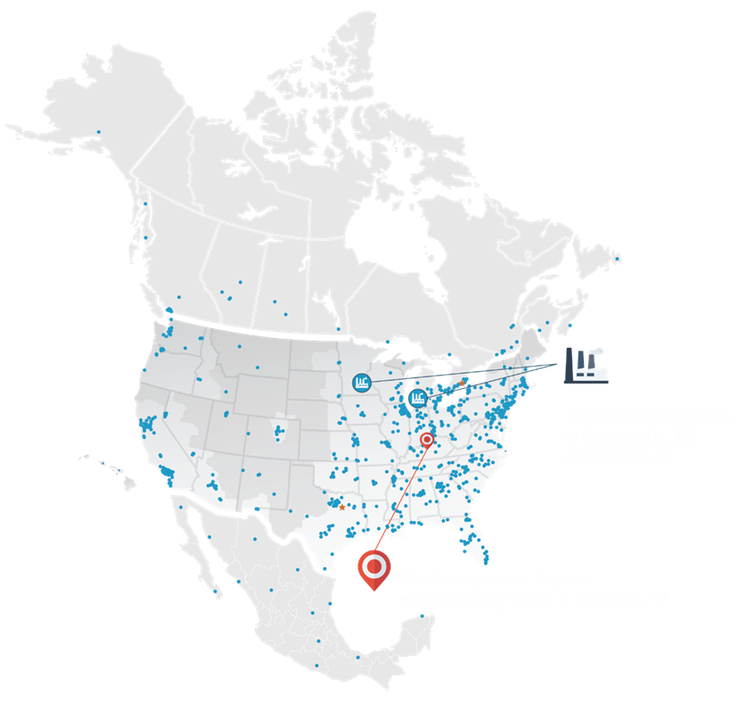
Trusted Autonomous Mobile Robot Advisor
150 Years of Industry Leadership
Global Leader in Autonomous Products
Dedicated AMR Technical Assistance Center
AMR Customer Success Team
Strategic Account Team
500+ Factory Direct Service Reps
240+ Field Reps
Brain Corp Partnership
Manufacturing Facility in Minneapolis, MN & Holland, MI
Distribution & Brush Manufacturing Facility in Louisville, KY
Confidential and proprietary - Copyright © 2023 Tennant Company

Slide 3

Turn Insights Into Action
Dedicated Customer Success Team focuses on making your robotic cleaning program successful.
  Combines robotics implementation experience and in-depth cleaning equipment knowledge to share best practices and tips for success
  Works with you to optimize your machines to achieve your results
  Identifies and resolve challenges by actively monitoring performance reporting
Confidential and proprietary - Copyright © 2023 Tennant Company

Slide 4

Our Robotic Journey
Introduced Lithium-Ion Technology to all 3 machines leading to longer runtime and opportunity charging
Announced a partnership
with Brain Corp
Shipped the first T380AMR, a smaller, maneuverable machine, designed to fit in tight and narrow spaces
2017
2018
2020
2021
2022
Today
Shipped the first T7AMR with Minimal Viable Product Strategy
Shipped the first T16AMR, the industry’s first robotic scrubber for large industrial spaces
Tennant machines can now be found in 20+ countries worldwide
Confidential and proprietary - Copyright © 2023 Tennant Company

Slide 5
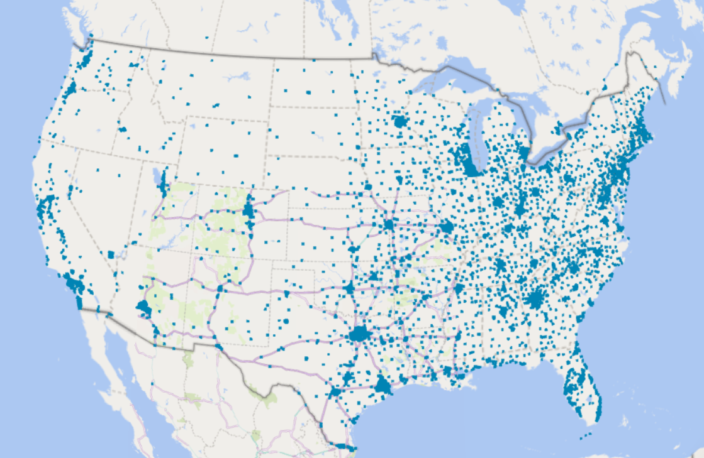
Tennant’s North America AMR Fleet
Confidential and proprietary - Copyright © 2023 Tennant Company
Notes:
Map highlighting where all of our AMR units are located in NA

Slide 6






Trusted. Responsive. Local.
Get the best return on your investment with high quality Tennant floor cleaning equipment — backed by the best service available
service techs
serving North America
licensed • bonded • insured
500+
hours annual training average
60
9 years
Factory certified
average tenure of service reps
robotic service techs
26% increase
in warranty usage when leveraging Tennant service
Planned maintenance
service plans designed to help you protect your investment
Confidential and proprietary - Copyright © 2023 Tennant Company
Notes:
We are here for you. Our Tennant Service Technicians service Tennant equipment everyday, all day. They’ve seen a lot of common issues and are dedicated to getting you back up and running. We offer service plans to meet your needs, allowing you to choose the plan that’s right for you. Plus, with our factory certified robotic service technicians have been specifically trained to service robotic scrubbers. Tennant Service Techs work hard to protect your warranty dollars and keep you cleaning.

Slide 7




How AMR Addresses Your Challenges
Solve Labor Challenges
Give time back to employees so they can focus on other higher value responsibilities; while also helping to bridge staffing issues.
Proof of Performance
Robots are great at capturing real-time data and provide proof of work and clean
Become a Technology Leader
Robots are a clear sign of your investment in innovation to create clean, healthily and safe spaces
Enhance Experience
Clean buildings enhance overall customer and employee experiences
Plus, you get a cleaner floor!
Confidential and proprietary - Copyright © 2023 Tennant Company
Notes:
Intended to tie back to the challenges discussed in the beginning – shows we know the challenges the customer is facing and how AMR can be a solution to those challenges
1.) Solve Labor Challenges
Robots help free up workers from dull, dirty, and dangerous tasks
Robots give valuable time back to workers to focus on higher-level tasks
2). Proof of Performance
Robots are great at capturing data and tracking KPIs and utilization
Robots provide proof of work reporting to satisfy compliance and regulatory needs
4). Enhance Overall Experience
Robots relieve some of the burden on workers and give valuable time back to focus on more
engaging higher-level activities
Robots deliver a consistent, verifiable clean to help satisfy the new, next-level customer expectations of clean
Clean Stores / Buildings make for more satisfied customers/building visitors
5). Become a technology leader
Businesses that don’t invest in the next wave of innovation are at greater risk of being left behind
Automation and robotics represent another pivotal moment that business cannot afford to miss

Slide 8

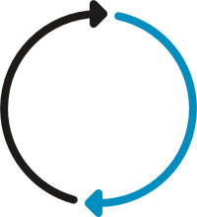
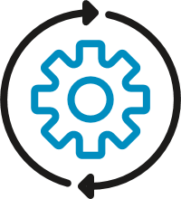


Why Tennant Partnered with Brain Corp
Ongoing Innovation & Updates
New features and robot performance optimization –continuous effort to improve
Robot Operation
“Teach and Repeat” a robot route
Autonomy Technology
Operating System, AI, Navigation and Safety controls
Connectivity & Infrastructure
Robot connectivity, remote diagnostics, data infrastructure and storage
Reporting & Analytics
Fleet management portal and email report subscriptions
Autonomy Expertise & Knowhow
Best in class software + best in class cleaning performance = customer success
Confidential and proprietary - Copyright © 2023 Tennant Company

Slide 9
Brain Corp’s Continuous Improvement
Area Fill:
A new way to teach the machine where you want it to clean. Simply drive around the perimeter of a space and the machine will fill it in on its own.
Consecutive Routes:
Allowing operators to clean multiple routes without having to return the machine back to the home marker
12 Routes per Marker:
Doubles the total number of cleaning routes available.
Learning Center:
Providing corresponding instructional videos for end-users
April
2019
August 2019
February 2020
May 2020
July
2021
October
2021
March
2022
Route History:
Allows users to access the route history directly from the user interface
Route Repeat Improvements:
Improved the Route Repeat feature to be configurable within the route selection screen
Stop & Honk:
Enables the operator to control exactly where they want the robot to make a complete stop and honk before proceeding
Brain has 56+ software updates in the last 24 months
Confidential and proprietary - Copyright © 2023 Tennant Company

Slide 10
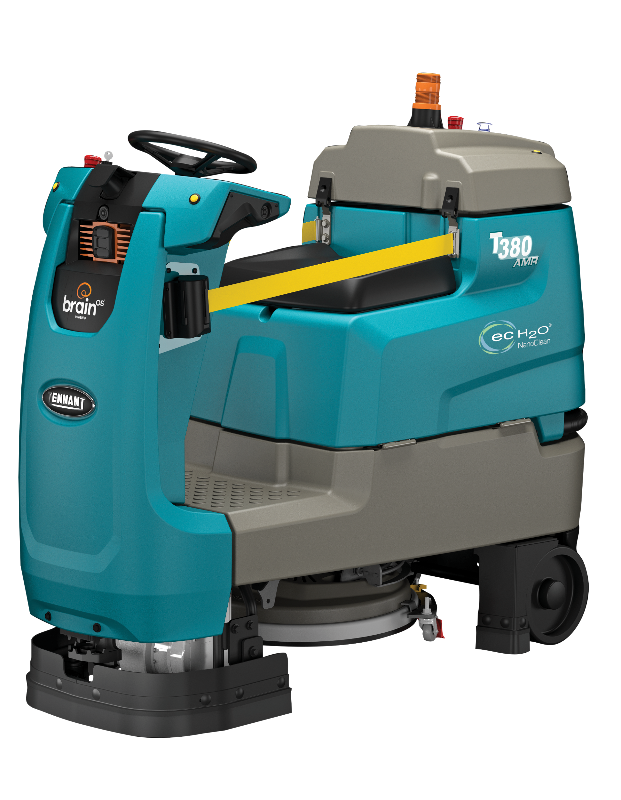
T380AMR Overview
Engineered for Autonomous Cleaning
  Increased safety & maximum productivity
  Specific machine designs to promote robotic cleaning
  Left & Right-hand turning capability
Cutting-edge vision-based A.I. system
  Powered by BrainOS® technology
  Create multiple routes in complex environments
  Adaptive navigation, obstacle avoidance
Consistent Cleaning Experience
  Teach & Repeat ensures consistent performance
  Productivity gains with fewer operator assists
  Data insights & operator alerts
Confidential and proprietary - Copyright © 2023 Tennant Company

Slide 11


T380AMR Advantages
Reduce Costs to Clean
Redeploy employees to focus on high-value tasks requiring hands-on work
Measure and track with weekly usage reports
Maintain Health and Safety
Safely avoid people and unplanned obstacles in real-world applications with BrainOS®
Safely charge batteries with a kickstand to ensure venting and prevent charger wire damage.
Enhance Facility Image
Clean more effectively and consistently by running multiple routes, back-to-back, without assistance.
Reassure employees and customers that clean is a priority by running the T380AMR during regular business hours.
Easy Operation & Maintenance
Simple, intuitive controls and programmed cleaning routes
Easy brush maintenance and replacement with a built-in brush wear indicator and Insta-Click™ brush head.
Confidential and proprietary - Copyright © 2023 Tennant Company

Slide 12
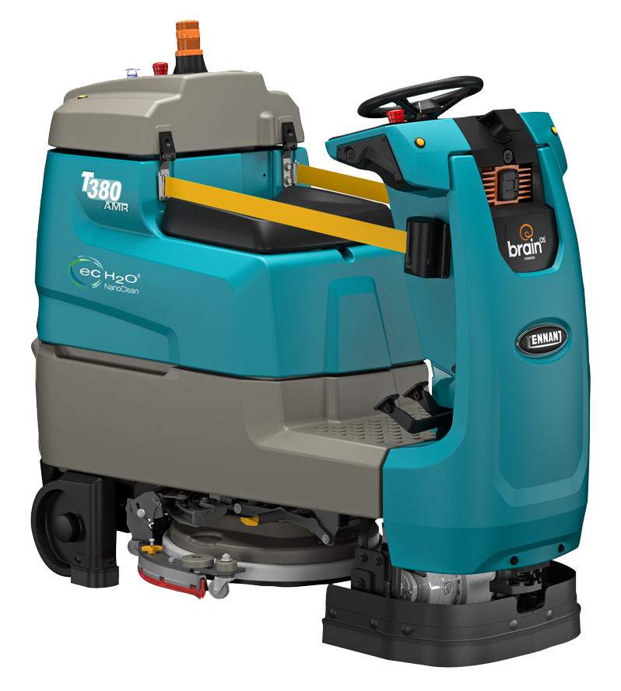
T380AMR Features
Seat pad designed to promote autonomous operation
Safety straps and seat-sensor switch to deter joy-riding
Lift assist and kickstand to easily access and safely charge batteries and prevent wire damage
The tapered front of the machine promotes maximum maneuverability
Updated pedals operate more like a car, with a separate brake pedal
Built-in sensor protection
Squeegee directly behind allows for cleaning in narrow aisles, tighter turns & smaller u-turns
Insta-Click® simplifies brush and pad changes
1
2
4
3
5
7
8
6
Confidential and proprietary - Copyright © 2023 Tennant Company

Slide 13

T380AMR Technology
3D Sensor
LIDAR
3D Sensor
BrainOS® Module
User Interface
3D Sensor
Warning Light
Start/Pause Button
Turn Indicators
Joy Ride Detection
Wheel Sensors
LIDAR
7
8
1
9
2
5
3
6
4
10
11
12
Confidential and proprietary - Copyright © 2023 Tennant Company

Slide 14

ec-H2O NanoClean® Technology
Green Cleaning & Sustainability
Imagine a new cleaning process:
  Available on all Tennant AMR equipment
  Electrically converts water into an innovative detergent-free solution
  Protect users by eliminating health issues associated with harsh cleaning chemicals.
  ec-H2O uses 70% less water than conventional scrubbing methods
How AMR benefits from ec-H2O?
Helps prolong the runtime
  Water molecules are electrically charged causing them to expand. Expanded water molecules have greater floor coverage when cleaning, leading to the use of less water needed to clean the floors.
  Less water needed to clean floors = more run time per tank
Spend more time cleaning
    Eliminate time required for chemical handling, mixing, and usage training
    Just fill with H₂O and go!
Confidential and proprietary - Copyright © 2023 Tennant Company

Slide 15
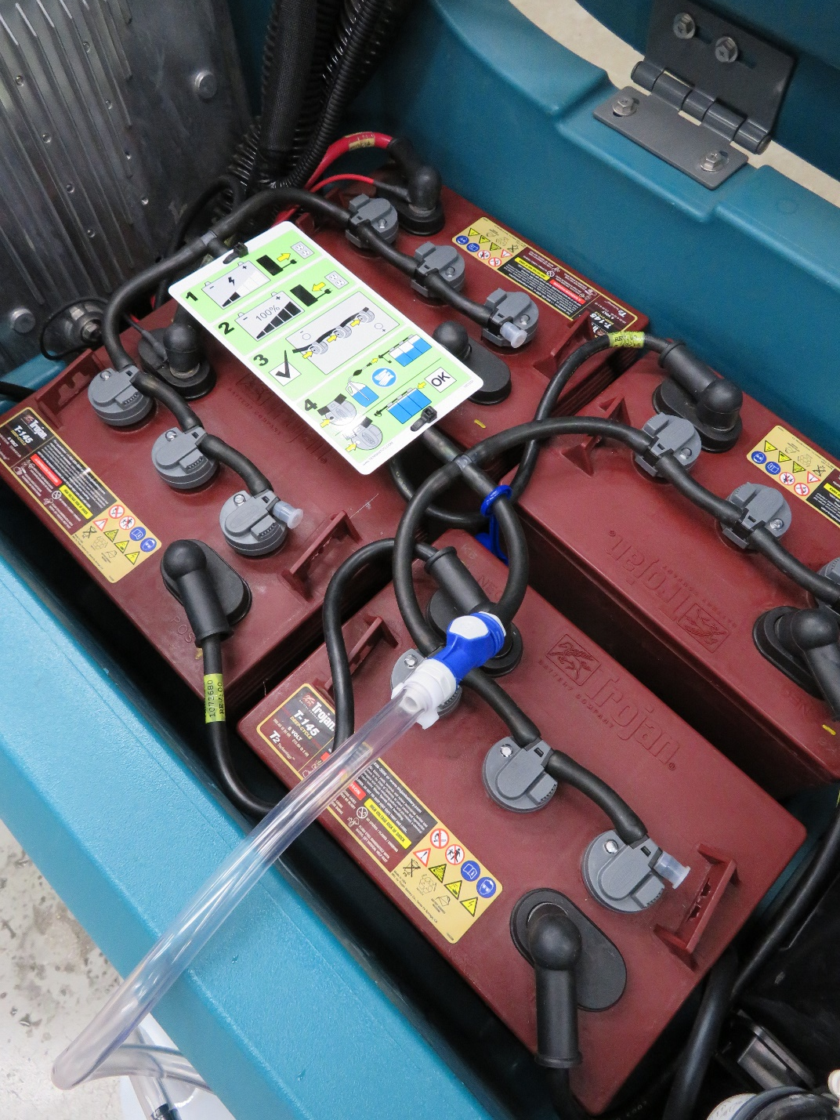
Manual Battery Watering System
Save time and money with a system that helps you decrease maintenance needs and increase battery life
Spend more time cleaning, and less time on battery maintenance with Manual Battery Watering’s quick, easy-to-use design that requires little to no training
Protect your operators from the possibility of acid contact and other risks associated with open battery maintenance
Confidential and proprietary - Copyright © 2023 Tennant Company

Slide 16

Benefits of Lithium-ion Batteries
Zero Maintenance
No more battery watering. No engine maintenance. No worries.
Maximized Productivity
Long life, fast charging, longer runtimes, & opportunity charging to minimize idle time.
Optimize equipment uptime by spending more time cleaning and less time dealing with your power source
Constantly communicates data to machine, to optimize safety, performance, productivity, and longevity
Long Battery Life
2,000+ charge cycles means fewer battery replacements
No fuel cylinder replacements
Simplified Operations
Opportunity charging does not reduce the life of the battery
No complicated charging process
Fewer battery replacements, no battery watering, lower charging costs, and minimal training required
Safer Facilities
Improved indoor air quality due to no emissions
Eliminates the need for flammable fuels on property
No exposure to battery acid or off-gassing during charging
Confidential and proprietary - Copyright © 2023 Tennant Company

Slide 17
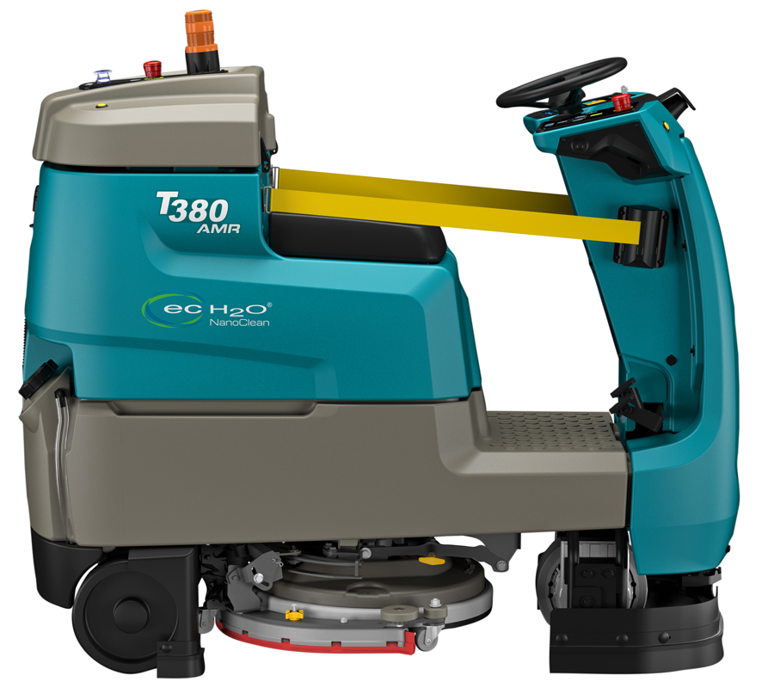
Key Markets for T380AMR
Retail (mid-to-large size)
Healthcare
Education
Hospitality
Confidential and proprietary - Copyright © 2023 Tennant Company

Slide 18
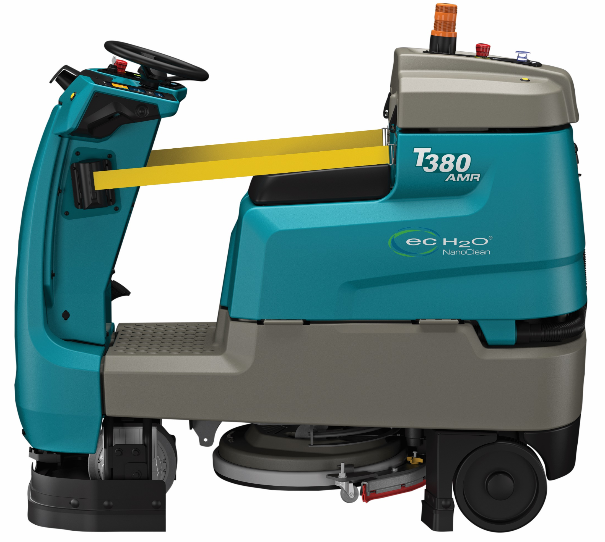
Target Applications
Facility Layout
  Mid-to-large size cleaning areas (40-90,000 sq ft)
  Currently scrubs 2 - 4 hours a night, 3-7 days/week
  Narrow aisles, pathways, tight and/or frequent turn around points
    3.5’ on the straightaway
    4.5’ on a turn into an aisle
    7.5’ for autonomous U-turn
Cleaning Challenges
  Increased cleaning and disinfection demands
  Higher customer expectations of clean
  Labor costs and employee retention
Understand the Drivers for a Robotic Solution
  Need for consistent cleaning and proof of clean data
  Ability to reallocate labor to high-value cleaning tasks, working alongside the robotic scrubber
  Desire to enhance overall facility image with innovative and sustainable equipment
Confidential and proprietary - Copyright © 2023 Tennant Company

Slide 19
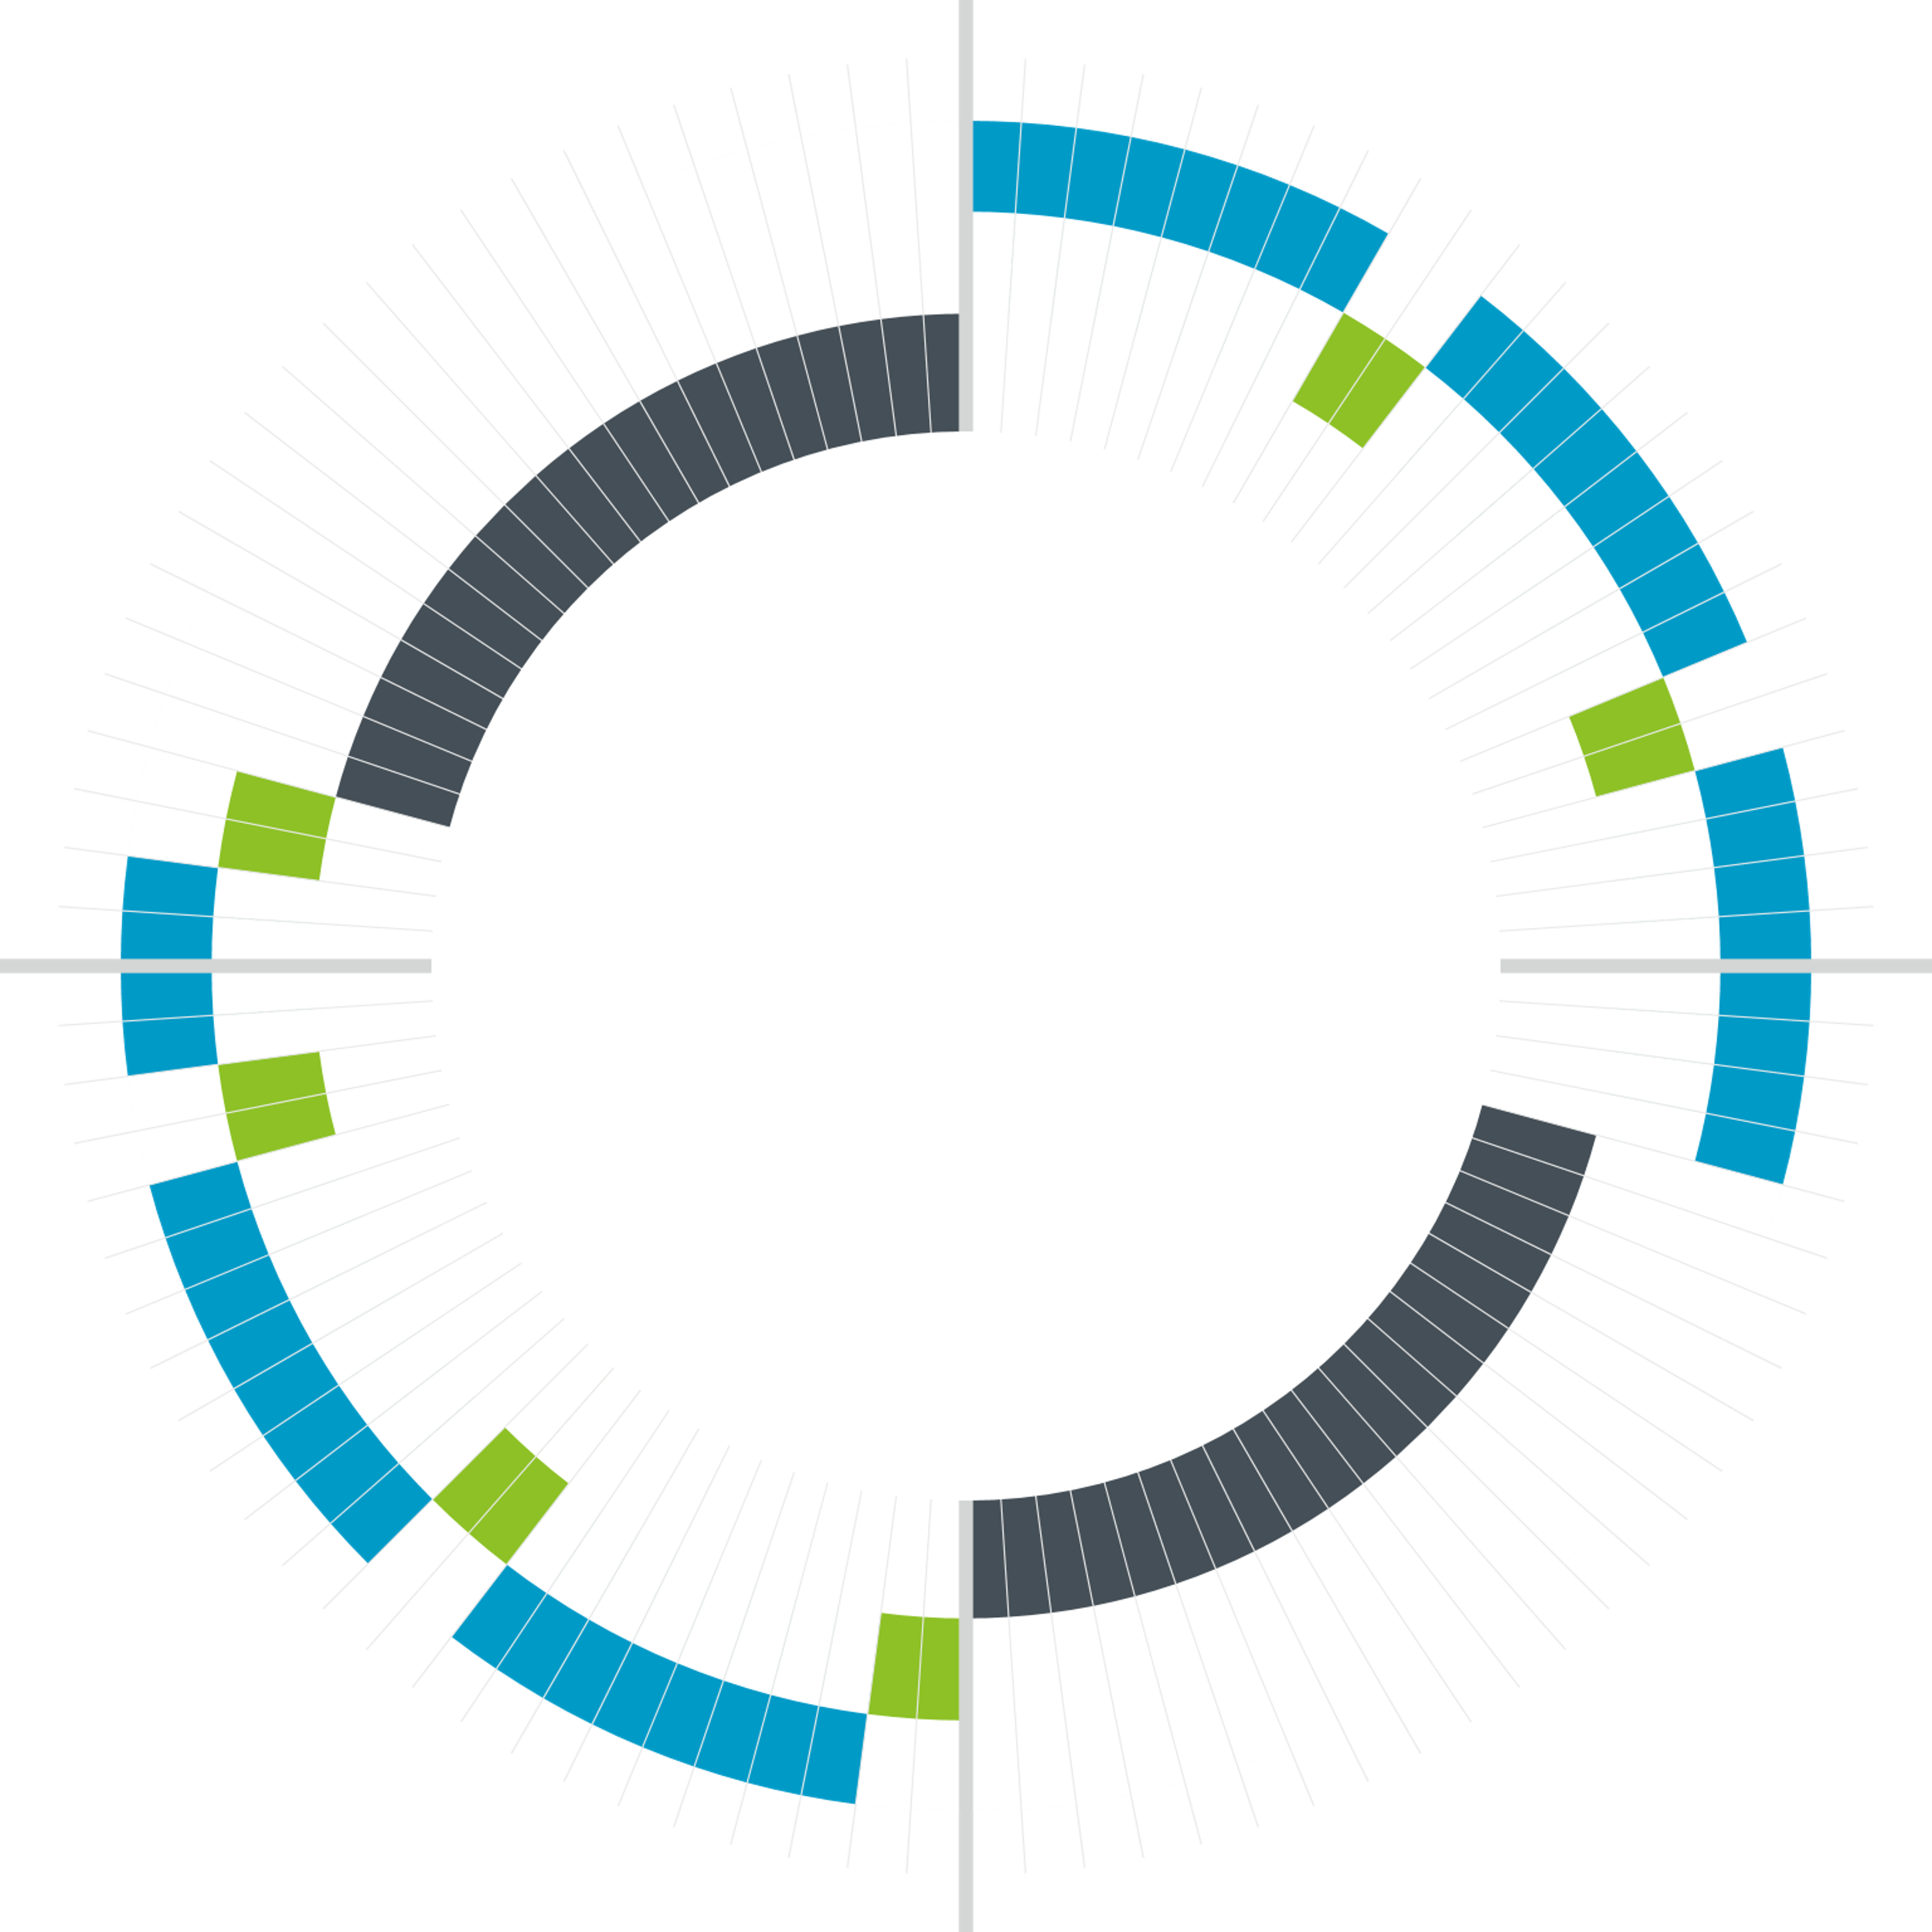
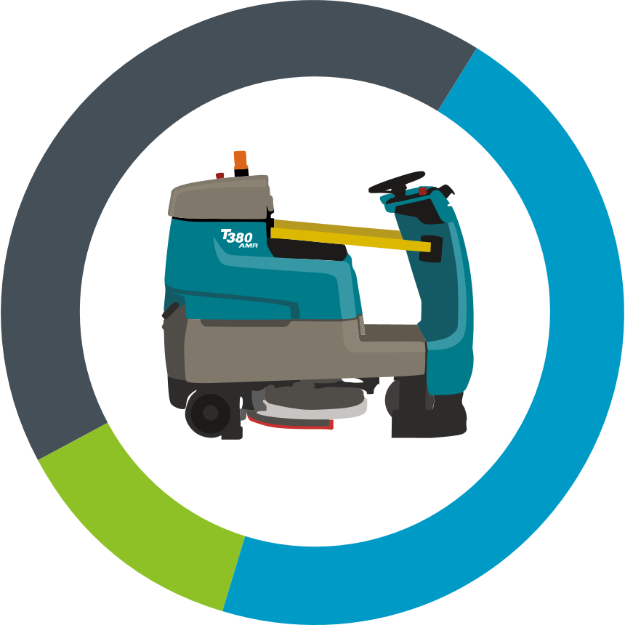

T380AMR Daily Run-Time
High-Capacity Lithium-Ion Battery
24
Daily Cleaning Capacity
10 hours charging
up to
18
11 hours
6
11 hours run time
run time in 24 hours
3 hours empty/fill
Run Time
Empty/Fill
Charging
Assumptions:
This example is based on an optimal Empty/Fill time of 30 mins - may take longer or less time depending on conditions. Estimated total charge and run time is based on High-Capacity Lithium-Ion Battery option. Estimated run time between empty/fill is based is based on ec-H2O NanoClean® Low Flow with a 60-gallon recovery tank.
12
Confidential and proprietary - Copyright © 2023 Tennant Company

Slide 20
Getting the Most Out of your Autonomous Cleaner
The combination of Lithium-ion technology, ec-H2O, and delayed start, help Tennant’s autonomous floor scrubbers clean longer daily
How is this possible?
Lithium-Ion technology:
  Helps reduce charge time while allowing opportunity charging. Meaning the operator can charge the machine while dumping and filling the tanks.
  Helping the machines run 10+ hrs a day.
ec-H2O technology:
  Electrically charges water molecules making them expand
  Leading to greater floor cleaning coverage, meaning you need less water needed to clean the floor
  Eliminates time required for chemical handling, mixing, and usage training
  ec-H2O is exclusive to Tennant
Delayed Start
  Schedule another cleaning shift during downtime, or when an operator isn’t present
Confidential and proprietary - Copyright © 2023 Tennant Company

Slide 21
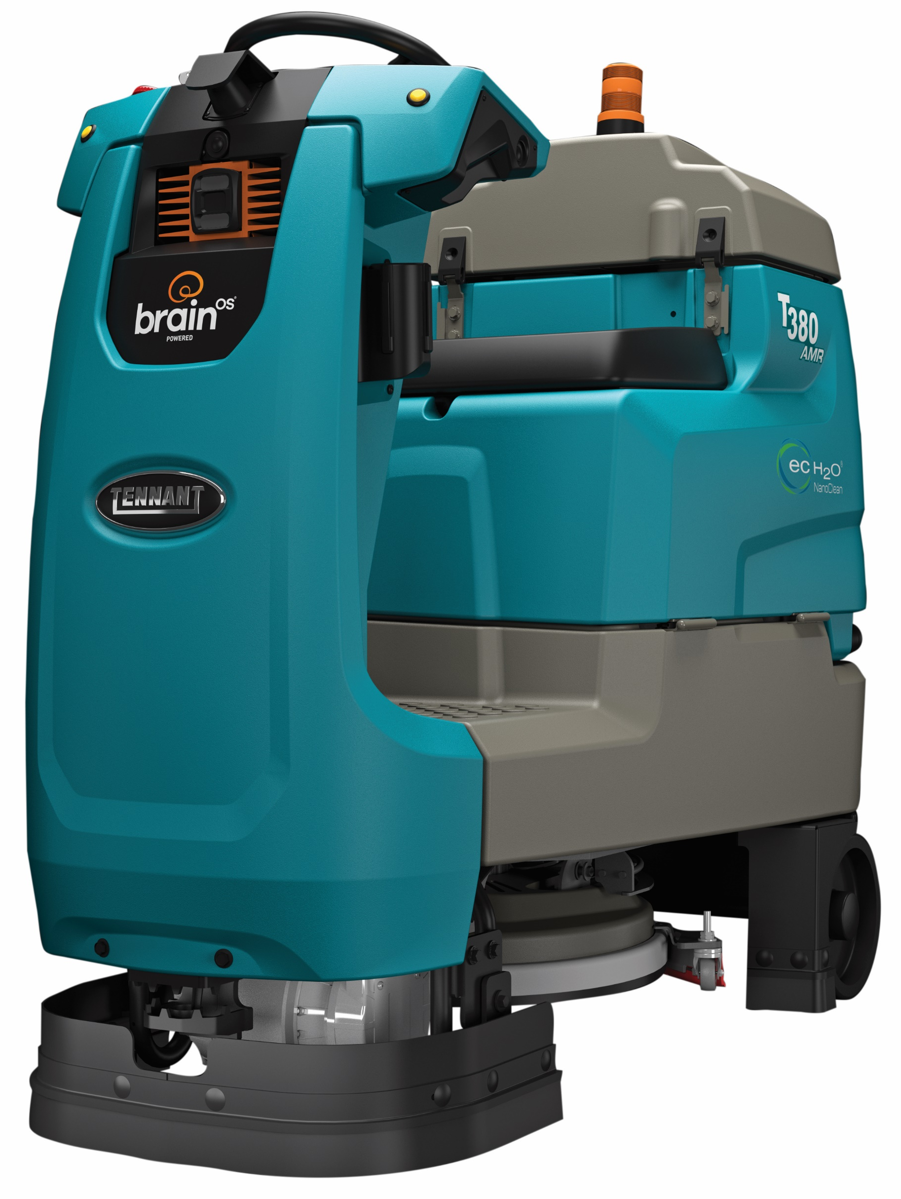
Clean Safely & Collaboratively
While the robot scrubs, employees can focus on other, value-add tasks:
Sanitize & Disinfect High Touch Surfaces
Check & Replenish Inventory
Perform General Purpose Cleaning
Complete Project Work
Ensure Entry Ways are Inviting & Safe
Focus On Reducing Slip & Fall Risks
Clean Walk-Off Mats More Frequently
Assist with Shipping & Receiving
Aid in Customer Service Support
Maintain Restroom Cleanliness
Sweep
Ensure Break Room Cleanliness
Confidential and proprietary - Copyright © 2023 Tennant Company

Slide 22
Upskill Employees With AMR
What is an “upskilled” employee?
Proactively training up your employees to gain additional, valuable skills. Employee is now a robot operator; the employees can now focus on doing other high skill tasks.
What it means for the employee?
The employee gains a valuable skill that can help them advance in their organization.
Employee is no longer just a scrubber driver or cleaning person; they are a robot operator.
Employees can now focus on other tasks that require high skill
What it means for the employer?
Upskilling the employee helps prepare them for the ever-changing environment they are working in.
As warehouse operations continue to automate, AMR helps train employees to work side by side with technology so that when they automate other things, they won’t be as intimidated.
Helps employers identify those that have the ability and motivation to do other tech related tasks in the facility.
Upskilling programs signal to employees that they are valued, and their professional development is a priority.
Tennant has upskilled 10,500+ employees
*We train a minimum of 2 employees at every AMR install
Confidential and proprietary - Copyright © 2023 Tennant Company
Notes:
This highlights the value in introducing AMR to your employees.

Slide 23
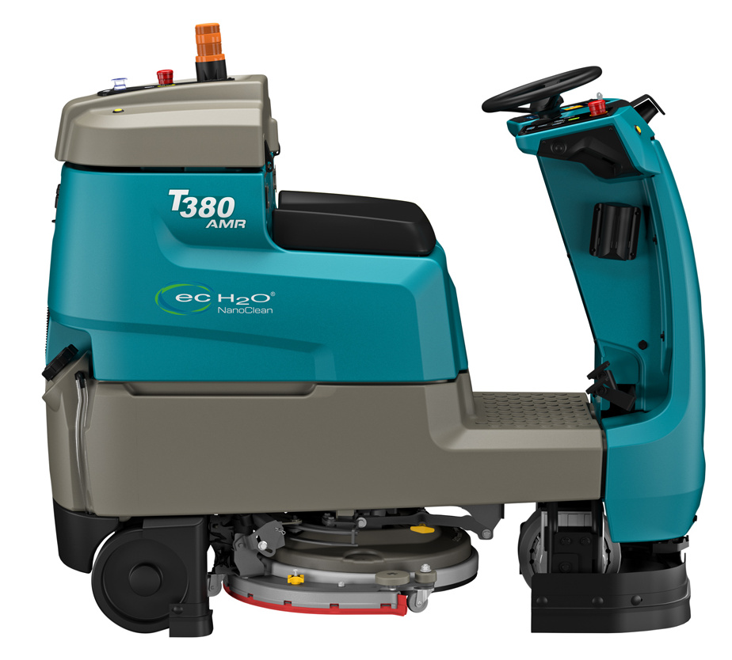
Break the Chain from Your Walk-Behind Scrubber
Employees who clean using walk-behind scrubbers are tethered to the machine and cannot clean other areas or handle other tasks while cleaning.
Break your employees free with AMR.
While the AMR machine is cleaning, the employee can now accomplish other high value tasks
Let the AMR machine operate highly repetitive mundane tasks to increase facility health and safety
Clean the same amount of area with 1 employee vs. 2 employees
Other tasks employees can perform with AMR:
Cleaning other areas
Inventory Management
Order Fulfillment
Restocking
Tag and Label Merchandise
Operate Forklift
Confidential and proprietary - Copyright © 2023 Tennant Company

Slide 24
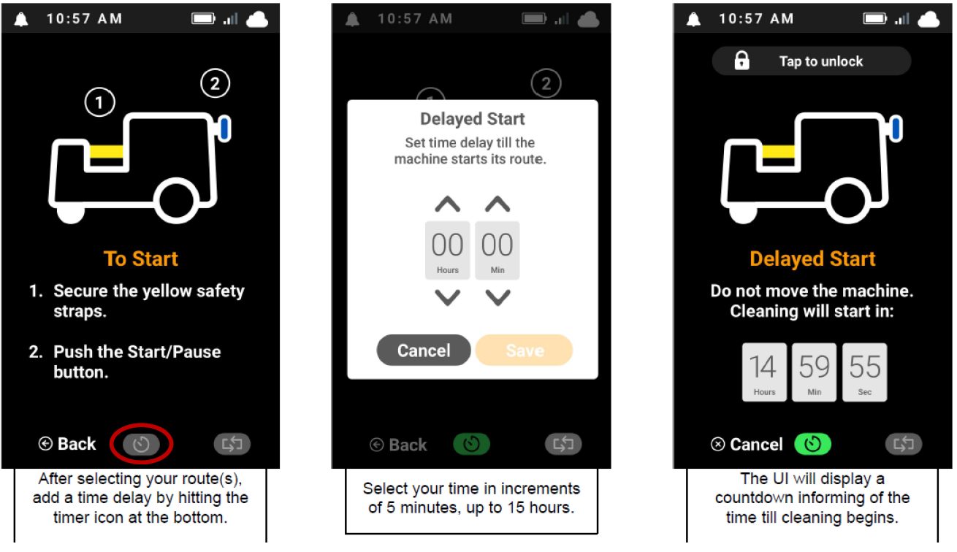
Delayed Start
Delayed start allows the user to select a specific time they want the machine to start cleaning.
Benefits of Delayed Start:
Run during downtime: Allowing the machine to run overnight or when there are no operators present
Added Convenience: Operators no longer need to be by the machine in order to start the cleaning process
Confidential and proprietary - Copyright © 2023 Tennant Company

Slide 25
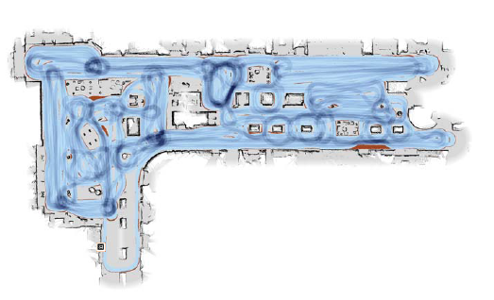
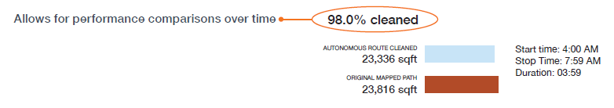
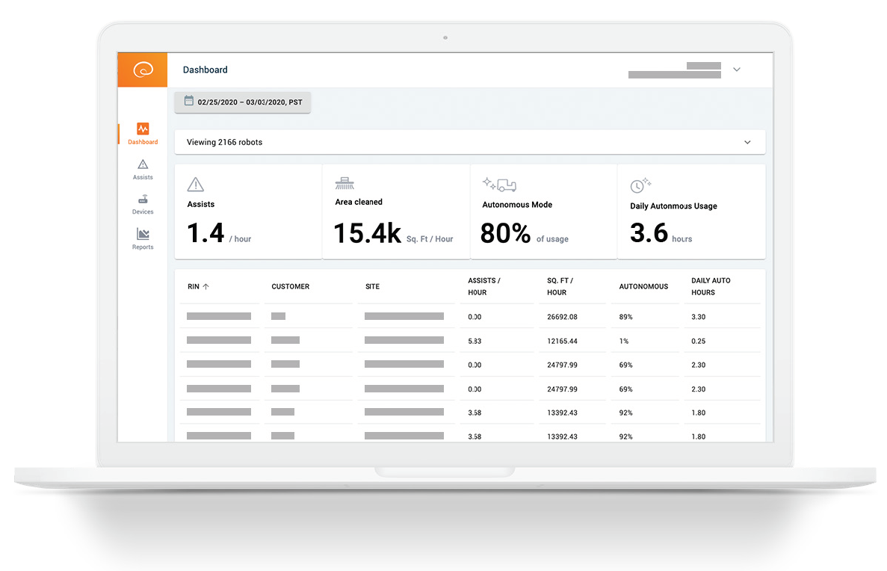
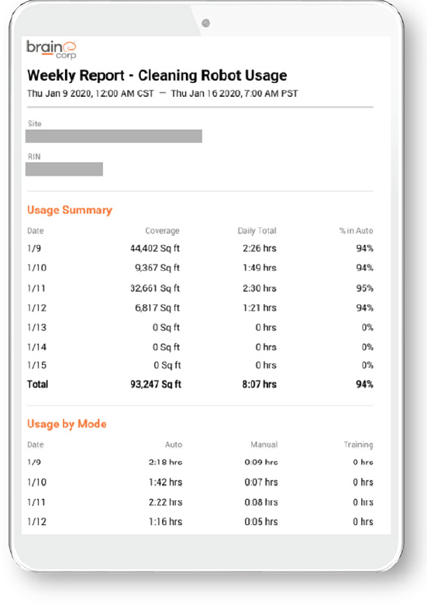
Performance Reporting
Weekly report
  Usage by time of day and day of week
    Autonomous vs. Manual vs.Training Usage
  Estimated area (sq. ft.) covered autonomously
  Heat maps
  Tennant internal support/auditor
Identify compliance issues and potential training opportunities
Confidential and proprietary - Copyright © 2023 Tennant Company

Slide 26
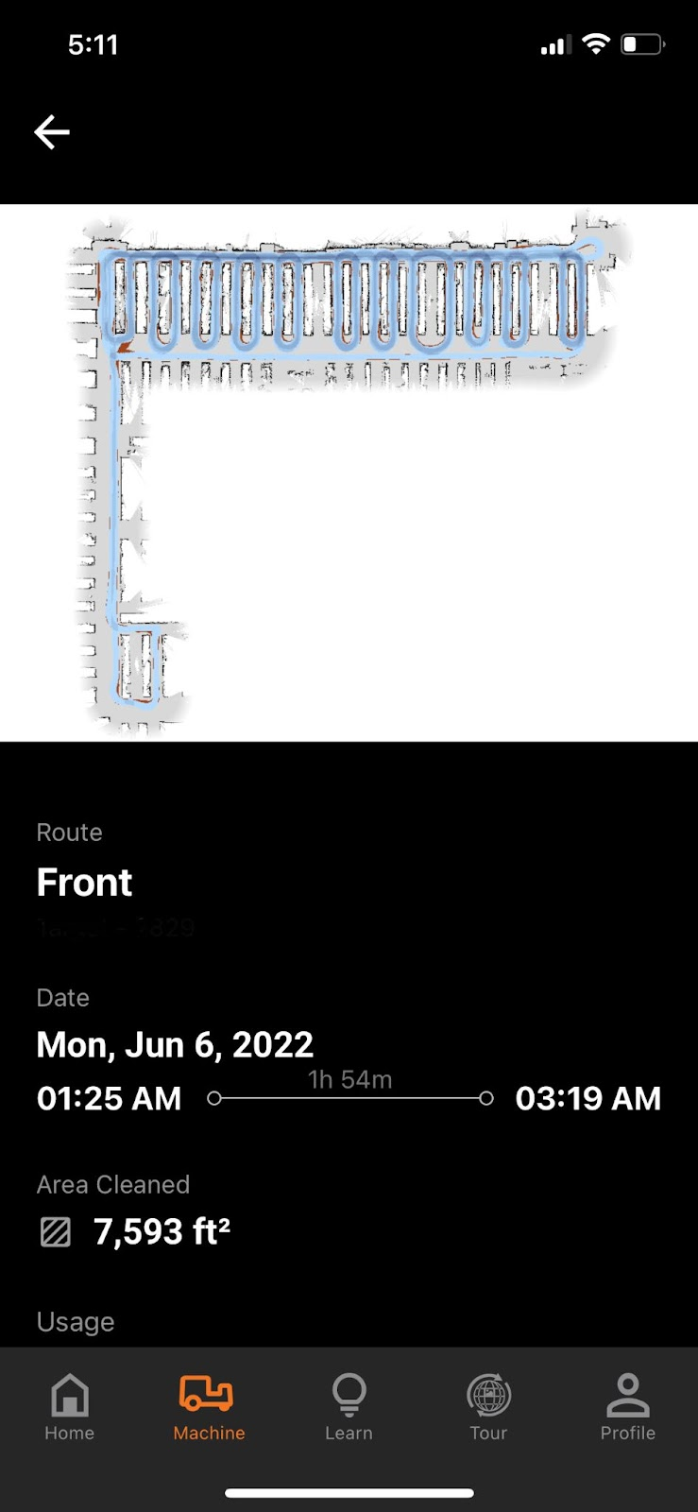
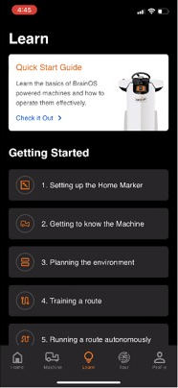
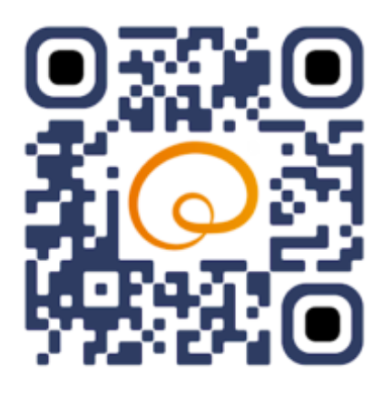
BrainOS® Mobile App
BrainOS® Mobile is a robot tool designed for anyone tasked with using, managing and monitoring BrainOS®-powered robots
What does it mean for user:
View and track machine status
Push notifications directly to User’s phone (assist, route completion, route start/end, maintenance)
What does it mean for management:
Sort by various metrics (autonomous usage %, area cleaned, routes run, etc.)
Site metrics (view trends, monitor patterns, and check on areas for improvement)
What does it mean for fleet management:
BrainOS® Mobile joins a suite of fleet management tools enabled by BrainOS® Autonomy Services including a Fleet Ops Portal
Delivering proof-of-work performance metrics and daily/weekly email reports to drive greater efficiencies
DOWNLOAD APP
Confidential and proprietary - Copyright © 2023 Tennant Company
Notes:
User receive important SMS notifications from their machine
Users can interact with their machines and oversee their robots’ productivity and performance at any time from anywhere, including remotely
User can see location and reason of assist events
Managers can see what was and wasn’t cleaned in their facility
Quickly see where autonomous routes are trained in a facility

Slide 27
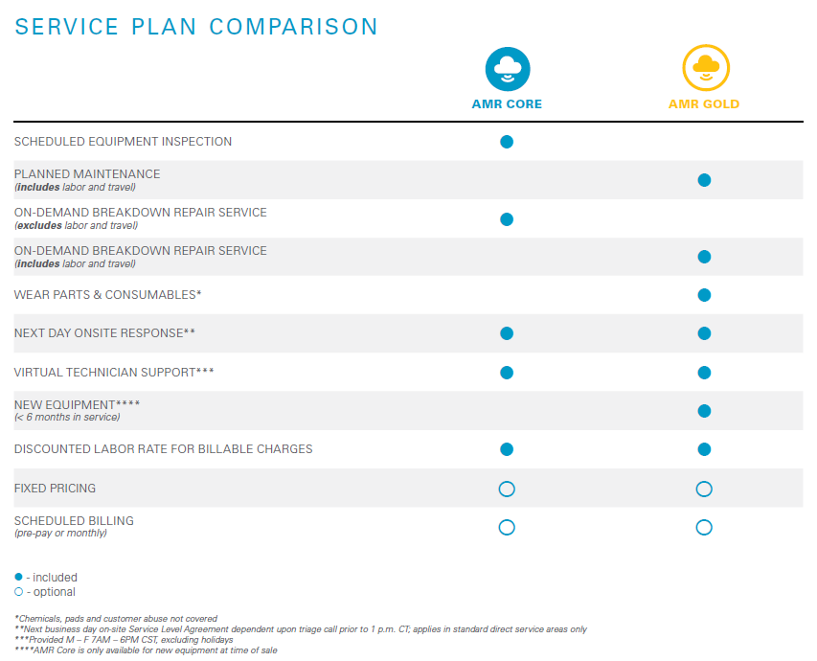


AMR Service Plan – Gold Service Offering
SERVICE PLAN COMPARISON
Uptime commitment – responsive through SLAs
  Breakdown repairs routed to TAC for triage (same day)
  Technician onsite next business day**
Full-Service Maintenance
  Planned maintenance, breakdown repairs, most consumables and includes brushes, batteries and parts
Performance assurance – inspections (equipment and software)
WHAT MATTERS MOST
Uptime Assurance
Budget Control
Investment Protection
Optimized Performance
Confidential and proprietary - Copyright © 2023 Tennant Company

Slide 28
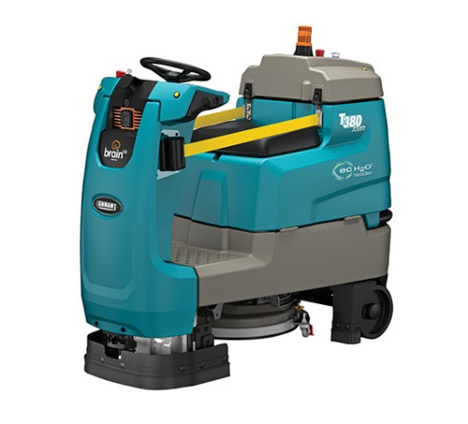
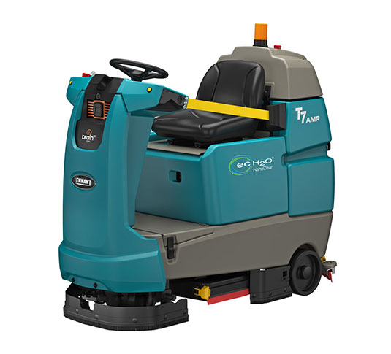
T380AMR & T7AMR
Feature | T380AMR | T7AMR
Cleaning path (disk) | 20 in / 500 mm | 26 in / 650 mm
Productivity (per hour) theoretical max manual mode | 33,440 ft² / 3,106 m² | 45,760 ft² / 4,250 m²
Solution tank | 20 gal / 75 L | 29 gal / 110 L
Length | 62 in / 1,575 mm | 65 in / 1,650 mm
Width | 25 in / 635 mm | 33.25 in / 850 mm
Height (to light) | 55 in / 1,397 mm | 57 in / 1,450 mm
Weight (tanks empty) with batteries | 850 lbs / 385 kg | 1,085 lbs / 492 kg
BrainOS® operating system | teach & repeat
Ideal applications | Typically 40K – 110K ft² facilities Midsize spaces with possible constricted areas Mid-sized retail, healthcare lobbies/hallways, schools Spaces where maneuverability and tighter turns required Smaller storage areas, spaces with elevators, or doorways | Typically 70K – 180K ft² facilities Large open areas with limited obstructions Large retail, convention centers, arenas, airports, multi-level schools and universities Productivity is primary concern; fewer dump & fills, aggressive down pressure to help with performance of various polishing tools
Specifications subject to change without notice and will vary throughout the operation of the machine; averages are shown.
Confidential and proprietary - Copyright © 2023 Tennant Company
Notes:
Dennis

Slide 29

T380AMR Pricing Lithium Version
Prices Include:
T380AMR
  Up to 10 Hours Scrubbing in 24-hour period
  Maintenance Free Sealed Battery
  ec-H2O NanoClean® technology (optional)
  Daily reporting on machine utilization
  1-800 Technical Assistance Center access
  Front Blue Light (optional)
 | T380AMR MACHINE |  |  | PRE-PAY AUTONOMY SERVICE |  |  |  | AUTONOMY SERVICE INCLUDED
 | PURCHASE | LEASE |  | 36 MONTH |  | 60 MONTH |  | 36 MONTH | 60 MONTH
Quantity | Price | Price |  | Payment 1 | Payment 2-36 | Payment 1 | Payment 2-60 | Payment 1-36 | Payment 1-60
1-49 Units
50-99 Units
100-249 Units
250+ Units
*Pricing does not include freight or taxes
Confidential and proprietary - Copyright © 2023 Tennant Company
Notes:
Pricing slides to be filled out by Sales rep

Slide 30
T380AMR Pricing FLA Version
Prices Include:
T380AMR
  Manual Battery Watering System (optional)
  ec-H2O NanoClean® technology (optional)
  Daily reporting on machine utilization
  1-800 Technical Assistance Center access
3 Year of Brain OS autonomy services ($X,XXX per additional year)
 | T380AMR MACHINE |  |  | PRE-PAY AUTONOMY SERVICE |  |  |  | AUTONOMY SERVICE INCLUDED
 | PURCHASE | LEASE |  | 36 MONTH |  | 60 MONTH |  | 36 MONTH | 60 MONTH
Quantity | Price | Price |  | Payment 1 | Payment 2-36 | Payment 1 | Payment 2-60 | Payment 1-36 | Payment 1-60
1-49 Units
50-99 Units
100-249 Units
250+ Units
*Pricing does not include freight or taxes
Confidential and proprietary - Copyright © 2023 Tennant Company
Notes:
Pricing slides to be filled out by Sales rep

Slide 31
Questions?
Confidential and proprietary - Copyright © 2023 Tennant Company

Slide 32
Appendix
Confidential and proprietary - Copyright © 2023 Tennant Company

Slide 33
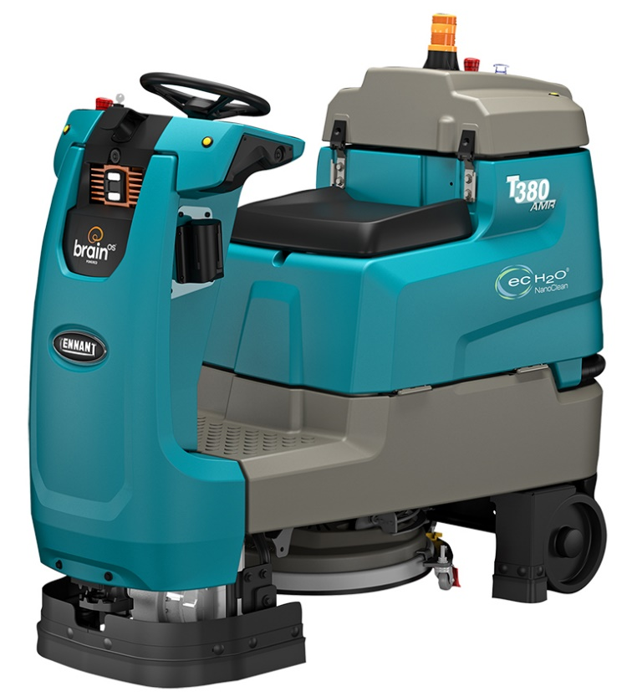
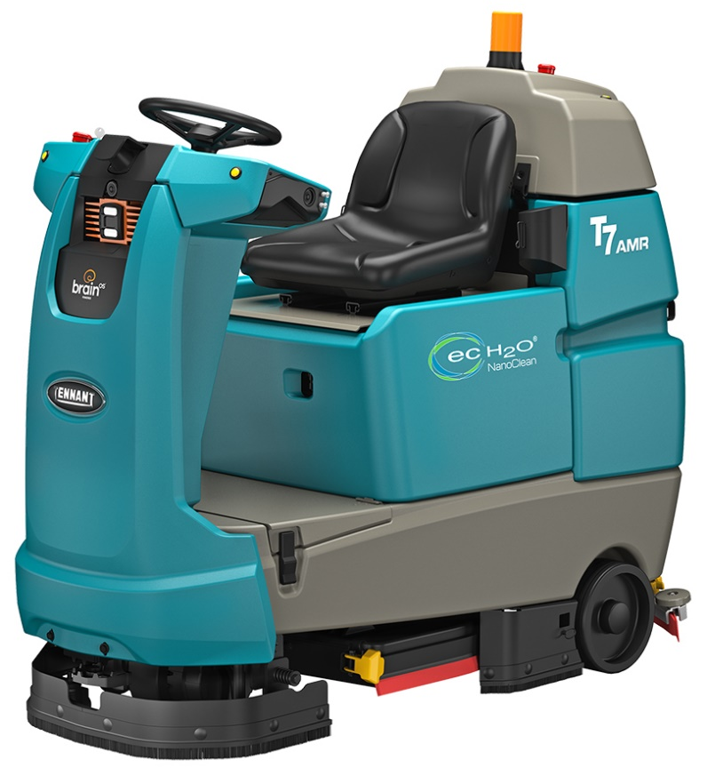
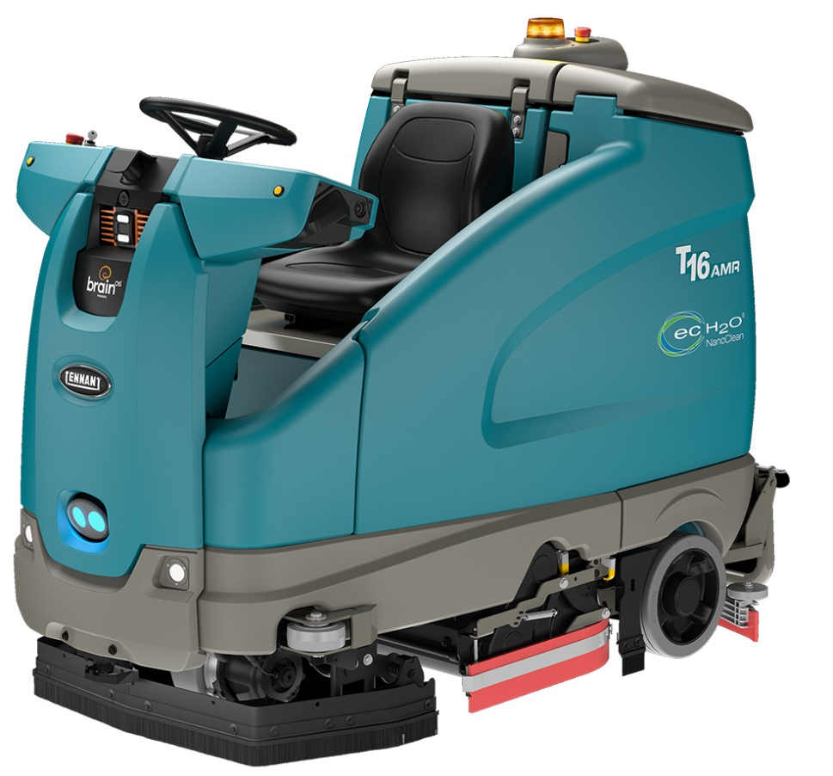
Tennant’s AMR Line-Up
 | T380AMR | T7AMR | T16AMR
Application | commercial to light warehousing | commercial to light warehousing | warehousing & manufacturing
Debris Capability | skirting | skirting | sweeping capacity
Cleaning Capability | scrubbing/polishing | scrubbing/polishing | scrubbing/sweeping
Runtime/Charge | up to 5 hours | up to 6.5 hours | up to 5.4 hours
Daily Cleaning Capacity | up to 10 hours | up to 13 hours | up to 15 hours
Primary Strength | maneuverability | largest installed base | capacity & sweeping
Confidential and proprietary - Copyright © 2023 Tennant Company

Slide 34
Feature Comparison
 | T380AMR | T7AMR | T16AMR
Scrub Technology | disk | disk | cylindrical
ec-H2O NanoClean® | optional | optional | standard
HD Squeegee Protection | n/a | n/a | standard
LED Head Lights | n/a | n/a | standard
Blue Light | n/a | aftermarket | standard
Ingress/Egress | both sides | both sides | right side
Battery Technology | flooded & lithium ion | flooded & lithium ion | flooded & lithium ion
Long Range Lower Lidar | n/a | n/a | standard
Confidential and proprietary - Copyright © 2023 Tennant Company

Slide 35
Spec Comparison
 | T380AMR | T7AMR | T16AMR
Scrub Path | 20 in / 500 mm | 26 in / 650 mm | 36 in / 910 mm
Scrub Technology | disk | disk | cylindrical
Solution Capacity | 20 gal / 75 L | 29 gal / 110 L | 50 gal / 190 L
Machine Voltage | 24 V | 24 V | 36 V
Hourly Capacity (1.8 mph) | 15,800 ft² | 20,600 ft² | 28,500 ft²
Cleaning Capacity / Charge | 63,360 ft² | 82,370 ft² | 159,670 ft²
Pass Through | 3½ ft | 4 ft | 5 ft
Turn in Clearance | 4½ ft | 5 ft | 6½ ft
180° Aisle - Turn | 7½ ft | 10 ft | 11½ ft
Confidential and proprietary - Copyright © 2023 Tennant Company

