Slide 1
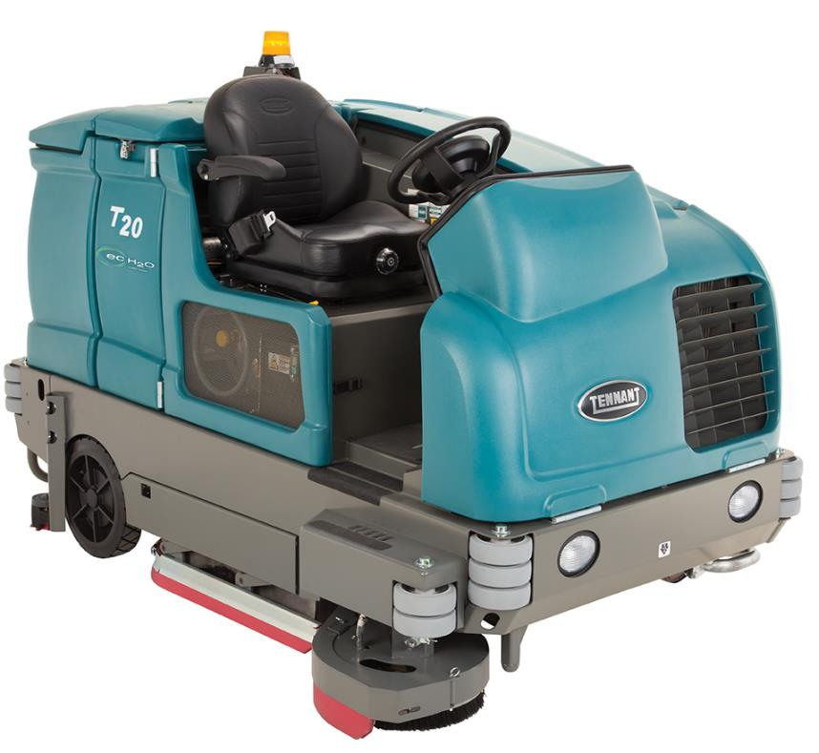
T20 INDUSTRIAL SCRUBBER
PRESENTER NAME MONTH.DATE.YEAR

Slide 2



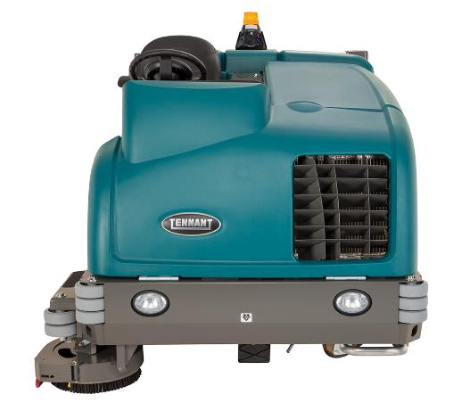

T20 INDUSTRIAL SCRUBBER
ADVANTAGES
Reduce Costs to Clean
  Clean more productively with innovative technology
  Quality construction extends machine life
Maintain Health and Safety
  Forward operator position, eyes-forward controls and open sightlines improve visibility
  Spacious operator compartment and full front shroud enhance comfort and safety
Enhance Facility Image
  Excellent scrubbing and water recovery performance
  Consistent power to the brush drive motors
Easy Operation & Maintenance
  Intuitive operator controls
  Tool-free access to main parts

Slide 3



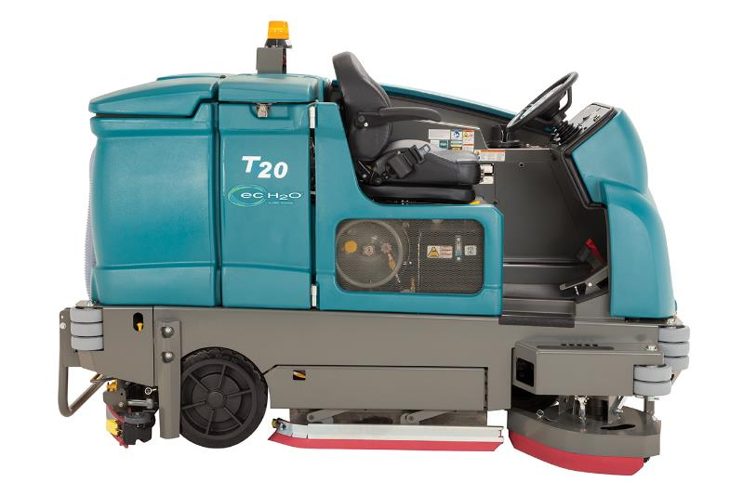

T20 INDUSTRIAL SCRUBBER
KEY MARKETS
Heavy and Light Manufacturing
Warehousing & Logistics
Distribution Centers
Food and Beverage

Slide 4

T20 SWEEPER-SCRUBBER
BUILT-IN RESULTS
SENTINEL RIDER SWEEPER
BUILT-IN RESULTS
PRODUCT FEATURES FOCUSED ON REDUCING COST & MAINTAINING HEALTH & SAFETY
Reduce Costs to Clean
Maximize productivity with aggressive scrubbing and MaxPro²™ hydraulic technology.
Scrub up to three times longer on a single tank of water with innovative ec-H2O™ technology.
Extend scrubbing path up to 54 in/1,370 mm with optional scrubbing side brush.
Extend machine life with heavy-gauge steel frame and corrosion-resistant Duramer™ body construction.
Protect your assert from damage upon impact with heavy-duty wraparound steel bumper.
Maintain Health & Safety
Improve operator visibility with steering-wheel-mounted controls and forward operator position.
Ensure operator leg and foot protection with full front shroud.
Reduce the potential for mold and odors with easy-to-clean solution and recovery tanks.
Reduce the risk of slips and falls with excellent water recovery.
Protect the operator from falling objects and debris with optional overhead guard.

Slide 5
T20 SWEEPER-SCRUBBER
BUILT-IN RESULTS
SENTINEL RIDER SWEEPER
BUILT-IN RESULTS
SENTINEL RIDER WEEPER
BUILT TO YO NEEDS
PRODUCT FEATURES FOCUSED ON ENHANCING IMAGE & EASY OPERATION & MAINTENANCE
Enhance Facility Image
Deliver exceptional cleaning results with aggressive scrubbing performance.
Deliver consistent power to the brush drive motors regardless of floor surface changes with MaxPro²™ hydraulic technology.
Meet the requirements of your environment with dual cylindrical brushes or three gimbal-mounted disc brushes.
Leave a clean path with unique Dura-Track™ parabolic rear squeegee.
Blast-clean hard-to-reach areas with optional high-powered pressure washer.
Easy Operation & Maintenance
Operation is made easy with Touch-n-Go™ control module and available Pro-Panel™ technology.
Simplify preventative maintenance with easy-to-identify yellow touch points.
Increase ease of operation maneuvering in congested spaces with front-wheel steering.
Reduce time spend on maintenance with no-tool access to all squeegees, brushes and filters.
Quickly and easily clean the recovery tank with the optional spray nozzle.

Slide 6
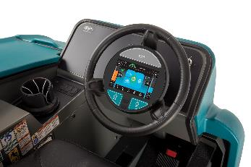
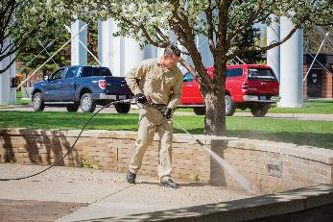
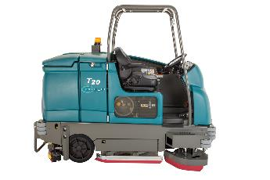
T20 SWEEPER-SCRUBBER
OPTIONAL FEATURES
Productivity and Ease of Operation:
  Pro-Panel™ Control Module with PerformanceView™
  54 in / 1,370 mm scrub path with scrubbing side brush
Versatile Cleaning:
  Spray hose and vacuum wand
  High-powered pressure washer
Solution Technologies:
  ec-H2O™ technology
  ES® (solution recycling / detergent metering)
Operator & Machine Protection:
  Overhead guard
  Rear squeegee protection
Asset Management:
  IRIS® Asset Manager

Slide 7

THANK YOU

