Slide 1
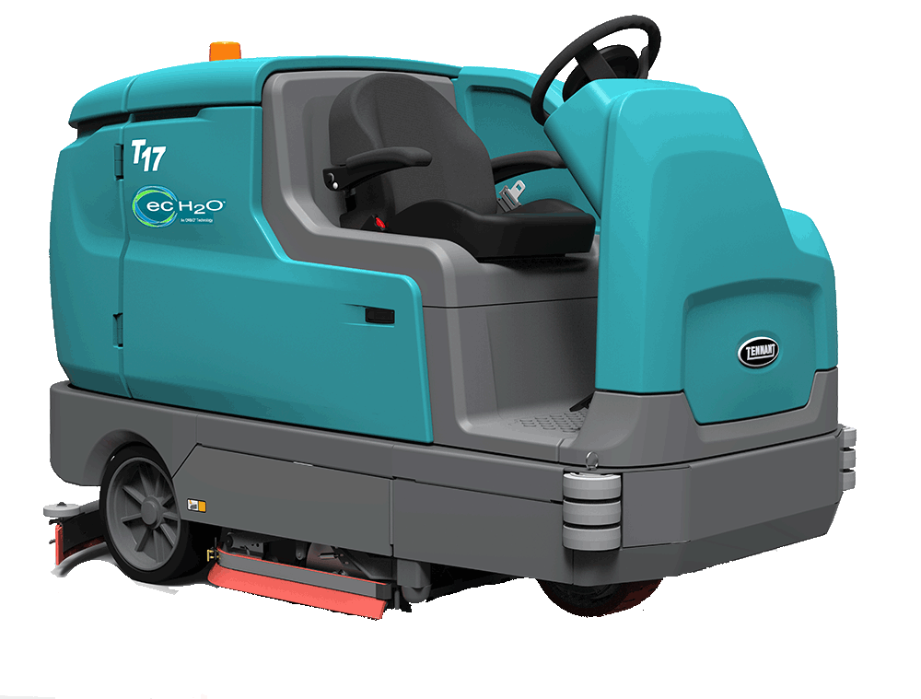
T17 PREVIEW
PRESENTER NAME MONTH.DATE.YEAR

Slide 2
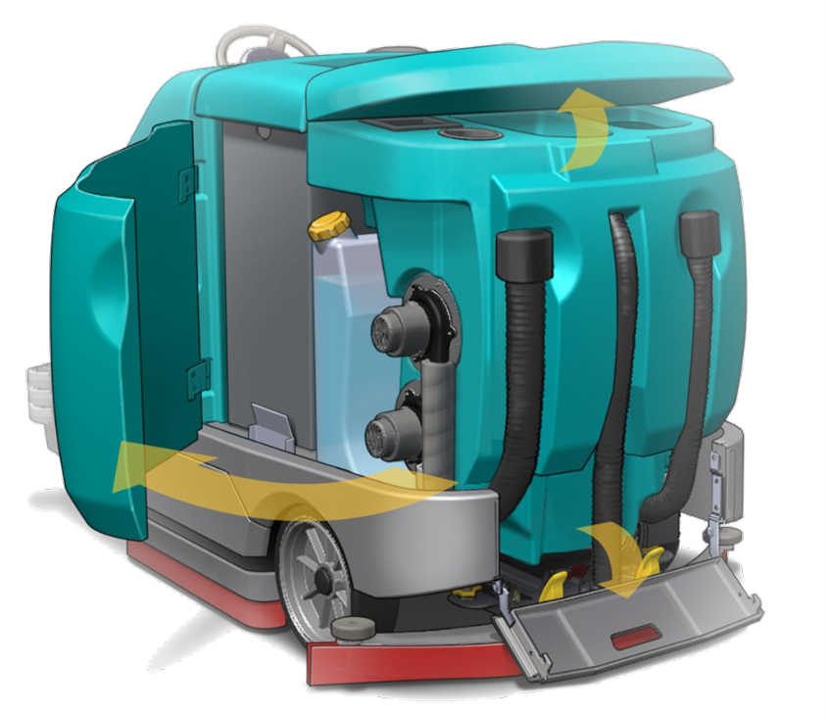
T17
ADVANTAGES
Reducing the Cost to Clean
  Clean More Productively
  Designed for Durability
Enhancing Health and Safety
Improving the Facility Image
Delivering Ease of Operation and Maintenance
Stands Apart from Other Offerings:
      Excellent Water Containment
      Largest Available Battery Capacity
      Substantial Water Capacity
      Scrubbing Side Brush
      ec-H2O
      Touch-n-Go™ Control Module with 1-Step™

Slide 3

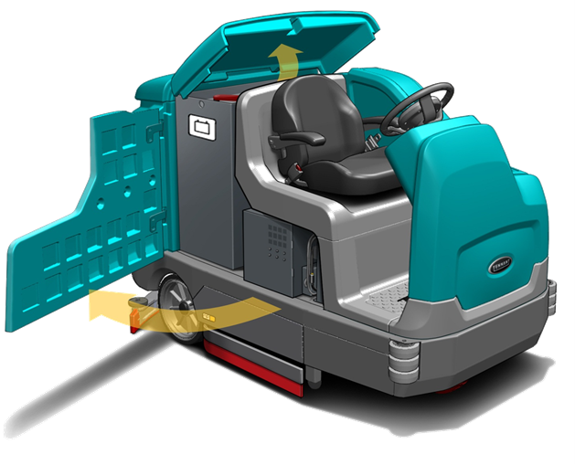
T17 RIDER SCRUBBER
BUILT-IN RESULTS
Maximizing Productivity
Clean effectively with a 40 in / 100 cm main scrub path
High performance cleaning delivered by two 1.5 hp / 1.125 kW
scrub brush motors
Capable of more cleaning with 75 gal / 285 L solution tank volume
Extraordinary water recovery with an articulating rear parabolic squeegee
Reduce dump and refill cycle time with the large drain hoses
for faster draining and cleanout for more productivity
Minimizing Cleaning Cost
Lower cost of ownership from maintenance free propel
& scrub brush motors
Operation is made easy with 1-Touch controls and a
control pod mounted in the steering wheel
Maintenance is simplified with yellow touch points
The investment is protected with a wrap around
steel bumper with stacked corner rollers
STANDARD FEATURES FOCUSED ON MAXIMIZING PRODUCTIVITY & MINIMIZING CLEANING COST

Slide 4

T17 RIDER SCRUBBER
BUILT TO YOUR NEEDS
SUBSTANTIALLY DIFFERENTIATED AND TAILORABLE TO VIRTUALLY ANY CUSTOMER NEED
Increase Productivity
  Increase productivity and reduce chemical use with ec-H20 chemical free cleaning technology
  Get more out of a tank of solution, up to 3 times more than conventional scrubbing with ES (solution recycling / detergent metering) system
  Clean longer with battery options: 625AH / 775AH AH (largest available capacity in its class)
  Run multiple shifts with a Battery rollout system
  Clean along edges and racking and move machine away from walls and obstructions for more operator peace of mind with a 52 in / 132 cm scrub path from the RH scrubbing side brush
  Handle light dry sweeping jobs to enable single pass sweeping and scrubbing with the Pre-sweep with a 50 in / 127 cm sweeping path
  Extend water recovery beyond the machine with the vacuum wand
  Simplify clean out with the on board spray hose providing water at the clean out site
Protect Your Investment
  Protects the operator by shielding them from falling objects with the FOPS certified overhead guard
  Protect the squeegee from damage when reversing with the squeegee protection kit

Slide 5

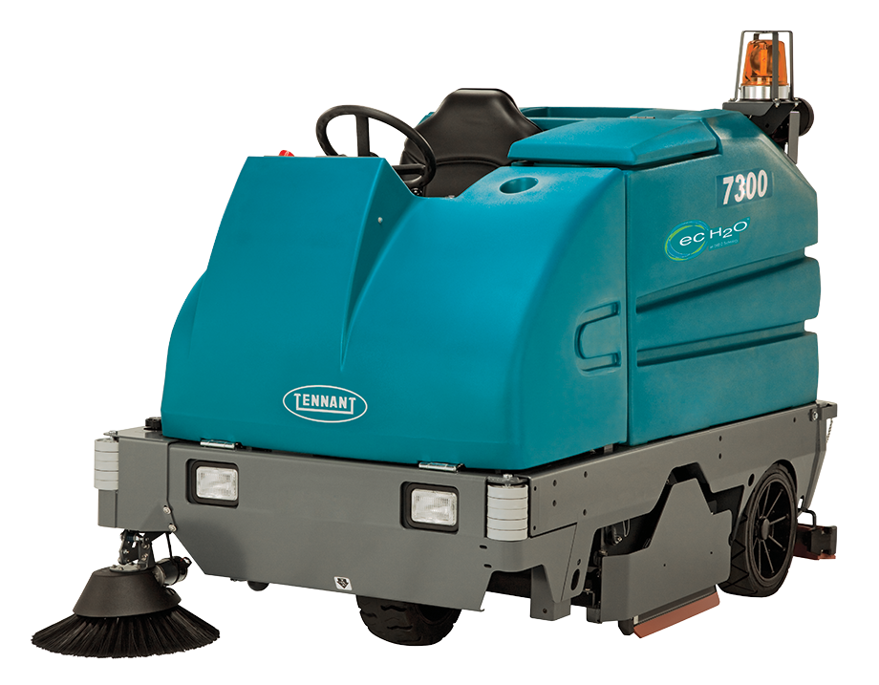
KEY
ENHANCEMENTS
T17
VS
7300
More productive
  Reduce dump/refill cycles for the operator from > 30% more solution capacity
  More effective and productive cleaning from 50% more powerful standard scrub motors
  Allows for up close edge cleaning without taking the machine next to the wall and provides up to 30% more cleaning capacity with an optional scrubbing side brush
  Clean up to an entire shift* with more available battery capacity
  Achieve excellent water control in turns with a articulating/swinging rear squeegee
  Spend less time cleaning out tanks large drain hoses with flow control cuffs
Easier to operate and maintain
  Operation made easy and comfortable with roomier operator compartment & Touch-n-Go control
  Routine maintenance is easy with yellow touch points
Lower Cost to Clean
  Lower operating cost with maintenance free propel and scrub brush motors
  Protect drain hoses and simplify tank clean out with a heavy duty tail gate
  More protection from available rear squeegee protection kit
  * Assumes 8 hour shift and the 930AH battery pack with the T17 working in economy mode)

