Slide 1

SERVICE
CAPABILITIES
PRESENTER NAME | MONTH.DATE.YEAR

Slide 2
MEETING
OBJECTIVES
Tennant Company Overview
  Equipment
  Quality Parts
  Unparalleled Service and Support
Next Steps
Q&A

Slide 3
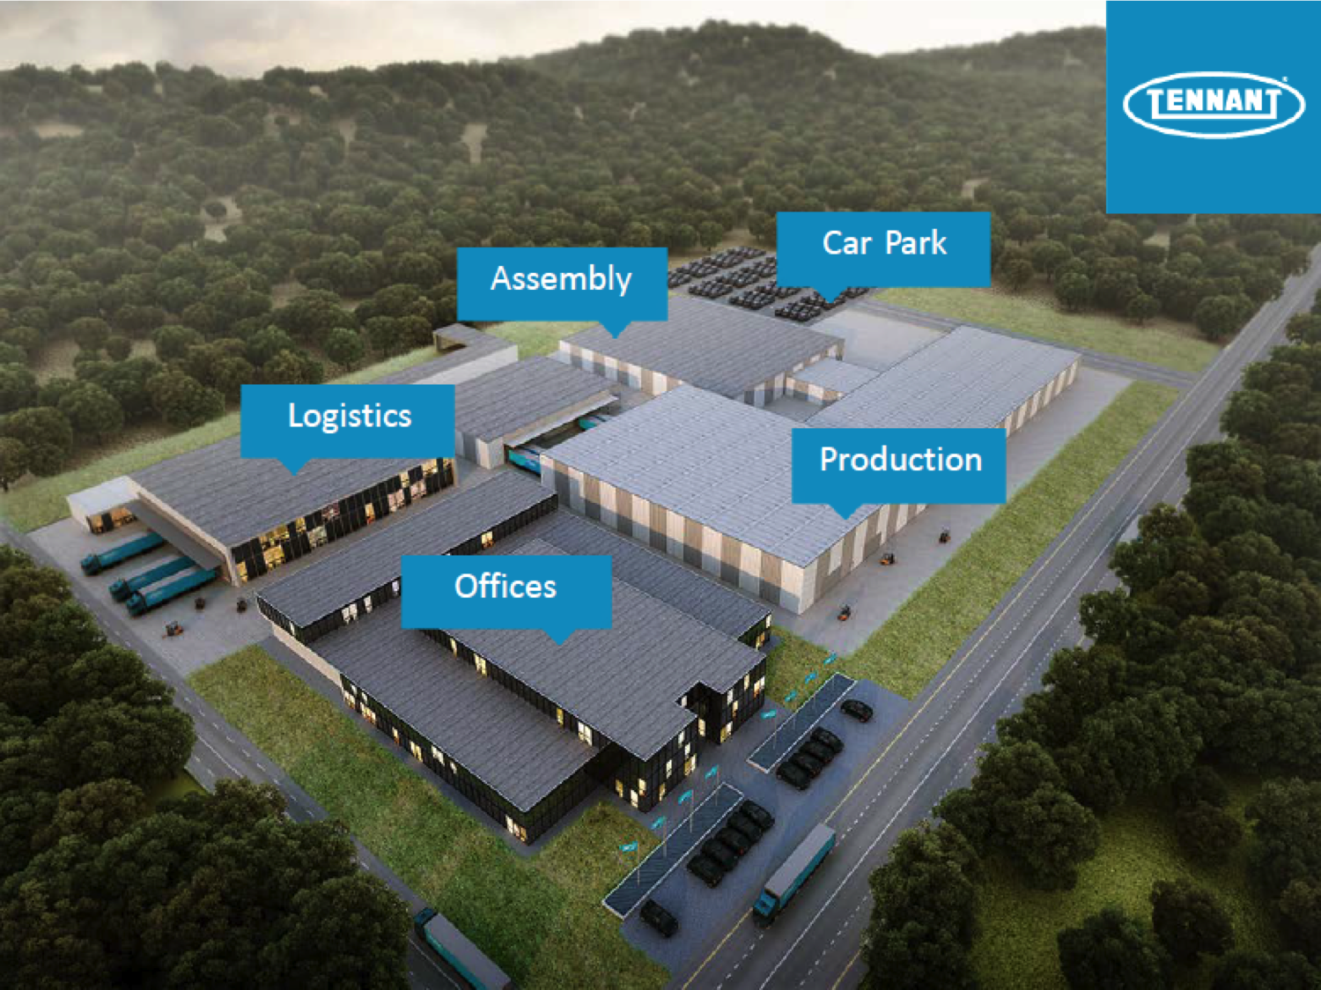
SOLUTIONS
FOR YOUR ENTIRE FACILITY

Slide 4
TENNANT
COMPANY
Performance – Innovative equipment and engineering deliver superior cleaning performance
Solutions – Environmentally sustainable solutions create a cleaner, safer world every day
Maintenance – Factory-trained, certified experts ready to deliver top-notch maintenance, parts and repair
Productivity – Customer service and support and customized training increase your productivity, uptime, and safety
Financing – Flexible programs offer financing solutions

Slide 5
for all your
cleaning challenges

Slide 6
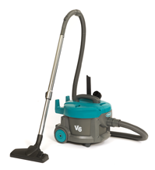
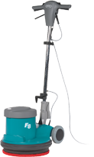
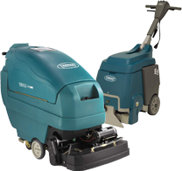
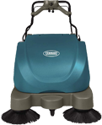
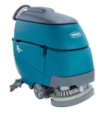
the machine you need
Vacuums
Single disc
& burnishers
Carpet
extractors
Walk-behind
sweepers
Walk-behind
scrubber-dryers

Slide 7
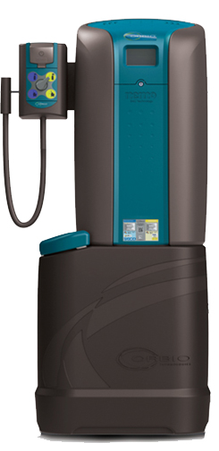
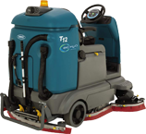
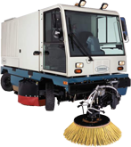
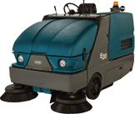
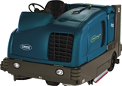
the machine you need
Sweeper-scrubbers
Ride-on
scrubber-dryers
Orbio® os3
Outdoor city
cleaning
Ride-on
sweepers

Slide 8

for a
cleaner world…
Products
Operations
Communities

Slide 9
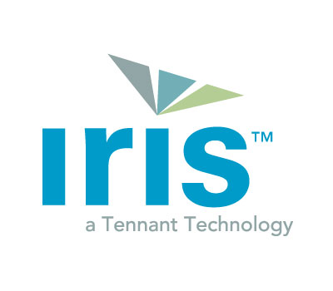





Industry leading technology

Slide 10
TENNANT SERVICE
DIFFERENCE
Unparalleled Service & Support
The most extensive factory-direct service network
Knowledgeable, one-stop service for Tennant and all other brands
of equipment
More than 400 factory-trained TennantTrue® Service professionals with an average of 10+ years on the job
Customizable service solutions to meet your unique needs
  Guaranteed service
  Prompt response and expert maintenance & repair
  Planned maintenance programs to maximize the uptime and life of your machines
Financing options to improve your bottom line

Slide 11


STILL SERVICING YOUR OWN
EQUIPMENT?
Is the work. . . .
Done right every time?
Completed on schedule?
Finished without sacrificing other responsibilities?

Slide 12
TEAM TENNANT
NETWORK
Trusted specialists since 1870 and largest manufacturer-trained service support network in the cleaning machine industry
400+
200+
100+
Service Professionals in North America
Service Professionals in Europe
Service Professionals in Asia

Slide 13
TEAM TENNANT
U.S. STRUCTURE
460
Tennant Factory-trained and Certified Service Professionals
Unmatched knowledge of Tennant equipment
Highly trained to quickly identify and fix problems
Services from repair to maintenance
12
Tennant Factory-based Experts
Technical service experts with deep understanding of every machine who work alongside Tennant engineers and designers
Phone consultations available at no cost with on-site experts at our U.S. manufacturing plants in Minnesota and Michigan

Slide 14
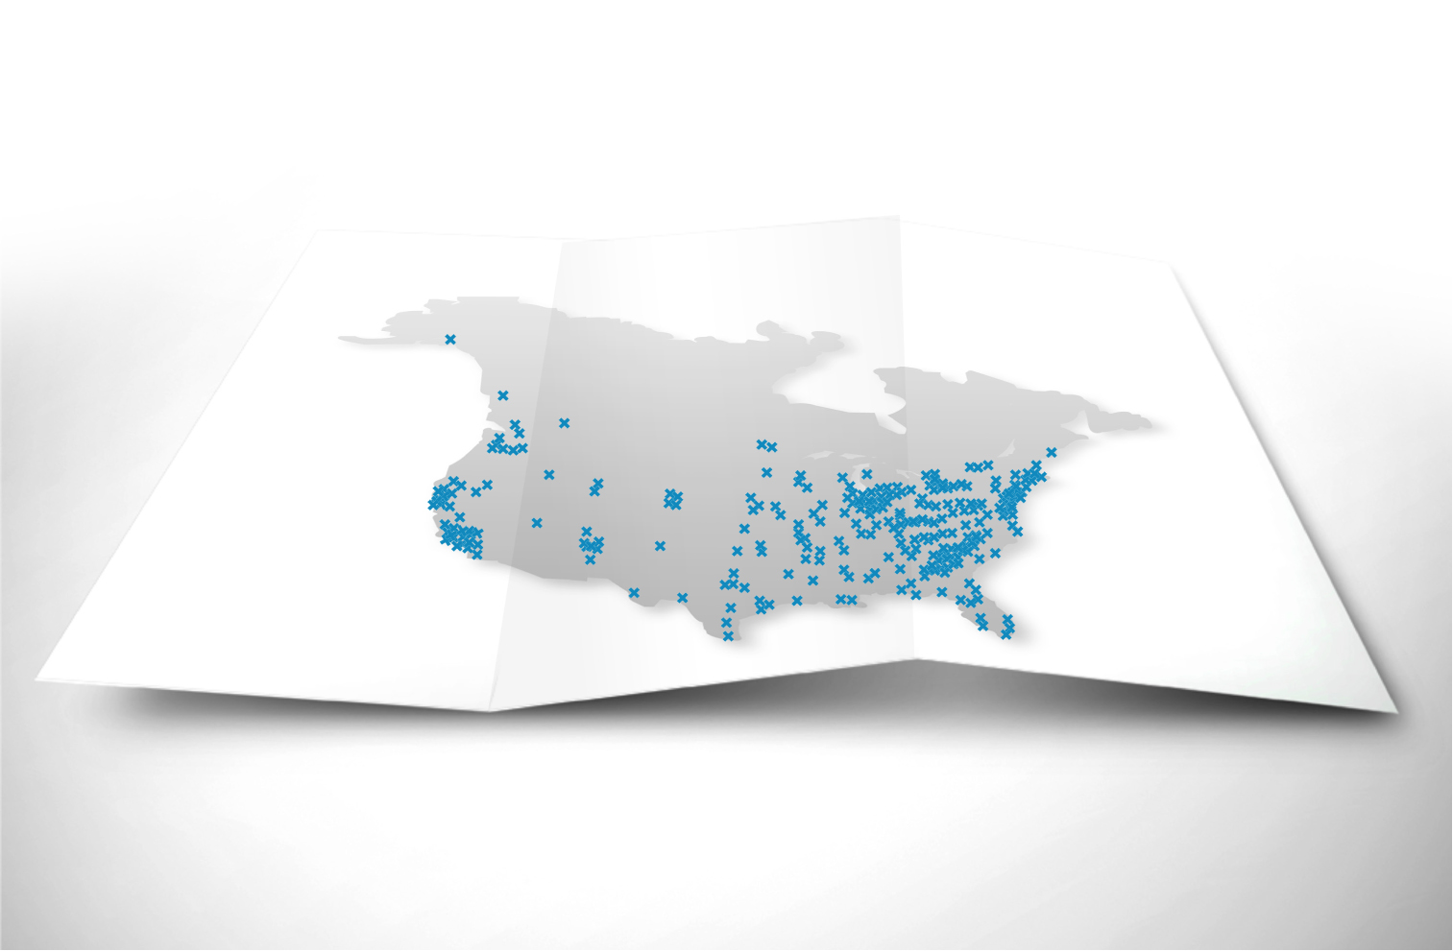
EXTENSIVE NORTH AMERICAN
SERVICE NETWORK
Reliable, on-time service to all locations
Extensive Tennant service network covers the U.S. and Canada
Extended network of 50 additional qualified distribution repair partners available to ensure we have you covered

Slide 15

HIGHLY
EQUIPPED
INVENTORY
Each service vehicle carries comprehensive service supplies to keep your machines operating at their maximum performance
More than $10,000 in critical equipment inventory and supplies on board, every day
Our proprietary inventory management ensures full parts supply – customized to your facility’s geography, season, and history – on board each vehicle at all times

Slide 16
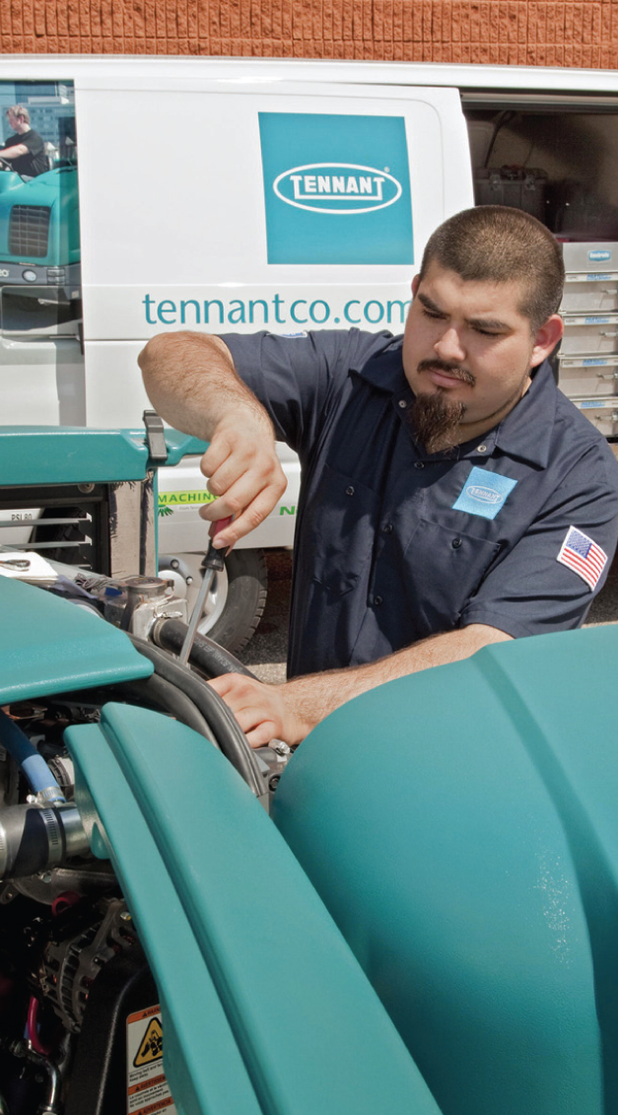
HIGHLY
EQUIPPED
EXPERTISE
Service LINK provides your service professional with immediate access to critical information:
Equipment service history
Technical support information
Warranty support information
Intensive training protocol
26%
MORE VALUE
ON WARRANTY WORK

Slide 17
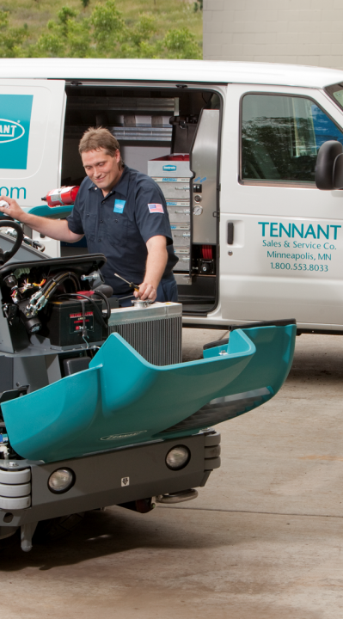
HIGHLY
EQUIPPED
TOOLS
Service vehicles are fully equipped with specialty tools for basic planned maintenance, immediate diagnosis, or complex repair
Onboard power tools with air compressor for increased efficiency
Bumper mounted crane expedites repairs that require lifting

Slide 18
EXPANDED SERVICE
CAPABILITIES
Tennant’s service networks, including over 50 authorized dealers and distributors, provide consistent service across the United States and Canada.
A single source provider means improved availability for fast and expert service on your entire equipment fleet

Slide 19
WHY TENNANT
PARTS
Performance & Value
Increased machine uptime and performance with genuine parts
Designed and tested by engineers to maximize the performance
Don’t risk inferior fit, form and function from non-OEM parts
Ensure your parts are TennantTrue® by ordering through your Tennant service professional

Slide 20
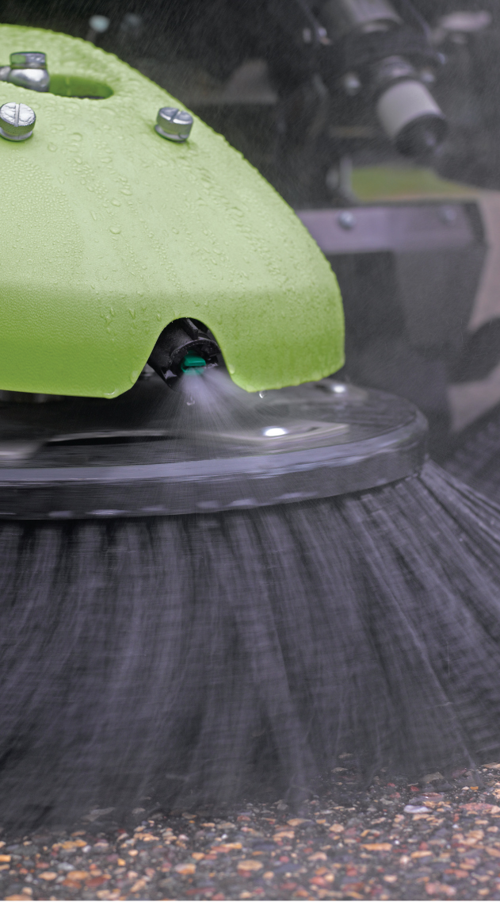
TENNANTTRUE®
BRUSHES
Reduce rework and extra labor costs; get superior performance the first time
Designed specifically for your Tennant machine
Achieve better cleaning performance and lower total cost
Brushes not designed for Tennant machines waste time, materials,
and money

Slide 21
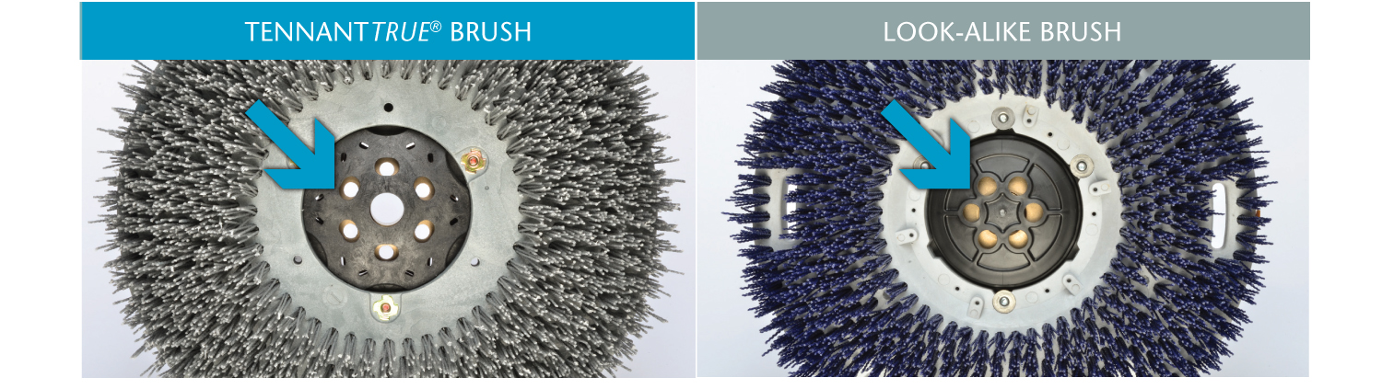
Disk Brush: Solution Holes
TennantTrue® disk brushes are specially designed for optimal and unobstructed flow of the cleaning solution to the working face of the brush.
Solution flows directly through to the floor
No wasted solution or related labor costs
Optimal cleaning performance
Obstructed holes block solution flow
Wasted cleaning solution and labor time costs
Reduced cleaning performance

Slide 22
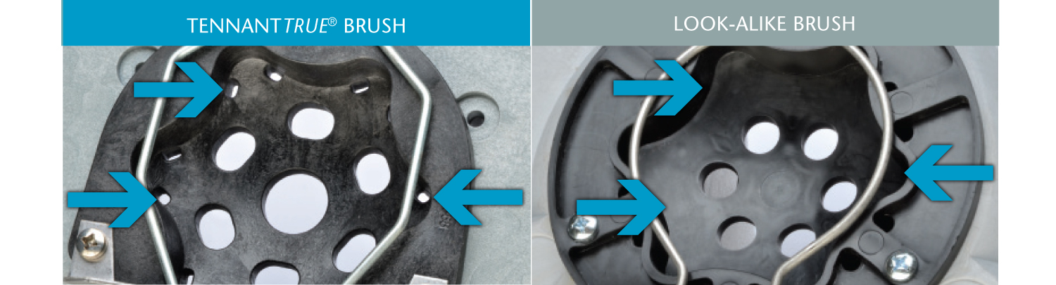
Disk Brush: Drain Holes
TennantTrue® scrubbing brushes include drain
holes to help clear the drive plug of debris.
Drain holes to flush debris and grit
Delays additional wear on machine’s drive plug
No drain holes to clear away debris
Grit and grim collect in the drive plug
Accelerated wear on the machine

Slide 23
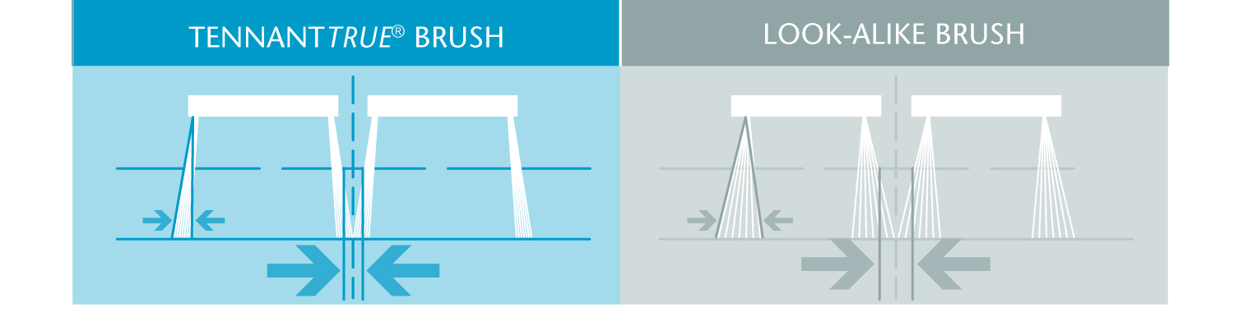
Disk Brush: Flair Diameter
Tennant designs and manufactures brushes for a precision fit to the machine to effectively clean. A wrong fit can result in inferior cleaning.
Precision fit to Tennant machine
Nearly perpendicular bristles produce better cleaning results
More effective cleaning in one pass
May be too big or too small for Tennant machines
As the brush wears, the gap between brushes increases, leaving an unscrubbed strip between the brushes
Extra costs for recleaning and parts

Slide 24
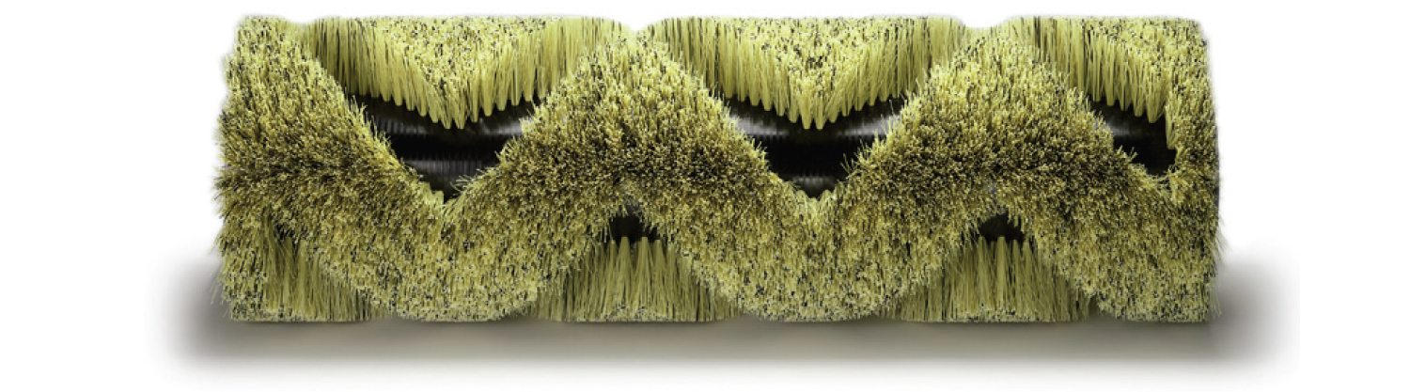
Cylindrical Brush: Manufacturing Standards
TennantTrue® brush tubes are manufactured to the industry’s tightest standard, ensuring smooth and balanced operation.
Precise extruding process creates
a straighter, rounder tube for
easier installation
Consistent cleaning performance
Minimize vibration and noise
Potential installation problems
Uneven cleaning performance
An unbalanced brush produces
chatter and noise

Slide 25
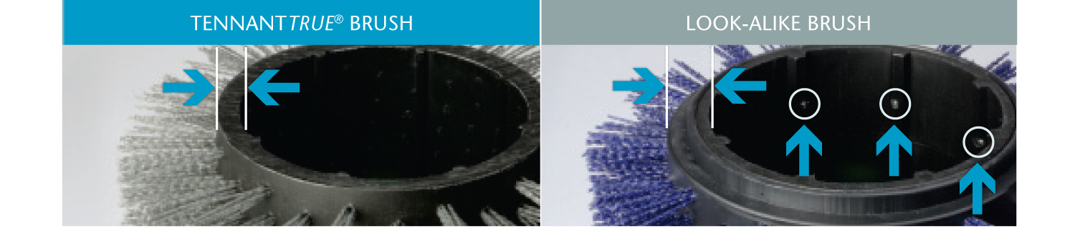
Cylindrical Brush: Spline Drive
The spline on each TennantTrue® brush tube is extruded as part of the brush manufacturing process to ensure the best fit on Tennant machines.
Spline extruded as part of the brush tube
Designed for Tennant machines; no adaptor required
Easy installation and high performance
Adaptor and screws needed to fit a Tennant machine can negatively impact installation and performance
Screws may interfere with the brush drive plug during installation
Difficult to install

Slide 26
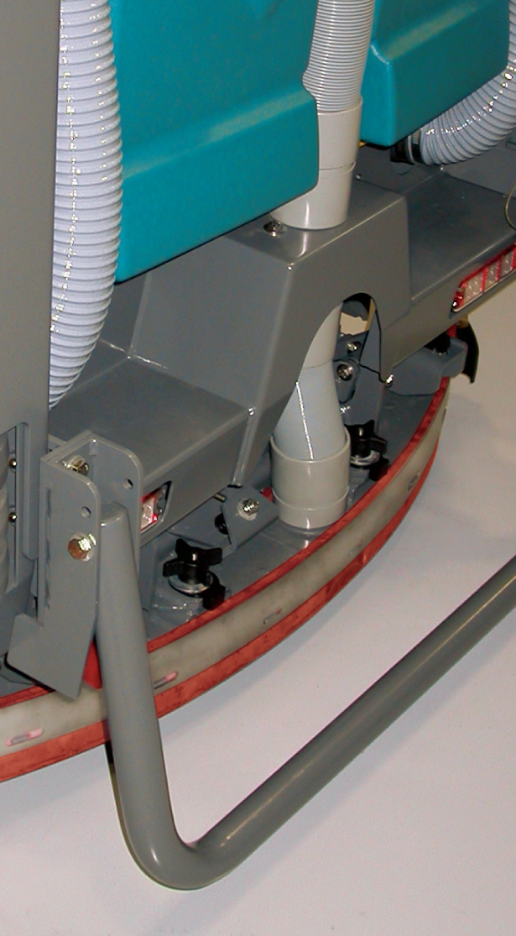
TENNANTTRUE®
SQUEEGEES
Every detail matters—TennantTrue® squeegees are precision engineered
for quality
Designed specifically for your Tennant machine
Maximize cleaning effectiveness in one pass
Only TennantTrue® squeegees are designed to fit perfectly in Tennant machines and maximize liquid collection and pickup

Slide 27
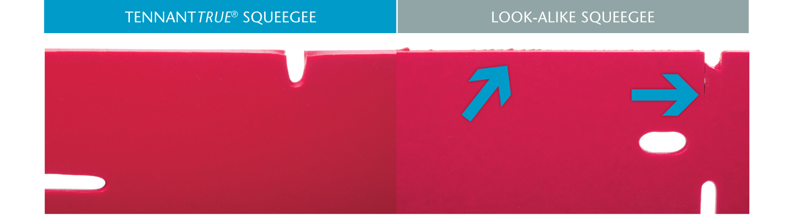
Precision Cut
TennantTrue® squeegees are consistently precision-cut using the highest quality cutting blades, ensuring optimal control of water and air.
Better seal with floor
Sharply cut edges
Specialized tooling
Poor seal with floor surface
Badly cut edges can allow water to escape

Slide 28
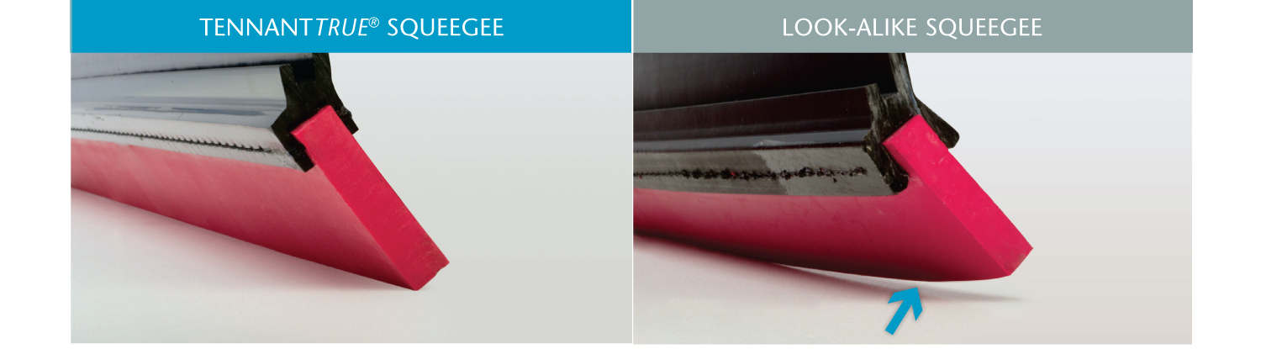
Precise Angle
TennantTrue® squeegees are precisely angled for optimal edge contact with the floor, resulting in maximum water pick-up.
Improved water pick-up
Precise angling
Reduced water pick-up
Exaggerated angle

Slide 29
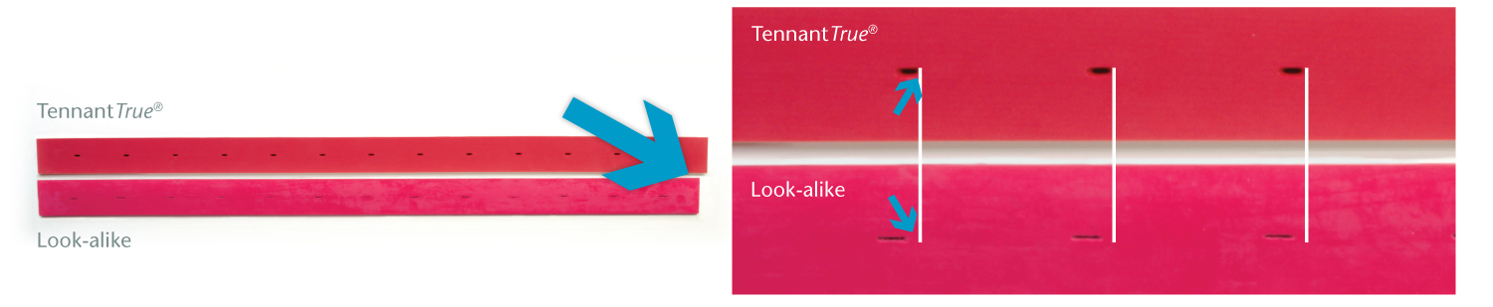
Aligned Mounting Holes
The mounting holes on TennantTrue® squeegees are specifically cut for Tennant equipment, ensuring maximum water pick-up and the strongest vacuum seal.
Better water pick-up
Optimal mounting hole design
Stronger vacuum seal
Potential rework and added labor costs
Sub-optimal fit
Poor water pick-up

Slide 30
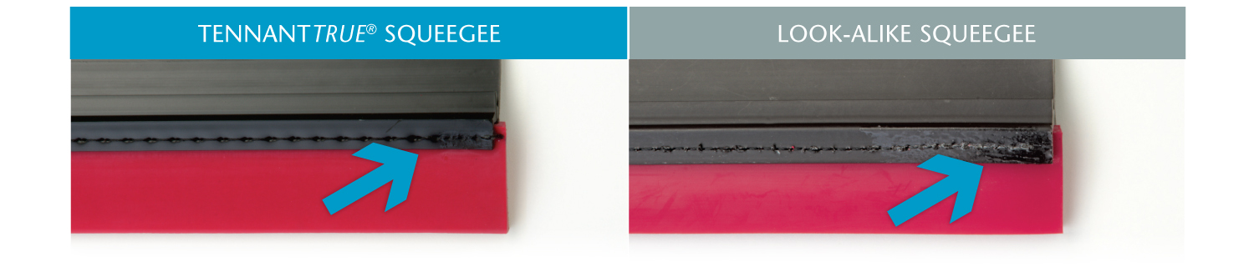
Secure Stitching
TennantTrue® squeegee blades are stitched securely to the mounting bar to eliminate gaps and movement and ensure the highest performance.
Consistent stitching
End-to-end stitching prevents movement and tears
Superior water pick-up
Sloppy stitching
Excessive blade movement and risk of tearing
Inferior water pick-up

Slide 31
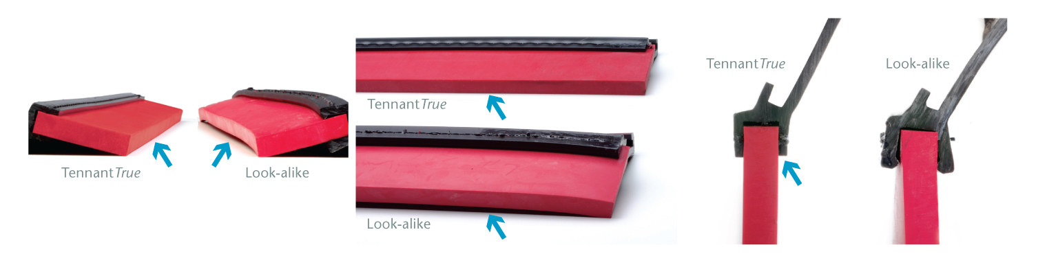
Blade Holder
Quality control requirements in TennantTrue® squeegees ensure a straight extrusion. Even the smallest curves or angles in look-alike squeegees can diminish performance.
Easy to install
Excellent water pick-up
Blade holder extruded straight
Difficult to install
Reduced water pick-up
May be curved, angled, or bent

Slide 32
SERVICE REQUESTS ARE
TOP PRIORITY
From the time you call for service, our target is to provide:
2
HOUR response time
24
HOUR visit
time
98%
Satisfaction RATING
Follow-up and a total satisfaction guarantee
On-the-spot answers via toll-free TechLine

Slide 33













SERVICE REQUEST Process
Service Request Received
Tracking Order Number Assigned
Request Sent
to Technician
Technician responds
with ETA
Service Complete and Review with Customer
Detailed Invoice
Sent to Customer

Slide 34
TENNANTTRUE®
GOLD SERVICE
Manage your budget and reduce unplanned costs with our all-inclusive maintenance program
Comprehensive coverage for planned maintenance, breakdowns, brushes, batteries etc.
Gold Service delivers peace of mind through optimized uptime and equipment life

Slide 35
TENNANTTRUE®
SILVER SERVICE
Gain predictability and control over your budget with our planned maintenance program
Peace of mind coverage for routine maintenance and comprehensive inspections
Silver Service keeps your machines running
at top performance with quality Tennant
OEM parts

Slide 36
TENNANTTRUE®
PAY AS YOU GO
Tennant’s world class service is always just a phone call away
Ensure your equipment is in top performance with regular service by a Tennant factory direct service pro
Pay for the service and parts you need when the work is performed

Slide 37
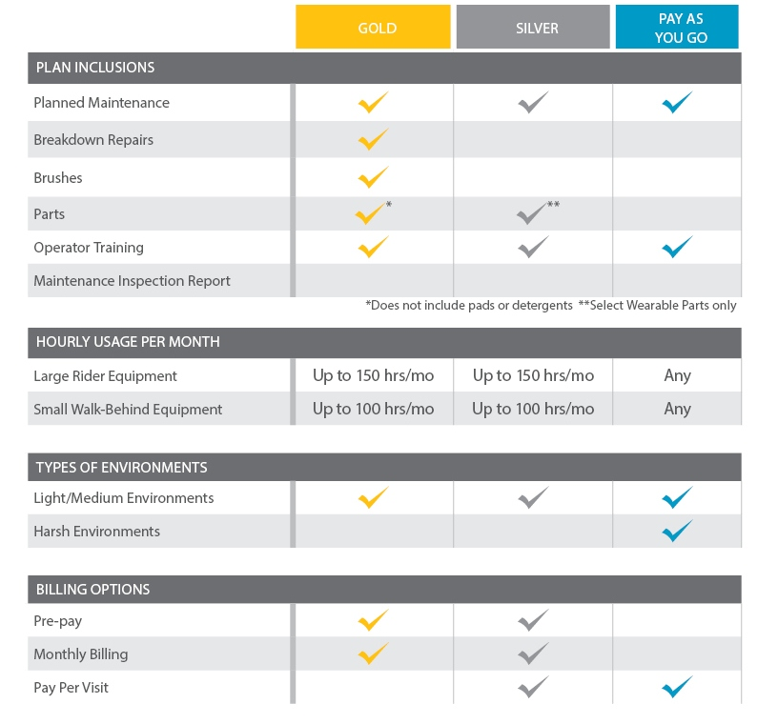
SERVICE OPTIONS that Fit Your Needs
*Gold and Silver contracts are available in 36, 48 and 60 month increments.

Slide 38
SERVICE & ASSET MANAGEMENT
REPORTING
Keep your equipment running at Peak Performance
Make decisions based on how the cleaning equipment is being used
Optimize performance and reduce your risk of breakdowns by servicing your machine and changing parts when needed
Flexible design enabling product enhancements and compatibility with Tennant’s future Asset Management solutions

Slide 39
DELIVERING
RESULTS
3.8
DAYS
Mean time between request and complete repair
86.5%
First time call to repair close (planned maintenance)

Slide 40
SERVICE SOLUTIONS
NEXT STEPS
Review the TennantTrue® Service materials
Request a detailed and customized quote for your facility
Become an official TennantTrue® Service client
Meet your TennantTrue® Service technician
Begin maximizing your uptime and protecting your budget
Contact me with any questions

Slide 41
THANK YOU

